Slide 1
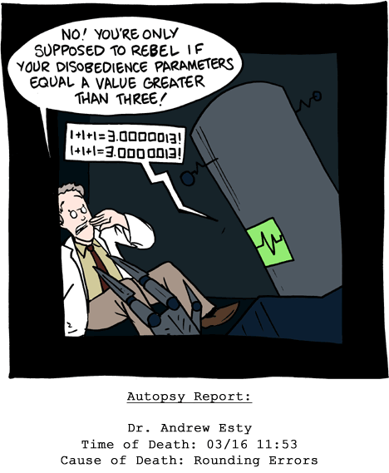
CSc 110, Autumn 2017
Lecture 25: File output
Adapted from slides by Marty Stepp and Stuart Reges
Notes:
1

Slide 2
Section attendance question
Read a file of section attendance (see next slide):
yynyyynayayynyyyayanyyyaynayyayyanayyyanyayna
ayyanyyyyayanaayyanayyyananayayaynyayayynynya
yyayaynyyayyanynnyyyayyanayaynannnyyayyayayny
And produce the following output:
Section 1
Student points: [20, 16, 17, 14, 11]
Student grades: [100.0, 80.0, 85.0, 70.0, 55.0]
Section 2
Student points: [16, 19, 14, 14, 8]
Student grades: [80.0, 95.0, 70.0, 70.0, 40.0]
Section 3
Student points: [16, 15, 16, 18, 14]
Student grades: [80.0, 75.0, 80.0, 90.0, 70.0]
Students earn 3 points for each section attended up to 20.

Slide 3
Section input file
student | 123451234512345123451234512345123451234512345
week | 1 2 3 4 5 6 7 8 9
 | yynyyynayayynyyyayanyyyaynayyayyanayyyanyayna ayyanyyyyayanaayyanayyyananayayaynyayayynynya yyayaynyyayyanynnyyyayyanayaynannnyyayyayayny
section 1 section 2 section 3
Each line represents a section.
A line consists of 9 weeks' worth of data.
Each week has 5 characters because there are 5 students.
Within each week, each character represents one student.
a means the student was absent (+0 points)
n means they attended but didn't do the problems (+1 points)
y means they attended and did the problems (+3 points)

Slide 4
Output to files
Open a file in write or append mode
'w' - write mode – replaces everything in the file
'a' – append mode – adds to the bottom of the file preserving what is already in it
name = open("filename", "w") # write
name = open("filename", "a") # append

Slide 5
Output to files
name.write(str) - writes the given string to the file
name.close() - closes file once writing is done
Example:
out = open("output.txt", "w")
out.write("Hello, world!\n")
out.write("How are you?")
out.close()
text = open("output.txt").read() # Hello, world!\nHow are you?
Notes:
common PrintStream bug:
- declaring it in a method that gets called many times. This causes the file to be re-opened and wipes the past contents. So only the last line shows up in the file.

