Slide 1
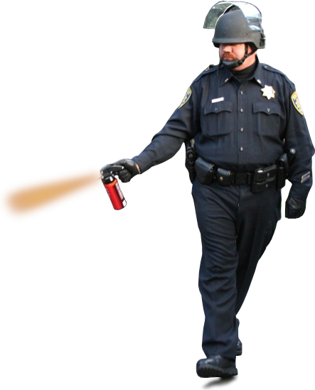
Social Interactive Networks where/how our society meets contents…
S. Felix Wu
University of California, Davis

Slide 2
contents

Slide 3
Contents + References

Slide 4
Users + Contents + References

Slide 5
Users + Contents + References

Slide 6
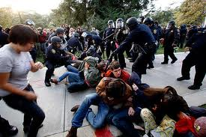
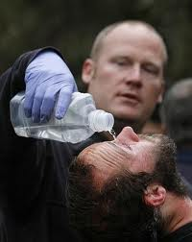
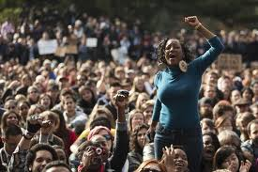
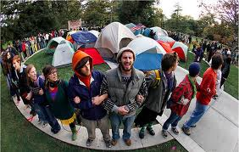
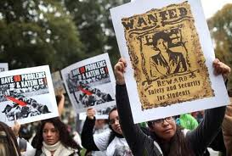
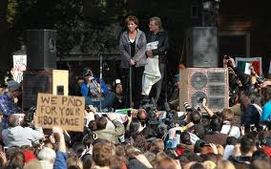
About UC Davis a lot of mixed emotions…

Slide 8
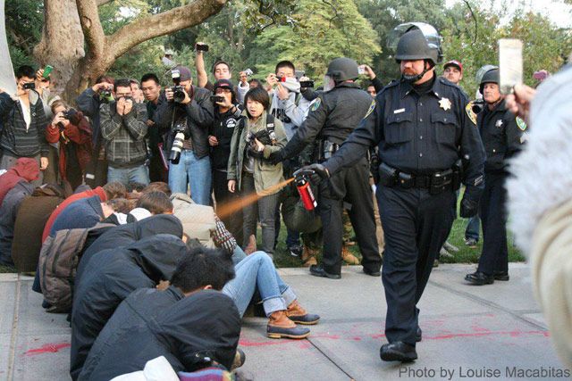
{"id" : "262907633759444_264463230270551",
"from" : {"name" : "Occupy UC Davis",
"category" : "Community",
"id" : "262907633759444"},
"message" : "Demand an internal investigation. To file an official complaint, you need to go to the police station in person. Sift through the videos. Write down all the badge numbers and names you can make out from the videos. The officers responsible will be held accountable.”, "type" : "status",
"created_time" : "2011-11-19T05:46:39+0000",
"updated_time" : "2011-11-19T14:07:11+0000",
"likes" : {"count":7},
"comments" :
{"data" : [
{"id" : "262907633759444_264463230270551_3351721",
"from" : {"name" : "**Name_0000000010790021**",
"id" : "**ID_0000000010792**" },
"message" : "The only thing there is to demand is the complete destruction of the UCP and the resignation of our Chancellor”,

Slide 9
ecs30 winter 2012, 240+ students (Intro. to programming in C)

Slide 10
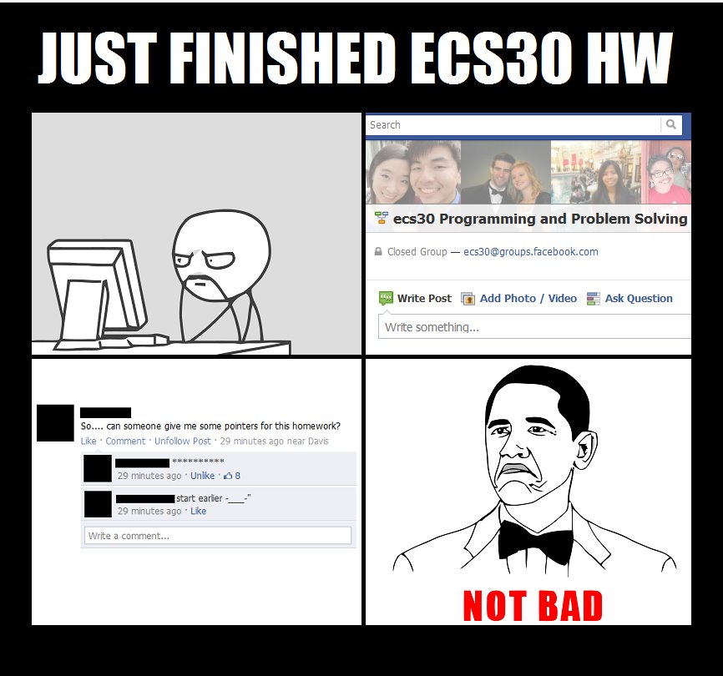
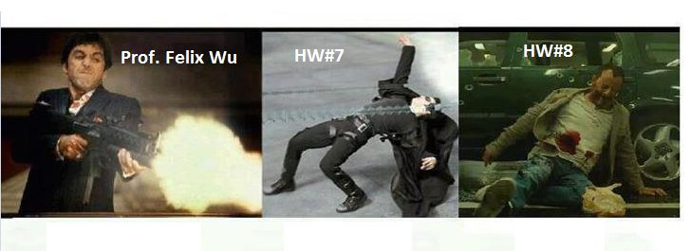

Slide 11
{"id” : "15704546335_10150171185276336",
"from” : {"name” : "Fox News",
"category” : "Media news publishing”,
"id” : "15704546335"},
"message” : "Breaking News: The White House releases President Obama's long-form birth certificate. Obama to comment at 9:45a ET -- Watch live on Fox News Channel.",
"actions” : [{"name” : "Comment",
"link” : "http:\/\/www.facebook.com\/15704546335\/posts\/10150171185276336"},…],
"created_time” : "2011-04-27T13:07:55+0000",
"updated_time” : "2011-11-19T01:34:55+0000",
"likes” : {"data":[…],"count":2052},
"comments”:
10772 comments, 16567 likes from 5604 individual users

Slide 12
Toward an online social-centric World
It’s not just about # of users or minutes spent
Interactions and Contents
E.g., many news media are now Facebook’ed and Tweet’ed!

Slide 15
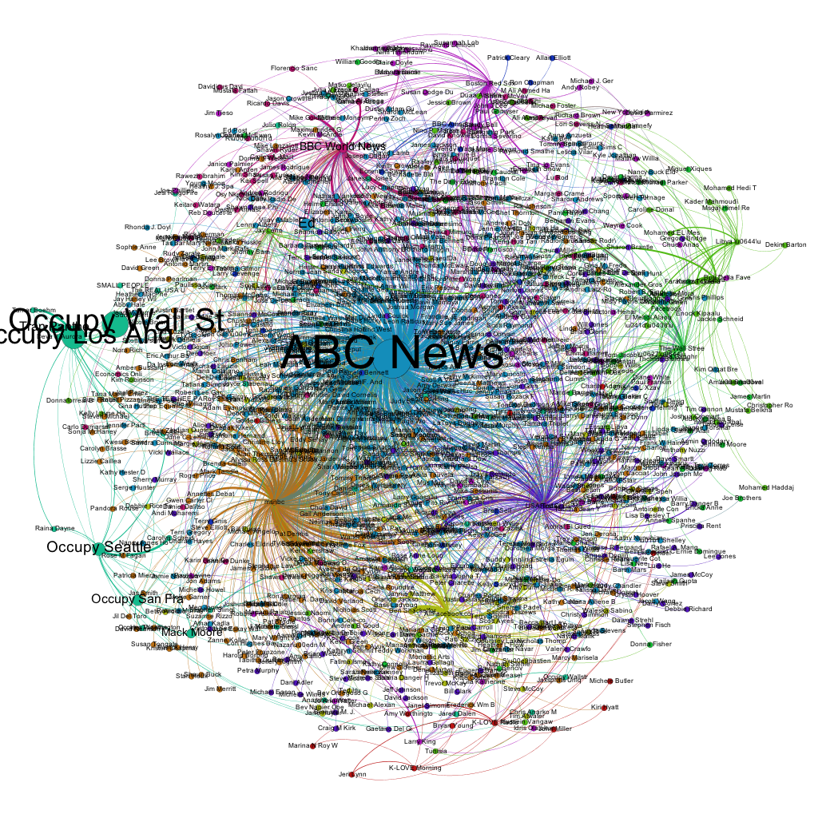
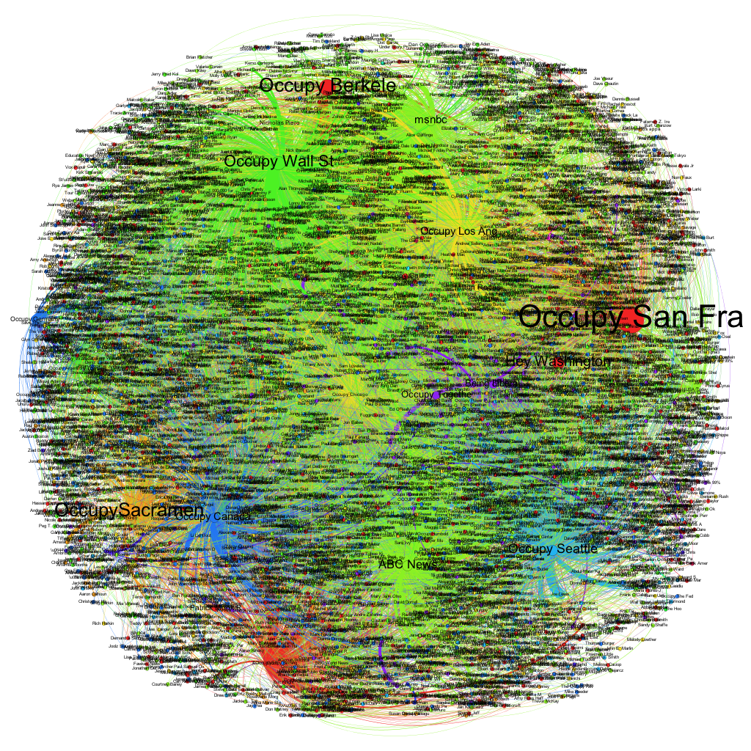

Slide 16
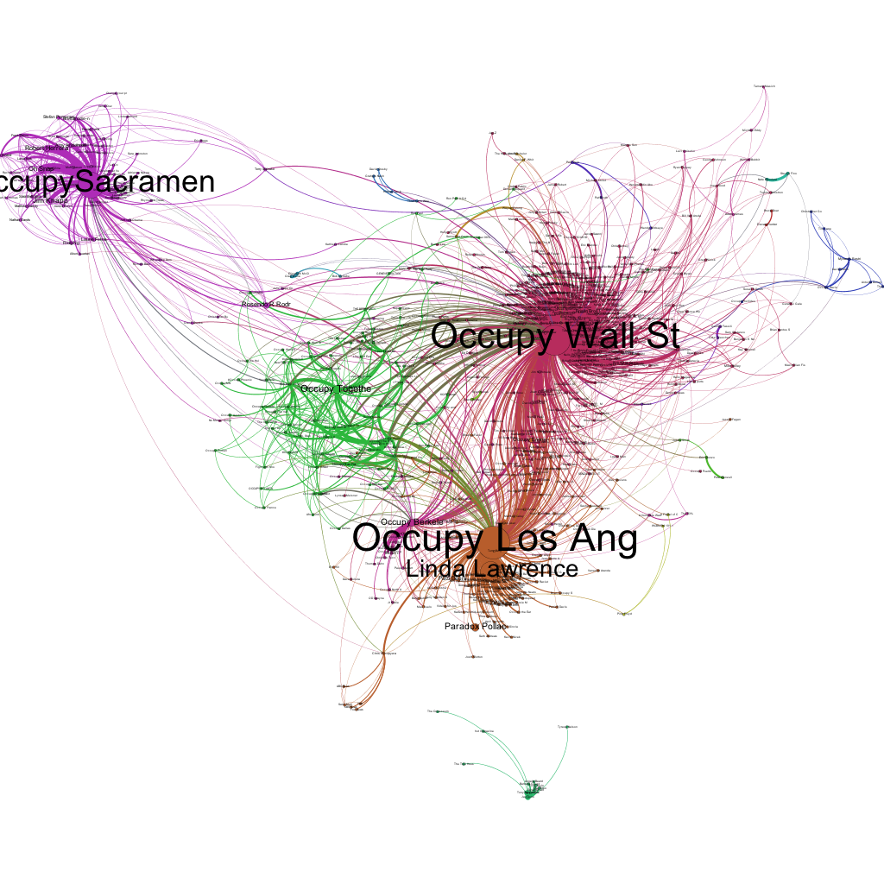
On November 18, 2011
November 6-12 of 2011

Slide 17
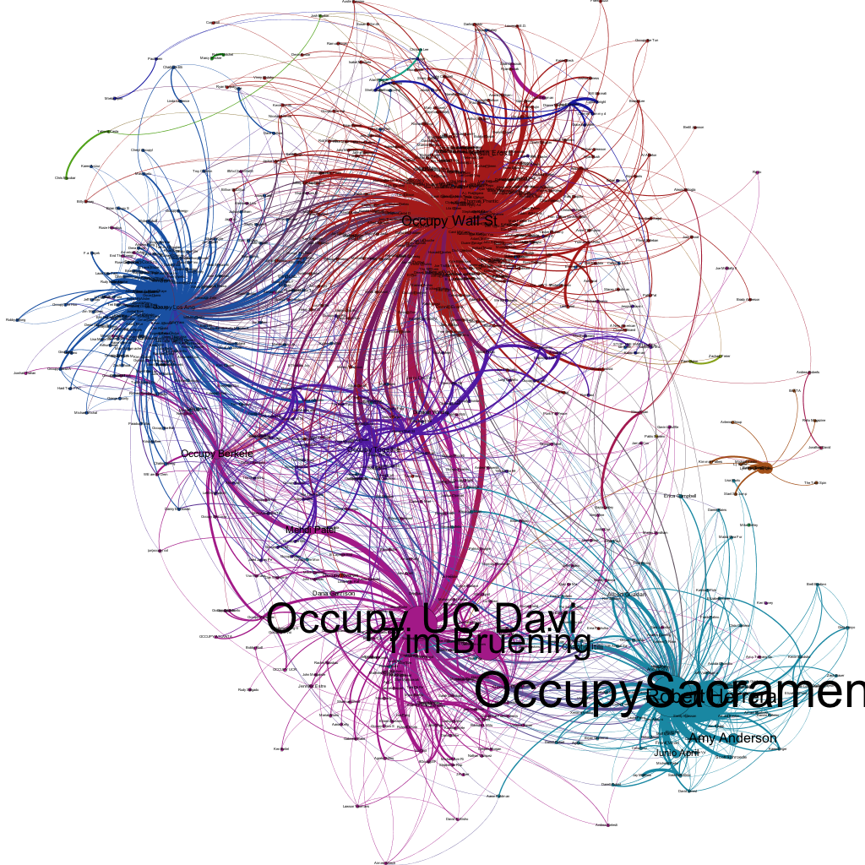
November 6-12 of 2011
November 20-26 of 2011

Slide 19
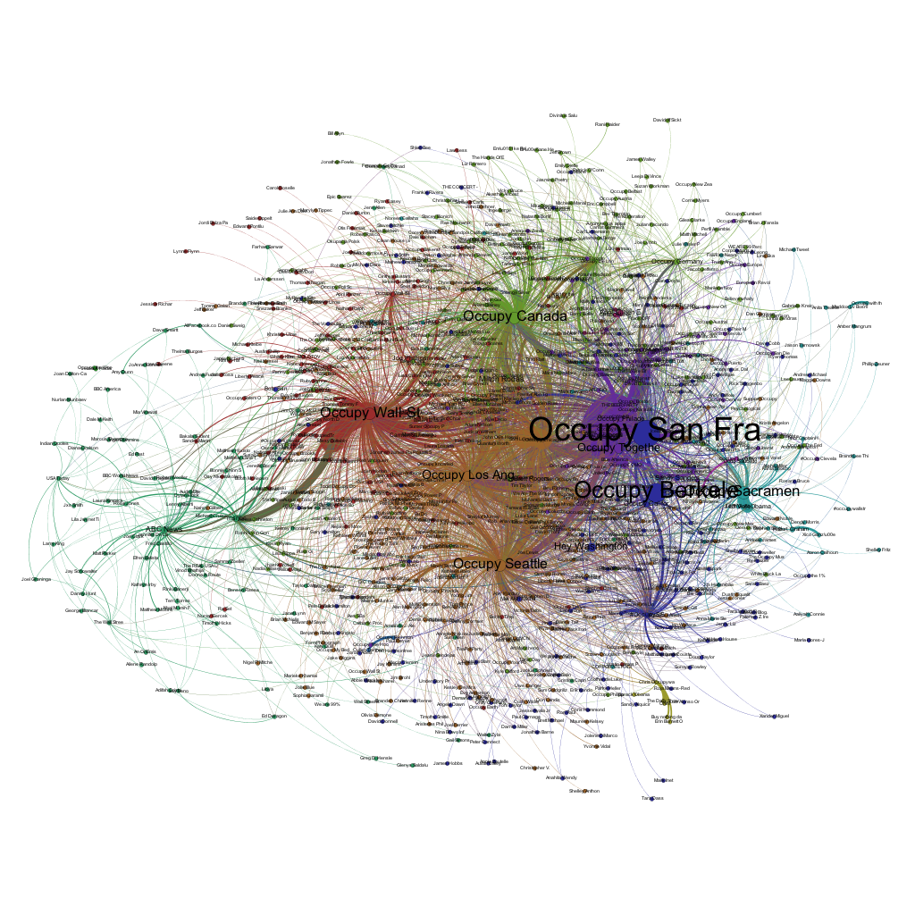

Slide 20
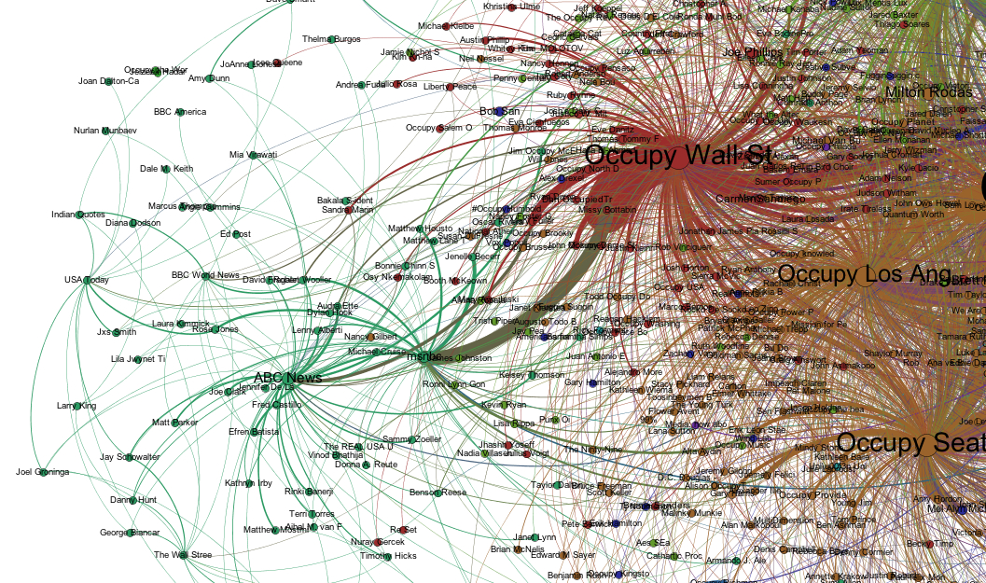

Slide 21
#Users
#Comments/Messages

Slide 22
#Users
#Comments/Messages

Slide 23
#Users
#Comments/Messages

Slide 24
#Users
#Comments/Messages

Slide 25
#Users
#Comments/Messages
Positive Emotion
Sad Anger
Negative Emotion

Slide 29
1. Social Intelligence
Social Structure/Community and Influence
Graph Analysis, Community detection, Diversity
Social Dynamics and Mobility
Micro-/Marco-structural SNA
Journalism/Communication Analysis
Information Cascade, Argumentation
Psychological/Sociological Linguistic Analysis
System Interference/artifact
Due Engineering/system design
Information accessibility/survivability

Slide 30
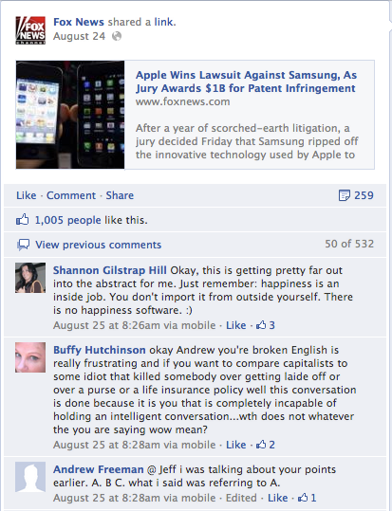
Social Structure based Information Ranking
Social Interactive Graph (SIG)
Likes on the post
Comments on the post
Likes on the comments
Tags among posts
It could be either directed or undirected.
Notes:
We first define two kinds of graphs on which we will apply our measurements. Social Interactive Graph is defined by considering all the interactions in a single post. There are four types of actions: XX, XX, XX, XX.

Slide 31
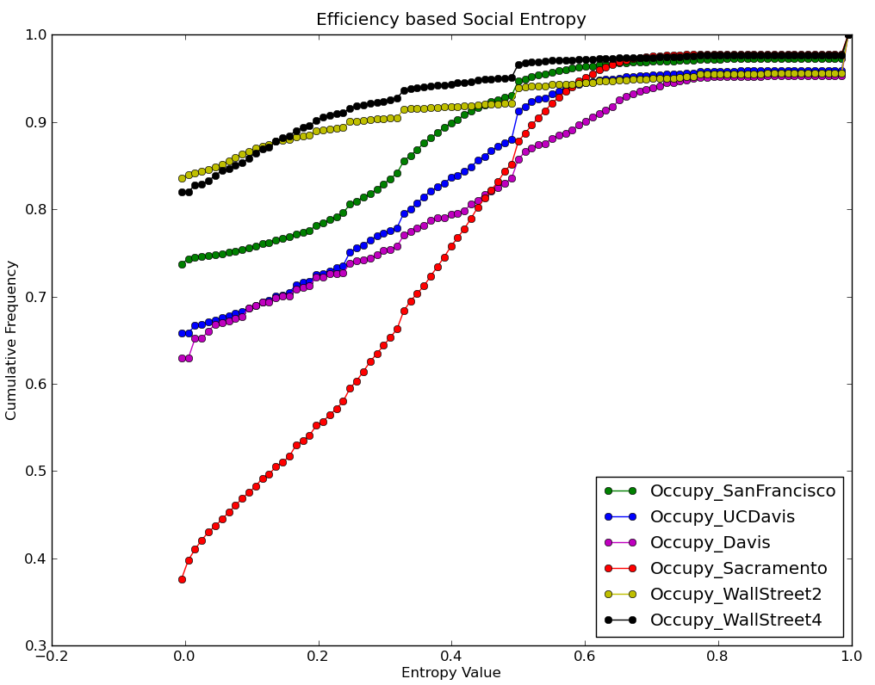
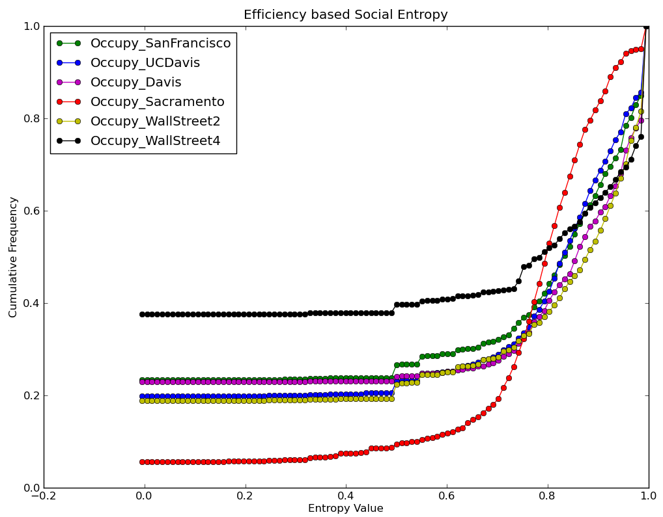
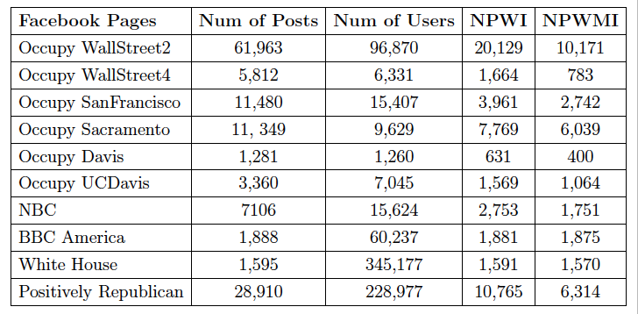
Social Structure based Information Ranking: Preliminary Results
Cumulative Frequency Distribution, Occupy Groups
Post Graph (PG)
Social Interactive Graph (SIG)
Notes:
A post does not attract any interactions, its entropy is zero. Sacramento, the average post a user participate is larger than one while others are all less than one. This means the interactions of users are more uniform distribution on the posts. So a lot of post has interactions on it and these interaction will provide more diverse

Slide 32
1. Social Intelligence
Social Structure/Community and Influence
Graph Analysis, Community detection, Diversity
Social Dynamics and Mobility
Micro-/Marco-structural SNA
Journalism/Communication Analysis
Information Cascade, Argumentation
Psychological/Sociological Linguistic Analysis
System Interference/artifact
Due Engineering/system design
Information accessibility/survivability

Slide 33
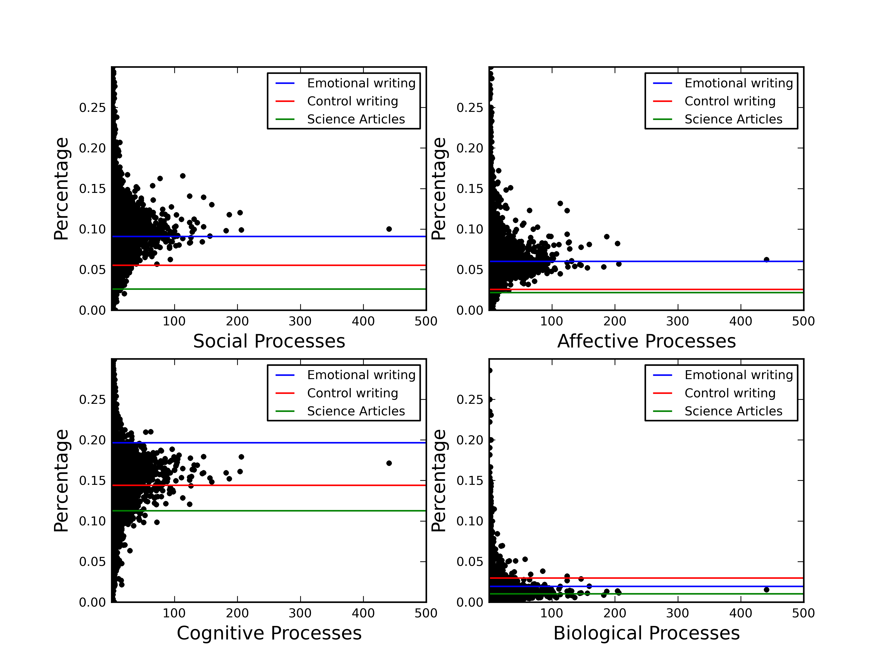

Slide 34
Timing of/Language used (in Comments)
 | 1-5 | 6-10 | 11-15 | 16-20 | 21-25 | 26-30 | 31-35 | 36-40 | 41-45 | 46-50 | Total
<30min | 2762 | 462 | 348 | 259 | 185 | 152 | 104 | 71 | 41 | 27 | 4411
>30min | 1599 | 74 | 20 | 12 | 1 | 0 | 2 | 2 | 5 | 3 | 1718
Total | 4361 | 536 | 368 | 271 | 186 | 152 | 106 | 73 | 46 | 30 | 6129
More than 70% first comment in the first 30 minutes.
If the post has more than 20 comments, only 2% of the posts has the first comment later than 30 minutes.
Only 5% posts got their first comment will have greater than 10 comments in total.

Slide 35
1. Social Intelligence
Social Structure/Community and Influence
Graph Analysis, Community detection, Diversity
Social Dynamics and Mobility
Micro-/Marco-structural SNA
Journalism/Communication Analysis
Information Cascade, Argumentation
Psychological/Sociological Linguistic Analysis
System Interference/artifact
Due policy/engineering/system design
Information accessibility/survivability

Slide 36
2. Network, System, Security/Privacy
Trying to capture how/where our society interacts:
Contents
Comments
Users
Likes
Engineering and Humanity/Society
Mutual Influence (and Resource Allocation?)
Decentralization, Ownership, SN “Neutrality” and Privacy
Social-aware X (e.g., X = Internet, Cloud/OS, Mobility, File storages…)

Slide 37
How to architect and build an Internet prototype to evaluate or possibly realize such an idea?
Application Entity
Application Entity
RelationshipPath Selection
Social
Entity
Social
Entity
Control interface
Network Entity
Network Route Binding
Network Entity

Slide 38
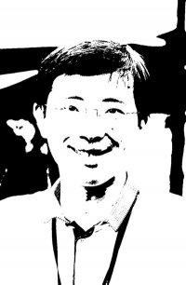
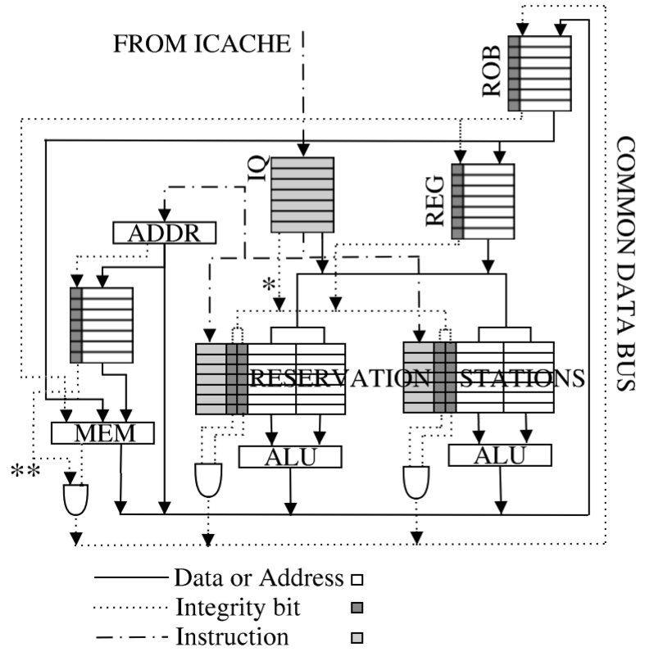
Application
Existing
Applications
Social-Enabled
Applications
and Games
Wrapper
Eric
Felix
Social Context
tagging
DSL/FAITH
Name-ID
resolution
Community
Oriented
Keywords
Social network
transformation
Policy/Reputation-based
Route discovery
OSN
FAITH over OSN
DSL ➔ FAITH
Emphasizing Trustworthiness in Social Informatics

Slide 41
This is very VERY preliminary!
Collaborators/advices/criticisms much needed!

Slide 42
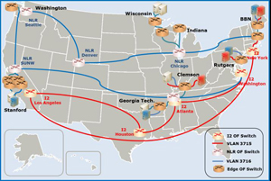
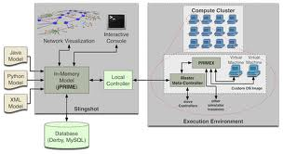
Acknowledgement
Time | Function | From | To | Pkt. Receivers | Rec. for next time
T_{i} | L(M) | U₅ | U₁ | U₁ | -
T_{i+1} | L(M) | U₆ | U₁ | U₁ | -
T_{i+2} | L(C₃) | U₈ | U₄ | U₄ | -
T_{j} | C₁(M) | U₂ | U₁ | U₁ | U₂
T_{j+1} | C₂(M,tag) | U₃ | U₁, U₇ | U₁, U₇, U₂ | U₂, U₇, U₃
T_{j+2} | C₃(M) | U₄ | U₁ | U₁, U₂, U₇, U₃ | U₂, U₇, U₃, U₄
T_{j+3} | C₄(M) | U₉ | U₁ | U₁ ,U₂, U₇, U₃, U₄ | U₂, U₇, U₃, U₄, U₉

Slide 43
Social Telemedia Environment for Experimental Research

Slide 44
And, of course, inspired by…

Slide 45
http://scholar.google.com/citations?hl=en&user=vth4SIcAAAAJ

Slide 46
“Truth hurts”

Slide 50
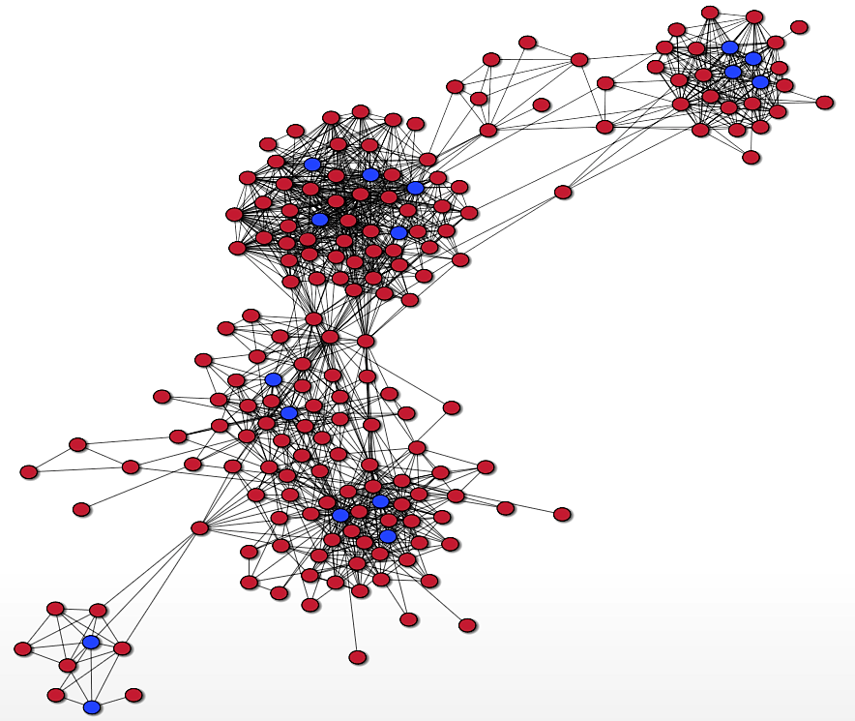
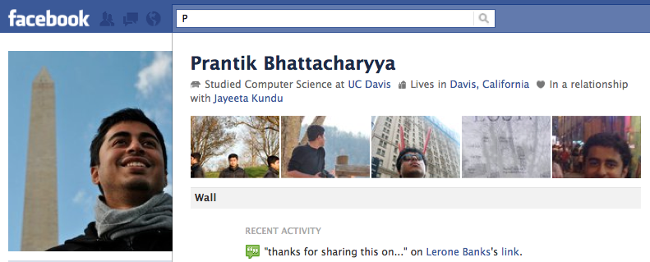
Ego-centric Social Network

