Slide 1
Parameterized Diamond Tiling for Stencil Computations with Chapel Parallel Iterators
Ian Bertolacci – Colorado State University
Catherine Olschanowsky – Colorado State University
Ben Harshbarger – Cray Inc.
Bradford L. Chamerlain – Cray Inc.
David G. Wonnacott – Haverford College
Michelle Mills Strout – Colorado State University
This project is supported by Department of Energy Early Career Grant DE-SC0003956 and National Science Foundation Grant CCF-1422725

Slide 2
HPC is a Software Engineering Nightmare
Performance code is a nightmare to develop.
Hardware is evolving rapidly.
Can your software be easily adapted to perform on the next big system?
Our work demonstrates that it is possible to develop code that is performant and adaptable.
Parameterized Diamond Tiling
Chapel iterators as tiling schedule abstraction
Notes:
Sentence indicating key contributions
Abstraction of advanced tiling code through chapel iterators

Slide 3
Chapel Programming Language
A new parallel programming language
Design and development led by Cray Inc.
Initiated under the DARPA HPCS program
Overall goal: Improve programmer productivity
Improve the programmability of parallel computers
Match or beat the performance of current programming models
Support better portability than current programming models
Improve the robustness of parallel codes

Slide 4
Target: Stencil Computations
Partial Differential Equation solvers
Air and fluid flow simulation
Seismic wave models and damage simulation
Blast-wave equations
Heat equations
Atmospheric modeling
Magnetic field simulations

Slide 5
Stencil Computations
t
[x,y]
t-1
[x,y-1]
[x-1,y]
[x,y]
[x+1,y]
[x,y+1]

Slide 6
Stencil Computations
t
[x+1,y]
t-1

Slide 7
Stencil Computations
C + OpenMP:
Chapel:

Slide 8
Stencil Computations
C + OpenMP:
A[t][x][y]=( A[t-1][x-1][y] + A[t-1][x][y-1]
+ A[t-1][x+1][y] + A[t-1][x][y+1]
+ A[t-1][x ][y] )/5;
Chapel:
A[t,x,y]=( A[t-1, x-1, y] + A[t-1, x, y-1]
+ A[t-1, x+1, y] + A[t-1, x, y+1]
+ A[t-1, x , y] )/5;

Slide 9
Stencil Computations
C + OpenMP:
for( int x = 1; x <= N; x += 1 )
for( int y = 1; y <= M; y += 1 )
A[t][x][y]=( A[t-1][x-1][y] + A[t-1][x][y-1]
+ A[t-1][x+1][y] + A[t-1][x][y+1]
+ A[t-1][x ][y] )/5;
Chapel:
for (x,y) in {1..N, 1..M} do
A[t,x,y]=( A[t-1, x-1, y] + A[t-1, x, y-1]
+ A[t-1, x+1, y] + A[t-1, x, y+1]
+ A[t-1, x , y] )/5;

Slide 10
Stencil Computations
C + OpenMP:
for( int t = 1; t <= T; t += 1 )
for( int x = 1; x <= N; x += 1 )
for( int y = 1; y <= M; y += 1 )
A[t][x][y]=( A[t-1][x-1][y] + A[t-1][x][y-1]
+ A[t-1][x+1][y] + A[t-1][x][y+1]
+ A[t-1][x ][y] )/5;
Chapel:
for t in 1..T do
for (x,y) in {1..N, 1..M} do
A[t,x,y]=( A[t-1, x-1, y] + A[t-1, x, y-1]
+ A[t-1, x+1, y] + A[t-1, x, y+1]
+ A[t-1, x , y] )/5;

Slide 11
Stencil Computations
C + OpenMP:
for( int t = 1; t <= T; t += 1 )
#pragma omp parallel for
for( int x = 1; x <= N; x += 1 )
for( int y = 1; y <= M; y += 1 )
A[t][x][y]=( A[t-1][x-1][y] + A[t-1][x][y-1]
+ A[t-1][x+1][y] + A[t-1][x][y+1]
+ A[t-1][x][y] )/5;
Chapel:
for t in 1..T do
forall (x,y) in {1..N, 1..M} do
A[t,x,y]=( A[t-1, x-1, y] + A[t-1, x, y-1]
+ A[t-1, x+1, y] + A[t-1, x, y+1]
+ A[t-1, x , y] )/5;

Slide 12
Stencil Computations
Naïve parallelization performance does not scale with additional cores!
Bandwidth-bound computation.
Naïve parallelism under utilizes the memory-hierarchy.

Slide 13
Traditional Solution: Space Tiling
Group spatial iterations together to reuse shared input data
No reuse of just-computed values.
8
3
6
1
5
7
2
4
2
1
4
7
5
8
3
6

Slide 14
Modern Solution: Diamond Tiling [Bandishi et al. SC12]
Mixes space and time tiling
A single tile will perform multiple time steps
Reuse just-computed values
t+3
t+2
t
t+1

Slide 15
Modern Solution: Diamond Tiling [Bandishi et al. SC12]
Mixes space and time tiling
A single tile will perform multiple time steps
Reuse just-computed values
t+3
t+2
t+1
t

Slide 16
Modern Solution: Diamond Tiling [Bandishi et al. SC12]
Mixes space and time tiling
A single tile will perform multiple time steps
Reuse just-computed values
Concurrent Startup
Many tiles can start in parallel

Slide 17
Modern Solution: Diamond Tiling [Bandishi et al. SC12]
t
x

Slide 18
Modern Solution: Diamond Tiling [Bandishi et al. SC12]
t
x

Slide 19
Software Engineering Limitations
Code generation requires a constant tile size.
Severely complicates application portability.
Must generate different code for each tile size that’s optimal for different stencils within application.
Lengthens performance profiling process.
Generated code is not human friendly
Multiple stencil-computations results in chains of convoluted loop nests.
Difficult to modify, debug, and improve.

Slide 20
Technical Contributions
Parameterized Diamond Tiling
Demonstration of Chapel iterators as effective tiling schedule deployment mechanism

Slide 21
Parameterized Diamond Tiling
Upper_{t}
Lower_{t}
Lower_{x}
Upper_{x}
Tile Size (Tau)

Slide 22
Parameterized Diamond Tiling
Upper_{t}
(2*tau+k0*tau+k1*tau-1)/2
(k0+tau+k1*tau)/2
Lower_{t}
Lower_{x}
Upper_{x}
(tau*k0–tau-tau*k1)/2
(tau+tau*k0–tau*k1)/2

Slide 23
Parameterized Diamond Tiling
Lower_{x}
Upper_{x}
Lx ≤ (tau*k0–tau-tau*k1)/2
(tau+tau*k0–tau*k1)/2 ≤ Ux

Slide 24
Parameterized Diamond Tiling
Upper_{t}
(k0+tau+k1*tau)/2 ≤ Ut
Lt ≤(2*tau+k0*tau+k1*tau-1)/2
Lower_{t}

Slide 25
Parameterized Diamond Tiling
Generalizable to higher dimensionality, different tiling hyperplanes.
Paper presents methodology to do this by hand.

Slide 26
Generated Code
C + OpenMP:
Tile Wave-fronts
for (kt=ceild(3,tau)-3; kt<=floord(3*T,tau); kt++) {
int k1_lb = ceild(3*Lj+2+(kt-2)*tau,tau*3);
int k1_ub = floord(3*Uj+(kt+2)*tau,tau*3);
int k2_lb = floord((2*kt-2)*tau-3*Ui+2,tau*3);
int k2_ub = floord((2+2*kt)*tau-3*Li-2,tau*3);
#pragma omp parallel for
for (k1 = k1_lb; k1 <= k1_ub; k1++) {
for (x = k2_lb; x <= k2_ub; x++) {
k2 = x - k1;
for (t = max(1, floord(kt*tau-1, 3));
t < min(T+1, tau + floord(kt*tau, 3));
t++) {
write = t & 1;
read = 1 - write;
for (x = max(Li,max((kt-k1-k2)*tau-t, 2*t-(2+k1+k2)*tau+2));
x <= min(Ui,min((1+kt-k1-k2)*tau-t-1, 2*t-(k1+k2)*tau));
x++) {
for (y = max(Lj,max(tau*k1-t, t-i-(1+k2)*tau+1));
y <= min(Uj,min((1+k1)*tau-t-1, t-i-k2*tau));
y++) {
A[write][x][y] = ( A[read][x-1][y] + A[read][x][y-1]+
A[read][x+1][y] + A[read][x][y+1]+
A[read][x ][y] )/5;
} } } } } }
Tile Coordinates
Time-Steps in Tile
Read/Write buffer
X,Y Coordinates
Stencil Operation
Notes:
NOTE:
Back in Jacobi 2D land

Slide 27
Generated Code
Chapel:
for kt in -2 .. floord(3*T,tau) {
var k1_lb: int = floord(3*Lj+2+(kt-2)*tau,tau_times_3);
var k1_ub: int = floord(3*Uj+(kt+2)*tau-2,tau_times_3);
var k2_lb: int = floord((2*kt-2)*tau-3*Ui+2,tau_times_3);
var k2_ub: int = floord((2+2*kt)*tau-2-3*Li,tau_times_3);
forall k1 in k1_lb .. k1_ub {
for x in k2_lb .. k2_ub {
var k2 = x-k1;
for t in max(1,floord(kt*tau,3))
.. min(T,floord((3+kt)*tau-3,3)){
write = t & 1;
read = 1 - write;
for x in max(Li,(kt-k1-k2)*tau-t,2*t-(2+k1+k2)*tau+2))
.. min(Ui,min((1+kt-k1-k2)*tau-t-1, 2*t-(k1+k2)*tau)) {
for y in max(Lj,tau*k1-t,t-x-(1+k2)*tau+1)
.. min(Uj,(1+k1)*tau-t-1,t-x-k2*tau){
A[write,x,y]=( A[read, x-1, y] + A[read, x, y-1]+
A[read, x+1, y] + A[read, x, y+1]+
A[read, x , y] )/5;
} } } } } }
Tile Wave-fronts
Tile Coordinates
Time-Steps in Tile
Read/Write buffer
X,Y Coordinates
Stencil Operation

Slide 28
Chapel Iterators
iter my_iter( N: int ): int { for i in 1..N do yield i;
for i in N..1 by -1 do yield i; } for j in my_iter( 10 ) do writeln( j );

Slide 29
Iterator Abstraction
Chapel
for kt in -2 .. floord(3*T,tau) {
var k1_lb: int = floord(3*Lj+2+(kt-2)*tau,tau_times_3);
var k1_ub: int = floord(3*Uj+(kt+2)*tau-2,tau_times_3);
var k2_lb: int = floord((2*kt-2)*tau-3*Ui+2,tau_times_3);
var k2_ub: int = floord((2+2*kt)*tau-2-3*Li,tau_times_3);
forall k1 in k1_lb .. k1_ub {
for x in k2_lb .. k2_ub {
var k2 = x-k1;
for t in max(1,floord(kt*tau,3))
.. min(T,floord((3+kt)*tau-3,3)){
write = t & 1;
read = 1 - write;
for x in max(Li,(kt-k1-k2)*tau-t,2*t-(2+k1+k2)*tau+2))
.. min(Ui,min((1+kt-k1-k2)*tau-t-1, 2*t-(k1+k2)*tau)) {
for y in max(Lj,tau*k1-t,t-x-(1+k2)*tau+1)
.. min(Uj,(1+k1)*tau-t-1,t-x-k2*tau){
A[write,x,y]=( A[read, x-1, y] + A[read, x, y-1]+
A[read, x+1, y] + A[read, x, y+1]+
A[read, x , y] )/5;
} } } } } }
iter DiamondTileIterator( lowerBound: int, upperBound: int, T: int,
tau: int,
param tag: iterKind): 4*int
where tag == iterKind.standalone {
for kt in -2 .. floord(3*T,tau) {
var k1_lb: int = floord(3*Lj+2+(kt-2)*tau,tau_times_3);
var k1_ub: int = floord(3*Uj+(kt+2)*tau-2,tau_times_3);
var k2_lb: int = floord((2*kt-2)*tau-3*Ui+2,tau_times_3);
var k2_ub: int = floord((2+2*kt)*tau-2-3*Li,tau_times_3);
forall k1 in k1_lb .. k1_ub {
for x in k2_lb .. k2_ub {
var k2 = x-k1;
for t in max(1,floord(kt*tau,3))
.. min(T,floord((3+kt)*tau-3,3)){
write = t & 1;
read = 1 - write;
for x in max(Li,(kt-k1-k2)*tau-t,2*t-(2+k1+k2)*tau+2))
.. min(Ui,min((1+kt-k1-k2)*tau-t-1, 2*t-(k1+k2)*tau)) {
for y in max(Lj,tau*k1-t,t-x-(1+k2)*tau+1)
.. min(Uj,(1+k1)*tau-t-1,t-x-k2*tau){
yield (read, write, x, y);
} } } } } } }

Slide 30
Reduction of Code Complexity
Without Iterator
With Iterator
for kt in -2 .. floord(3*T,tau) {
var k1_lb: int = floord(3*Lj+2+(kt-2)*tau,tau_times_3);
var k1_ub: int = floord(3*Uj+(kt+2)*tau-2,tau_times_3);
var k2_lb: int = floord((2*kt-2)*tau-3*Ui+2,tau_times_3);
var k2_ub: int = floord((2+2*kt)*tau-2-3*Li,tau_times_3);
forall k1 in k1_lb .. k1_ub {
for x in k2_lb .. k2_ub {
var k2 = x-k1;
for t in max(1,floord(kt*tau,3))
.. min(T,floord((3+kt)*tau-3,3)){
write = t & 1;
read = 1 - write;
for x in max(Li,(kt-k1-k2)*tau-t,2*t-(2+k1+k2)*tau+2))
.. min(Ui,min((1+kt-k1-k2)*tau-t-1, 2*t-
(k1+k2)*tau)) {
for y in max(Lj,tau*k1-t,t-x-(1+k2)*tau+1)
.. min(Uj,(1+k1)*tau-t-1,t-x-k2*tau){
A[write,x,y]=( A[read, x-1, y] + A[read, x, y-1]+
A[read, x+1, y] + A[read, x, y+1]+
A[read, x , y] )/5;
} } } } } }
forall (read, write, x ,y) in
DiamondTileIterator(L, U, T, tau) {
A[write, x, y] = ( A[read, x-1, y] +
A[read, x, y-1] +
A[read, x, y ] +
A[read, x, y+1] +
A[read, x+1, y] )/5;
}

Slide 31
Metrics of Success
Parameterized Diamond Tiling is competitive with fixed size Diamond Tiling.
Chapel iterator performance is competitive with C + OpenMP implementation.

Slide 32
Methodology
Hardware:
Workstation Machine
Single socket Intel Xeon E5
8 Core (16 Hyper-Threads) 2.6GHz
32Kb L1 data, 256Kb L2, 20Mb L3 Cache
32 Gb RAM
Benchmarks:
Jacobi 1D & 2D
Problem sizes 2x L3 cache

Slide 33
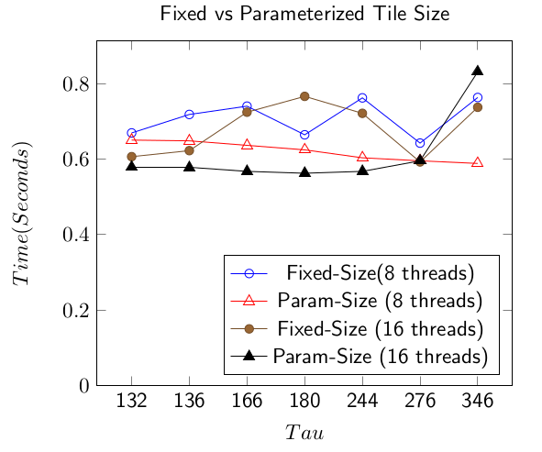
Parameterized vs Fixed Tile Sizes
Parameterized tile size does better than fixed.

Slide 34
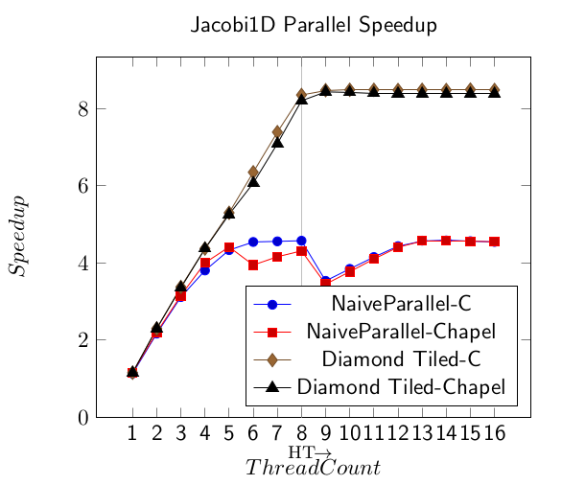
Competitive Performance
Maximum Speedup:
Chapel: 8.4x
C + OpenMP: 8.5x

Slide 35
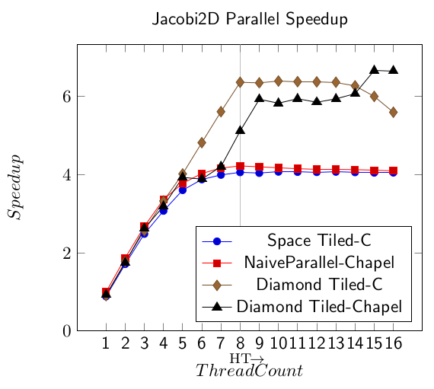
Competitive Performance
Maximum Speedup:
Chapel: 6.7x
C + OpenMP: 6.4x

Slide 36
Conclusion
Parameterized tile size Diamond Tiling is just as effective as fixed tile size Diamond Tiling.
Diamond Tiling implemented in Chapel iterators is competitive with Diamond Tiling in C + OpenMP.
Chapel iterators make advanced tiling schedules much easier to adopt and use.

