Slide 1
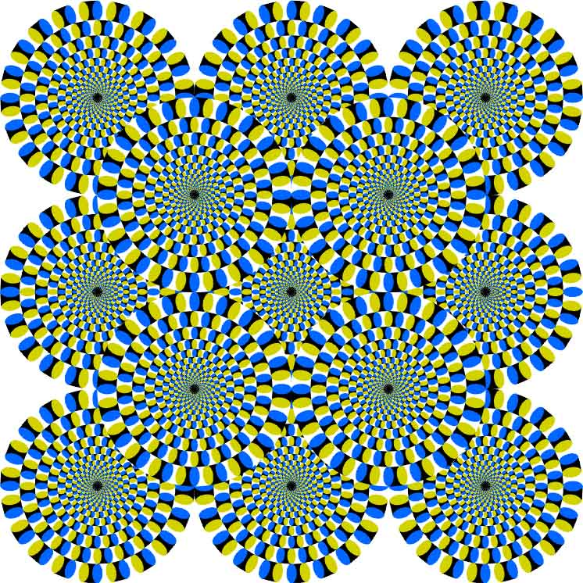
CSc 110, Autumn 2016
Lecture 7: Graphics
Adapted from slides by Marty Stepp and Stuart Reges

Slide 2
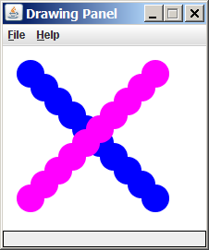
Graphical objects
We will draw graphics in Python using a new kind of object:
DrawingPanel: A window on the screen.
Not part of Python; provided by the instructor. See class web site.

Slide 3
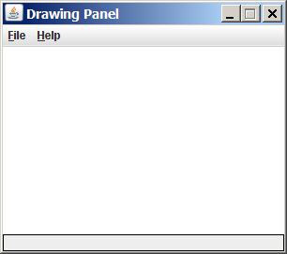
DrawingPanel
To create a window:
<name> = DrawingPanel(<width>, <height>)
<name> = DrawingPanel(<width>, <height>, background="color")
Example:
panel = DrawingPanel(300, 200)
The window has nothing on it.
We can draw shapes and lines on it.
If passed the optional third parameter
it will have a background color

Slide 4
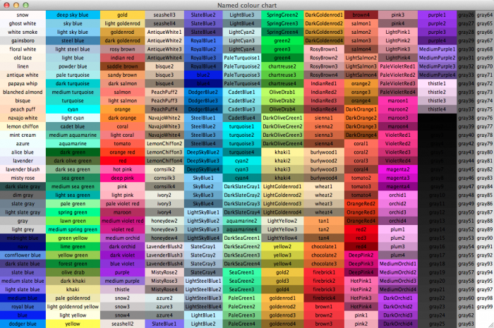
Named colors
Chart credit Smith.edu

Slide 5
Custom colors
You can construct custom colors using hex.
# followed by six numbers 0 – 9 and letters A – F
A is 10, B is 11 and so on
#000000 is black
#FFFFFF is white
Colors get darker as the number gets lower
The first two digits are the amount of red, the next two green, the last two blue
panel = DrawingPanel(80, 50, background="#3367D3")

Slide 6
Drawing shapes
panel.canvas.create_line(x1, y1, x2, y2, fill="color")
line between points (x1, y1), (x2, y2) in color
panel.canvas.create_oval(x1, y1, x2, y2, outline="color")
outline largest oval that fits in a box with top-left at (x1, y1) and lower right at (x2, y2) outlined in color
panel.canvas.create_rectangle(x1, y1, x2, y2, outline="color")
outline of rectangle with top-left at (x1, y1) and bottom right at (x2, y2) outlined in color
panel.canvas.create_text(x, y, text="string")
text centered vertically and horizontally around (x, y)

Slide 7
Coordinate system
Each (x, y) position is a pixel ("picture element").
(0, 0) is at the window's top-left corner.
x increases rightward and the y increases downward.
The rectangle from (0, 0) to (200, 100) looks like this:
(0, 0) x+
(200, 100)
y+

Slide 8
Filled in shapes
To draw a shape with a fill set its fill instead of outline.
from drawingpanel import * # so I can use Graphics
def main():
p = DrawingPanel(150, 70)
# inner red fill
p.canvas.create_rectangle(20, 10, 120, 60, fill="red")
This will automatically fill the shape but give it a black border. To remove the border add width=0.
p.canvas.create_rectangle(20, 10, 120, 60, fill="red", width=0)

Slide 9
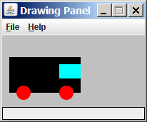
Superimposing shapes
When two shapes occupy the same pixels, the last one drawn is seen.
from drawingpanel import *
def main():
p = DrawingPanel(200, 100, background="light gray")
p.canvas.create_rectangle(10, 30, 110, 80, fill="black")
p.canvas.create_oval(20, 70, 40, 90, fill="red", width=0)
p.canvas.create_oval(80, 70, 100, 90, fill="red", width=0)
p.canvas.create_rectangle(80, 40, 110, 60, fill="cyan", width=0)

Slide 10
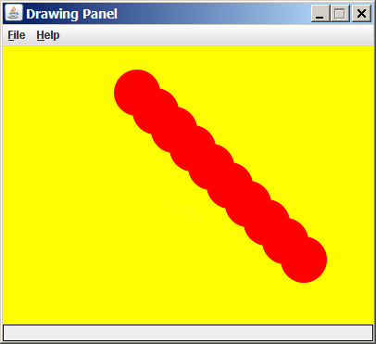
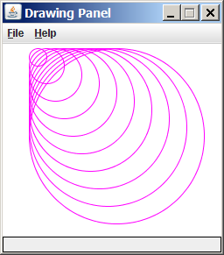
Drawing with loops
The x1, y1, x2, y2 expression can contain the loop counter, i.
panel = DrawingPanel(400, 300, background="yellow")
for i in range(1, 11):
panel.canvas.create_oval (100 + 20 * i, 5 + 20 * i,
150 + 20 * i, 55 + 20 * i
fill="red", width=0)
panel = DrawingPanel(250, 220)
for i in range(1, 11):
panel.canvas.create_oval (30, 5, 30 + 20 * i,
5 + 20 * i, fill="magenta")

Slide 11
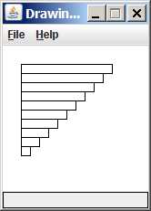
Loops that begin at 0
Beginning a loop at 0 and using < can make coordinates easier to compute.
Example:
Draw ten stacked rectangles starting at (20, 20), height 10, width starting at 100 and decreasing by 10 each time:
panel = DrawingPanel(160, 160)
for i in range(0, 10):
panel.canvas.create_rectangle (20, 20 + 10 * i,
120 – 10 * i, 30 + 10 * i)

Slide 12
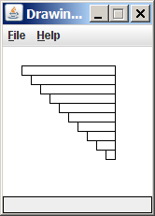
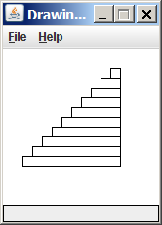
Drawing w/ loops questions
Code from previous slide:
panel = DrawingPanel(160, 160)
for i in range(0, 10):
panel.canvas.create_rectangle (20, 20 + 10 * i,
120 – 10 * i, 30 + 10 * i)
Write variations of the above program that draw the figures at right as output.

Slide 13
Drawing w/ loops answers
Solution #1:
panel = DrawingPanel(160, 160)
for i in range(0, 10):
panel.canvas.create_rectangle (20 + 10 * i, 20 + 10 * i,
120, 30 + 10 * i)
Solution #2:
panel = DrawingPanel(160, 160)
for i in range(0, 10):
panel.canvas.create_rectangle (110 – 10 * i, 20 + 10 * i,
120, 30 + 10 * i)

Slide 14
Drawing with functions
To draw in multiple functions, you must pass DrawingPanel.
def main():
panel = DrawingPanel(200, 100), background="light gray")
drawCar(panel)
def draw_car(DrawingPanel panel):
p.canvas.create_rectangle(10, 30, 110, 80, fill="black")
p.canvas.create_oval(20, 70, 40, 90, fill="red", width=0)
p.canvas.create_oval(80, 70, 100, 90, fill="red", width=0)
p.canvas.create_rectangle(80, 40, 110, 60, fill="cyan", width=0)

Slide 15
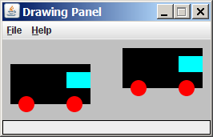
Parameterized figures
Modify the car-drawing function so that it can draw many cars, such as in the following image.
Top-left corners: (10, 30), (150, 10)
Hint: We must modify our draw_car function to accept x/y coordinates as parameters.

Slide 16
Parameterized answer
def main():
panel = DrawingPanel(260, 100, background="light gray")
draw_car(panel, 10, 30)
draw_car(panel, 150, 10)
def draw_car(p, x, y):
p.canvas.create_rectangle(x, y, 100 + x, 50 + y, fill="black")
p.canvas.create_oval(x + 10, y + 40, x + 30, y + 60, fill="red", width=0)
p.canvas.create_oval(x + 70, y + 40, x + 90, y + 60, fill="red", width=0)
p.canvas.create_rectangle(x + 70, y + 10, x + 100, y + 30, fill="cyan",
width=0)

Slide 17
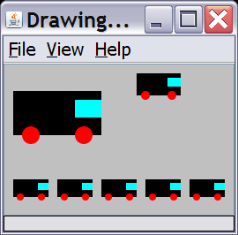
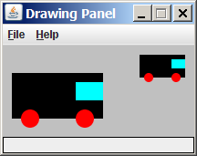
Drawing parameter question
Modify draw_car to allow the car to be drawn at any size.
Existing car: size 100. Second car: (150, 10), size 50.
Once you have this working, use a for loop with your function to draw a line of cars, like the picture at right.
Start at (10, 130), each size 40, separated by 50px.

Slide 18
Drawing parameter answer
def main():
panel = DrawingPanel(260, 100, background="light gray")
draw_car(panel, 10, 30, 100)
draw_car(panel, 150, 10, 50)
for i in range(0, 5):
draw_car(panel, 10 + i * 50, 130, 40);
def draw_car(p, x, y, size):
p.canvas.create_rectangle(x, y, x + size, y + size / 2, fill="black")
p.canvas.create_oval(x + size / 10, y + size / 10 * 4, x + size / 10 * 3, y +
size / 10 * 6, fill="red", width=0)
p.canvas.create_oval(x + size / 10 * 7, y + size / 10 * 4, x + size / 10 * 9,
y + size / 10 * 6, fill="red", width=0)
p.canvas.create_rectangle(x + size / 10 * 7, y + size / 10, x + size,
y + size / 10 * 3, fill="cyan", width=0)

Slide 19
Animation with sleep
DrawingPanel's sleep function pauses your program for a given number of milliseconds.
You can use sleep to create simple animations.
panel = DrawingPanel(250, 200)
for i in range(1, NUM_CIRCLES + 1):
panel.canvas.create_oval(15 * i, 15 * i, 30 + 15 * i, 30 + 15 * i)
panel.sleep(500)
Try adding sleep commands to loops in past exercises in this chapter and watch the panel draw itself piece by piece.

