Slide 1
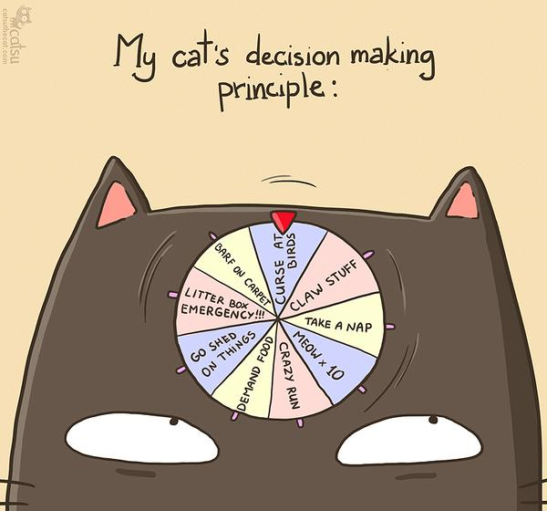
CSc 110, Autumn 2016
Lecture 9: input; if/else
Adapted from slides by Marty Stepp and Stuart Reges

Slide 2
Interactive Programs with input

Slide 3
Interactive programs
interactive program: Reads input from the console.
While the program runs, it asks the user to type input.
The input typed by the user is stored in variables in the code.
Can be tricky; users are unpredictable and misbehave.
But interactive programs have more interesting behavior.

Slide 4
input
input: An function that can read input from the user.
Using an input object to read console input:
name = input(prompt)
Example:
name = input("type your name: ")
The variable name will store the value the user typed in

Slide 5
input example
def main():
age = input("How old are you? ")
years = 65 - age
print(years + " years until retirement!")
Console (user input underlined):
How old are you?
age | 29
29
Traceback (most recent call last):
File "<pyshell#13>", line 1, in <module>
print(65 - age)
TypeError: unsupported operand type(s) for -: 'int' and 'str'
Notes:
It's also useful to write a program that prompts for multiple values, both on the same line or each on its own line.

Slide 6
input example
def main():
age = int(input("How old are you? "))
years = 65 - age
print(str(years) + " years until retirement!")
Console (user input underlined):
How old are you?
36 years until retirement!
age | 29
years | 36
29
Notes:
It's also useful to write a program that prompts for multiple values, both on the same line or each on its own line.

Slide 7
The if/else statement

Slide 8
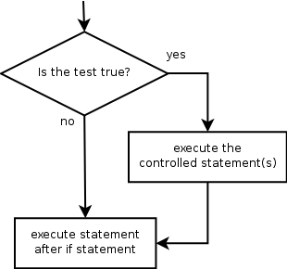
The if statement
Executes a block of statements only if a test is true
if (test):
statement
...
statement
Example:
gpa = float(input("gpa? "))
if (gpa >= 2.0):
print("Application accepted.")

Slide 9
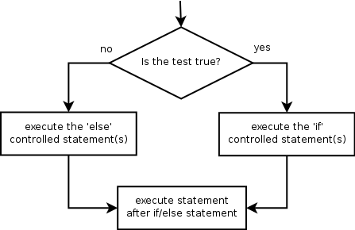
The if/else statement
Executes one block if a test is true, another if false
if (test):
statement(s)
else:
statement(s)
Example:
gpa = float(input("gpa? "))
if (gpa >= 2.0):
print("Welcome to Mars University!")
else:
print("Application denied.")

Slide 10
Relational expressions
if statements use logical tests.
if (i <= 10): ...
These are boolean expressions
Tests use relational operators:
Operator | Meaning | Example | Value
== | equals | 1 + 1 == 2 | True
!= <> | does not equal | 3.2 != 2.5 3.2 <> 2.5 | True
< | less than | 10 < 5 | False
> | greater than | 10 > 5 | True
<= | less than or equal to | 126 <= 100 | False
>= | greater than or equal to | 5.0 >= 5.0 | True
Notes:
Note that == tests equality, not = . The = is used for the assignment operator!

Slide 11
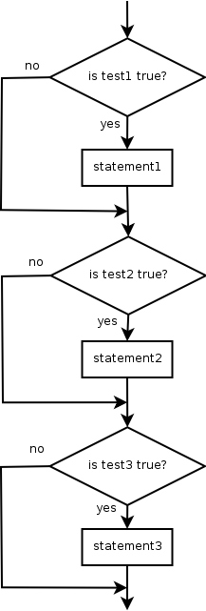
Misuse of if
What's wrong with the following code?
percent = float(input("What percentage did you earn? "))
if (percent >= 90):
print("You got an A!")
if (percent >= 80):
print("You got a B!")
if (percent >= 70):
print("You got a C!")
if (percent >= 60):
print("You got a D!")
if (percent < 60):
print("You got an F!")
...

Slide 12
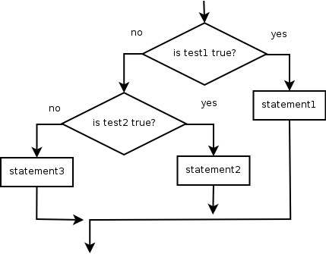
Nested if/else
Chooses between outcomes using many tests
if (test):
statement(s)
elif (test):
statement(s)
else:
statement(s)
Example:
if (x > 0):
print("Positive")
elif (x < 0):
print("Negative")
else:
print("Zero")

Slide 13
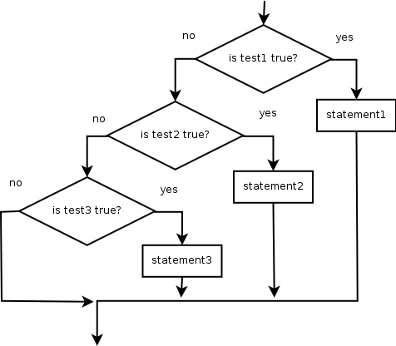
Nested if/else/if
If it ends with else, exactly one path must be taken.
If it ends with if, the code might not execute any path.
if (test):
statement(s)
elif (test):
statement(s)
elif (test):
statement(s)
Example:
if (place == 1):
print("Gold medal!")
elif (place == 2):
print("Silver medal!")
elif (place == 3):
print("Bronze medal.")

Slide 14
Nested if structures
exactly 1 path (mutually exclusive) if (test): statement(s) elif (test): statement(s) else: statement(s) | 0 or 1 path (mutually exclusive) if (test): statement(s) elif (test): statement(s) elif (test): statement(s)
0, 1, or many paths (independent tests; not exclusive) if (test): statement(s) if (test): statement(s) if (test): statement(s)

Slide 15
Which nested if/else?
(1) if/if/if (2) nested if/else (3) nested if/else/if
Whether a user is lower, middle, or upper-class based on income.
(2) nested if / else if / else
Whether you made the dean's list (GPA ≥ 3.8) or honor roll (3.5-3.8).
(3) nested if / else if
Whether a number is divisible by 2, 3, and/or 5.
(1) sequential if / if / if
Computing a grade of A, B, C, D, or F based on a percentage.
(2) nested if / else if / else if / else if / else

