Slide 1
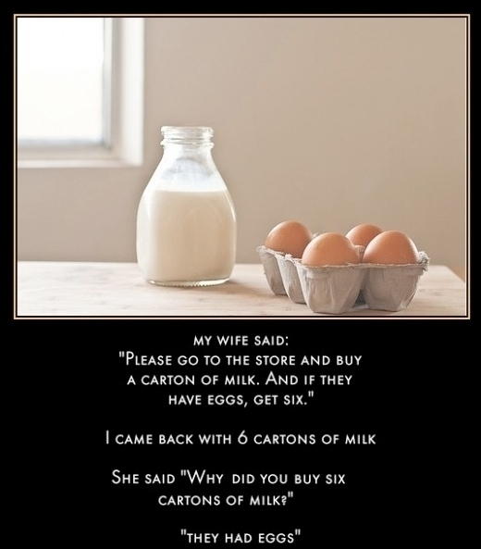
CSc 110, Autumn 2016
Lecture 18: Line-Based File Input
Adapted from slides by Marty Stepp and Stuart Reges
Programming feel like that?

Slide 2
IMDb movies problem
Consider the following Internet Movie Database (IMDb) data:
1 9.1 196376 The Shawshank Redemption (1994)
2 9.0 139085 The Godfather: Part II (1974)
3 8.8 81507 Casablanca (1942)
Write a program that displays any movies containing a phrase:
Search word? part
Rank Votes Rating Title
2 139085 9.0 The Godfather: Part II (1974)
40 129172 8.5 The Departed (2006)
95 20401 8.2 The Apartment (1960)
192 30587 8.0 Spartacus (1960)
4 matches.
Is this a token or line-based problem?

Slide 3
"Chaining"
main should be a concise summary of your program.
It is bad if each function calls the next without ever returning (we call this chaining):
A better structure has main make most of the calls.
Functions must return values to main to be passed on later.
main
functionA
functionB
functionC
functionD
main
functionA
functionB
functionD
functionD

Slide 4
Bad IMDb "chained" code 1
# Displays IMDB's Top 250 movies that match a search string.
def main():
get_word()
# Asks the user for their search word and returns it.
def get_word():
search_word = input("Search word: ")
search_word = search_word.lower()
print()
file = open("imdb.txt")
search(file, search_word)
# Breaks apart each line, looking for lines that match the search word.
public static String search(file, search_word):
matches = 0
for line in file:
line_lower = line.lower() # case-insensitive match
if (search_word in line_lower):
matches += 1
print("Rank\tVotes\tRating\tTitle")
display(line)
print(str(matches) + " matches.")

Slide 5
Bad IMDb "chained" code 2
# Displays the line in the proper format on the screen.
def display(line):
parts = line.split()
rank = parts[0]
rating = parts[1]
votes = parts[2]
title = ""
for i in range(3, len(parts):
title += parts[i] + " " # the rest of the line
print(rank + "\t" + votes + "\t" + rating + "\t" + title)

Slide 6
Better IMDb answer 1
# Displays IMDB's Top 250 movies that match a search string.
def main():
search_word = get_word()
file = open("imdb.txt")
line = search(input, search_word)
if (line.length() > 0):
print("Rank\tVotes\tRating\tTitle")
while (line.length() > 0):
display(line)
line = search(input, search_word)
print(matches + " matches.")
# Asks the user for their search word and returns it.
def get_word():
search_word = input("Search word" ")
search_word = search_word.lower()
print()
return search_word
...

Slide 7
Better IMDb answer 2
...
# Breaks apart each line, looking for lines that match the search word.
def search(file, search_word):
for line in file:
line_lower = line.lower() # case-insensitive match
if (search_word in line):
return line
return "" # not found
# displays the line in the proper format on the screen.
def display(line):
parts = line.split
rank = parts[0]
rating = parts[1]
votes = parts[2]
title = ""
for i in range(3, len(parts)):
title += parts[i] + " " # the rest of the line
print(rank + "\t" + votes + "\t" + rating + "\t" + title)

Slide 8
File output
Notes:
8

Slide 9
Output to files
Open a file in write or append mode
'w' - write mode – replaces everything in the file
'a' – append mode – adds to the bottom of the file preserving what is already in it
name = open("filename", "w") # write
name = open("filename", "a") # append

Slide 10
Output to files
name.write(str) - writes the given string to the file
name.close() - closes file once writing is done
Example:
out = open("output.txt", "w")
out.write("Hello, world!\n")
out.write("How are you?")
out.close()
text = open("output.txt").read() # Hello, world!\nHow are you?
Notes:
common PrintStream bug:
- declaring it in a method that gets called many times. This causes the file to be re-opened and wipes the past contents. So only the last line shows up in the file.

Slide 11
Removing short words
A lot of algorithms that process language ignore very common words like "and".
Write a program that reads a file and displays the words of that file as a list.
Then display them with all words shorter than 4 characters removed.

Slide 12
Removing short words
def main():
file = open("text.txt")
words = file.read().split()
print(words)
i = 0
while(i < len(words)):
word = words[i]
if len(word) < 4:
words.remove(word)
i -= 1
i += 1
print(words)
main()

