Slide 1
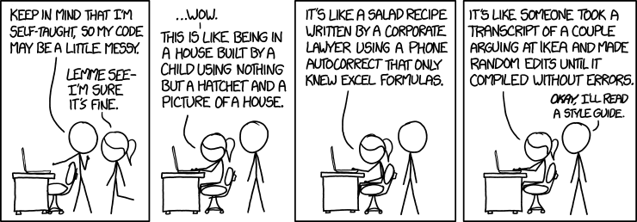
CSc 110, Autumn 2016
Lecture 23: Tuples
Adapted from slides by Marty Stepp and Stuart Reges

Slide 2
Black box testing example
Write a function named remove_bad_pairs that accepts as a parameter a list of integers, and removes any adjacent pair of integers in the list if the left element of the pair is larger than the right element of the pair. Every pair's left element is at an even-numbered index in the list, and every pair's right element is at an odd index in the list. For example, suppose a variable named list stores the following element values:
[3, 7, 9, 2, 5, 5, 8, 5, 6, 3, 4, 7, 3, 1]
We can think of this list as a sequence of pairs:
[3, 7, 9, 2, 5, 5, 8, 5, 6, 3, 4, 7, 3, 1]
The pairs 9-2, 8-5, 6-3, and 3-1 are "bad" because the left element is larger than the right one, so these pairs should be removed. So the call of remove_bad_pairs(list) would change the list to store:
[3, 7, 5, 5, 4, 7]
If the list has an odd length, the last element is not part of a pair and is also considered "bad;" it should therefore be removed by your function.
If an empty list is passed in, the list should still be empty at the end of the call.

Slide 3
What should you test?
Focus on edge cases
Don't just test 1, 2, 3, 4, 5, 6, etc – that won't tell you anything new
Common edge cases
1, 0, -1
Empty list

Slide 4
White box testing example
remove_bad_pairs(list):
if (len(list) % 2 != 0):
v.remove(list[-1])
i = 0
while(i < len(list)):
if (i % 2 != 0 and list[i - 1] > list[i]):
list.remove(i - 1)
list.remove(i)

Slide 5
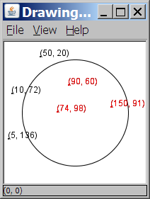
A programming problem
Given a file of cities' names and (x, y) coordinates:
Winslow 50 20
Tucson 90 60
Phoenix 10 72
Bisbee 74 98
Yuma 5 136
Page 150 91
Write a program to draw the cities on a DrawingPanel, then simulates an earthquake that turns all cities red that are within a given radius:
Epicenter x? 100
Epicenter y? 100
Affected radius? 75

Slide 6
A bad solution
lines = open("cities.txt").readlines()
names = [0] * len(lines)
x_coords = [0] * len(lines)
y_coords = [0] * len(lines)
for i in range(0, len(lines)):
parts = lines[i].split()
names[i] = parts[0]
x_coords[i] = parts[1] # read each city
y_coords[i] = parts[2]
...
parallel lists: 2+ lists with related data at same indexes.
Considered poor style.

Slide 7
Observations
The data in this problem is a set of points.
It would be better stored together

Slide 8
Tuples
A sequence similar to a list but it cannot be altered
Good for storing related data
We mainly store the same type of data in a list
We usually store related things in tuples
Creating tuples
name = (data, other_data, … , last_data)
tuple = ("Tucson", 80, 90)

Slide 9
Using tuples
You can access elements using [] notation, just like lists and strings
tuple = ("Tucson", 80, 90)
low = tuple[1]
You cannot update a tuple!
Tuples are immutable
You can loop through tuples
the same as lists
operation | call | result
len() | len((1, 2, 3)) | 3
+ | (1, 2, 3) + (4, 5, 6) | (1, 2, 3, 4, 5, 6)
* | ('Hi!',) * 4 | ('Hi!', 'Hi!', 'Hi!', 'Hi!')
in | 3 in (1, 2, 3) | True
for | for x in (1,2,3): print x, | 1 2 3
min() | min((1, 3)) | 1
max() | max((1, 3)) | 3

Slide 10
Days till
Write a function called days_till that accepts a start month and day and a stop month and day and returns the number of days between them
call return
days_till("december", 1, "december", 10) 9
days_till("novembeR", 15, "december", 10) 25
days_till("OCTober", 6, "december", 17) 72
days_till("october", 6, "ocTober", 1) 360

Slide 11
Days till solution
def days_till(start_month, start_day, stop_month, stop_day):
months = (('january', 31),('february', 28),('march', 31),('april', 30), ('may', 31),('june', 30),
('july', 31), ('august', 31),('september', 30), ('october', 31), ('november', 30), ('december', 31))
if start_month.lower() == stop_month.lower() and stop_day >= start_day:
return stop_day - start_day
days = 0
for i in range(0, len(months)):
month = months[i]
if month[0] == start_month.lower():
days = month[1] - start_day
i += 1
while months[i % 12][0] != stop_month.lower():
days += months[i % 12][1]
i += 1
days += stop_day
return days

