Slide 1
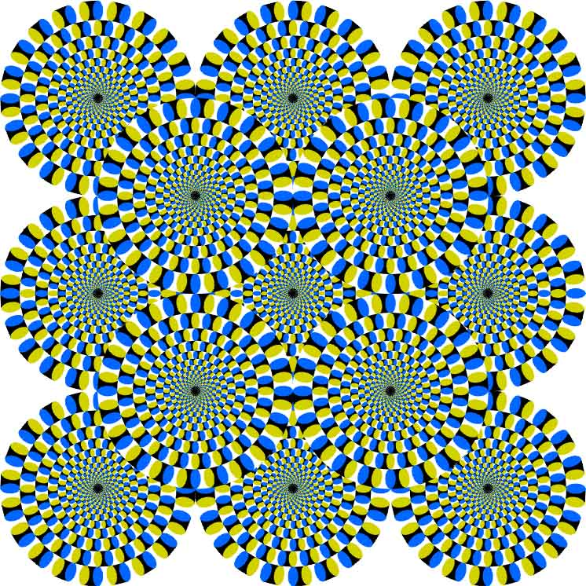
CSc 110, Autumn 2017
Lecture 7: Multiple Parameters and Graphics
Adapted from slides by Marty Stepp and Stuart Reges

Slide 2
Multiple parameters
A function can accept multiple parameters. (separate by , )
When calling it, you must pass values for each parameter.
Declaration:
def <name>(<name>, ..., <name>):
<statement>(s)
Call:
<name>(<exp>, <exp>, ..., <exp>)

Slide 3
Multiple parameters example
def main():
print_number(4, 9)
print_number(17, 6)
print_number(8, 0)
print_number(0, 8)
def print_number(number, count):
for i in range(0, count):
print(number, end="")
print()
Output:
444444444
171717171717
00000000

Slide 4
A "Parameter Mystery" problem
def main():
x = 9
y = 2
z = 5
mystery(z, y, x)
mystery(y, x, z)
def mystery(x, z, y):
print(z, "and", (y - x))
Notes:
Output:
2 and 4
9 and 3

Slide 5
Value semantics
value semantics: When numbers and strings are passed as parameters, their values are copied.
Modifying the parameter will not affect the variable passed in.
def strange(x):
x = x + 1
print("1. x = ", x)
def main():
x = 23
strange(x)
print("2. x = ", x)
...
Output:
1. x = 24
2. x = 23

Slide 6
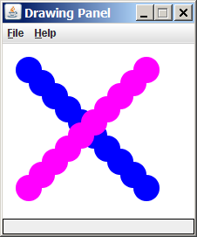
Graphical objects
We will draw graphics in Python using a new kind of object:
DrawingPanel: A window on the screen.
Not part of Python; provided by the instructor. See class web site.

Slide 7
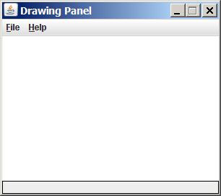
DrawingPanel
To create a window:
<name> = DrawingPanel(<width>, <height>)
<name> = DrawingPanel(<width>, <height>, background="color")
Example:
panel = DrawingPanel(300, 200)
The window has nothing on it.
We can draw shapes and lines on it.
If passed the optional third parameter
it will have a background color

Slide 8
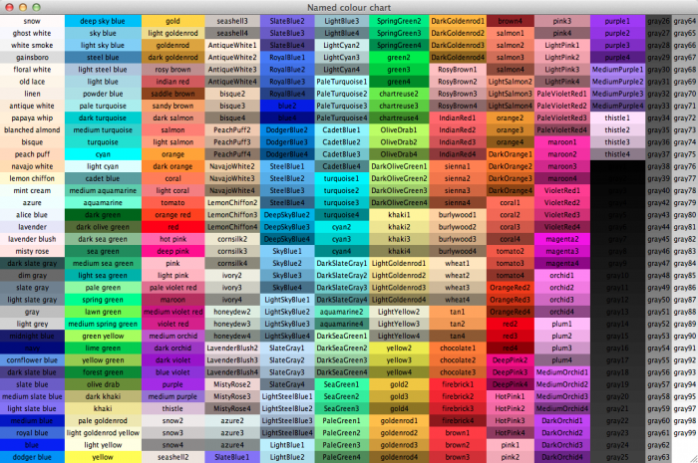
Named colors
Chart credit Smith.edu

Slide 9
Custom colors
You can construct custom colors using hex.
# followed by six numbers 0 – 9 and letters A – F
A is 10, B is 11 and so on
#000000 is black
#FFFFFF is white
Colors get darker as the number gets lower
The first two digits are the amount of red, the next two green, the last two blue
panel = DrawingPanel(80, 50, background="#3367D3")

Slide 10
Drawing shapes
Function name | Description
p.draw_line(x1, y1, x2, y2) | line between points (x1, y1), (x2, y2)
p.draw_oval(x, y, width, height) | outline largest oval that fits in a box of size width * height with top-left at (x, y)
p.draw_rect(x, y, width, height) | outline of rectangle of size width * height with top-left at (x, y)
p.draw_string("text", x, y) | text with upper-left at (x, y)
p.fill_oval(x, y, width, height) | fill largest oval that fits in a box of size width * height with top-left at (x,y)
p.fill_rect(x, y, width, height) | fill rectangle of size width * height with top-left at (x, y)
p.set_color("color") | set the default color to "color"
You can pass an additional "color" to any shape as a last parameter
p.draw_rect(50, 100, 60, 60, "red")

Slide 11
Coordinate system
Each (x, y) position is a pixel ("picture element").
(0, 0) is at the window's top-left corner.
x increases rightward and the y increases downward.
The rectangle from (0, 0) to (200, 100) looks like this:
(0, 0) x+
(200, 100)
y+

Slide 12
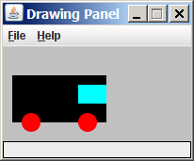
Superimposing shapes
When two shapes occupy the same pixels, the last one drawn is seen.
from DrawingPanel import *
def main():
p = DrawingPanel(200, 100, background="light gray")
p.fill_rect(10, 30, 100, 50, "black")
p.fill_oval(20, 70, 20, 20, "red")
p.fill_oval(80, 70, 20, 20, "red")
p.fill_rect(80, 40, 30, 20, "cyan")

Slide 13
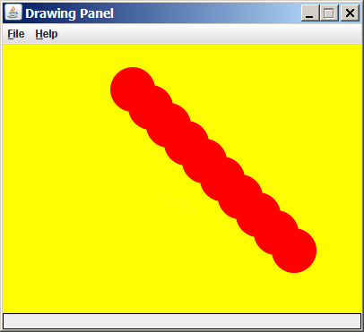
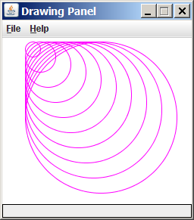
Drawing with loops
The x1, y1, w, h expression can contain the loop counter, i.
panel = DrawingPanel(400, 300, background="yellow")
for i in range(1, 11):
panel.fill_oval (100 + 20 * i, 5 + 20 * i,
50, 50, "red")
panel = DrawingPanel(250, 220)
for i in range(1, 11):
panel.draw_oval (30, 5, 20 * i, 20 * i, "magenta")

Slide 14
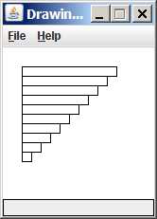
Loops that begin at 0
Beginning a loop at 0 and using < can make coordinates easier to compute.
Example:
Draw ten stacked rectangles starting at (20, 20), height 10, width starting at 100 and decreasing by 10 each time:
panel = DrawingPanel(160, 160)
for i in range(10):
panel.draw_rect(20, 20 + 10 * i, 100 – 10 * i, 10)

Slide 15
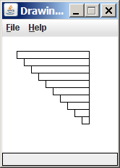
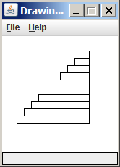
Drawing w/ loops questions
panel = DrawingPanel(160, 160)
for i in range(0, 10):
panel.draw_rectangle (20, 20 + 10 * i,
100 – 10 * i, 10)
Write variations of the above program that draw the figures at right as output.

Slide 16
Drawing w/ loops answers
Solution #1:
panel = DrawingPanel(160, 160)
for i in range(0, 10):
panel.draw_rectangle (20 + 10 * i, 20 + 10 * i,
100 - 10 * i, 10)
Solution #2:
panel = DrawingPanel(160, 160)
for i in range(0, 10):
panel.draw_rect(110 - 10 * i, 20 + 10 * i,
10 + 10 * i, 10)

Slide 17
Drawing with functions
To draw in multiple functions, you must pass DrawingPanel.
def main():
panel = DrawingPanel(200, 100, background="light gray")
draw_car(panel)
def draw_car(p):
p.fill_rect(10, 30, 100, 50, "black")
p.fill_oval(20, 70, 20, 20, "red")
p.fill_oval(80, 70, 20, 20, "red")
p.fill_rect(80, 40, 30, 20, "cyan")

Slide 18
Pseudo-Randomness
Computers generate numbers in a predictable way using a mathematical formula
Parameters may include current time, mouse position
In practice, hard to predict or replicate
True randomness uses natural processes
Atmospheric noise (http://www.random.org/)
Lava lamps (patent #5732138)
Radioactive decay

Slide 19
Random
Method name | Description
random.random() | returns a random float in the range [0, 1) in other words, 0 inclusive to 1 exclusive
random.randint(min, max) | returns a random integer in the range [min, max) in other words, min to max-1 inclusive
random generates pseudo-random numbers.
random can be accessed by including the following statement:
import random
Example:
import random
random_number = random.randint(1, 10) # 1-9

Slide 20
Generating random numbers
To get a number in arbitrary range [min, max] inclusive:
random.randint(min, max)
Where size of range is (max – min + 1)
Example: A random integer between 4 and 10 inclusive:
n = random.randint(4, 10)

