Slide 1
CSc 110, Autumn 2017
Lecture 9: Graphics and Nested Loops
Adapted from slides by Marty Stepp and Stuart Reges
Can you write this in Python?
Notes:
1

Slide 2
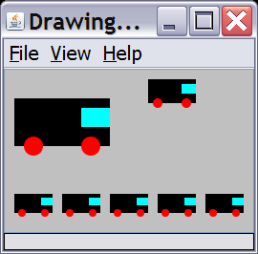
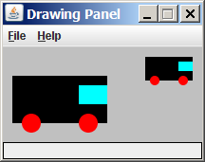
Drawing parameter question
Modify draw_car to allow the car to be drawn at any size.
Existing car: size 100. Second car: (150, 10), size 50.
Once you have this working, use a for loop with your function to draw a line of cars, like the picture at right.
Start at (10, 130), each size 40, separated by 50px.

Slide 3
Animation with sleep
DrawingPanel's sleep function pauses your program for a given number of milliseconds.
You can use sleep to create simple animations.
panel = DrawingPanel(250, 200)
for i in range(1, NUM_CIRCLES + 1):
panel.draw_oval(15 * i, 15 * i, 30, 30)
panel.sleep(500)
Try adding sleep commands to loops in past exercises in this chapter and watch the panel draw itself piece by piece.

Slide 4
Drawing parameter answer
def main():
panel = DrawingPanel(260, 100, background="light gray")
draw_car(panel, 10, 30, 100)
draw_car(panel, 150, 10, 50)
for i in range(0, 5):
draw_car(panel, 10 + i * 50, 130, 40);
def draw_car(p, x, y, size):
p.fill_rect(x, y, size, size / 2, "black")
p.fill_oval(x + size / 10, y + size / 5 * 2, size / 5, size / 5, "red")
p.fill_oval(x + size / 10 * 7, y + size / 5 * 2, size / 5, size / 5, "red")
p.fill_rect(x + size / 10 * 7, y + size / 10, size / 10 * 3, size / 5, "cyan")

Slide 5
How to add parameters
The panel must always be a parameter to a function that draws
Add in position (x, y) parameters
These change x and y but not width and height of figures
Add size parameter
This changes width and height and sometimes x and y
Think of all sizes and placements as percentages of the size
size (width) was 100, wheel was 70 from left, that is 70% from the left so, size / 10 * 7

Slide 6
Nested Loops
What does the following code output?
def main():
for i in range(1, 10):
for j in range(1, 10):
print(j * i, end="\t")
print()
main()

Slide 7
Outputting a Grid
controls the number of rows
for i in range(n, m):
for j in range(n, m):
...
creates a single row

Slide 8
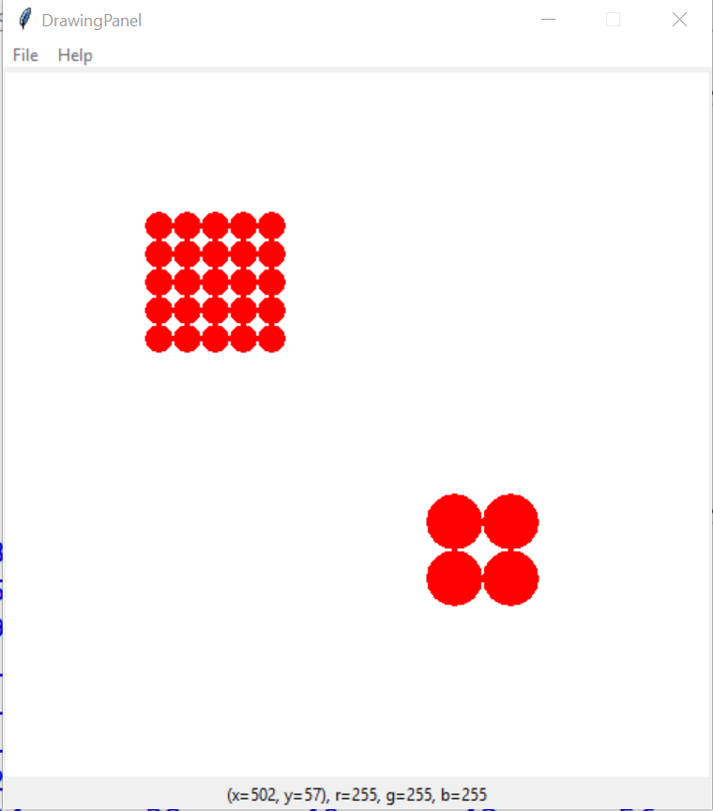
Output the following figures
Left grid:
x = 100
y = 100
circle size = 20
number of circles = 5
Right grid:
x = 300
y = 300
circle size = 40
number of circles = 2

