Slide 1
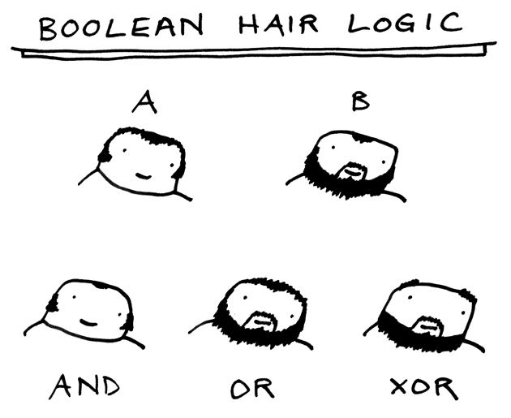
CSc 110, Autumn 2016
Lecture 12: Advanced if/else; Cumulative sum
Adapted from slides by Marty Stepp and Stuart Reges

Slide 2
Nested if/else question
Write a program that produces output like the following:
This program reads data for two
people and computes their basal
metabolic rate and burn rate.
Enter next person's information:
height (in inches)? 73.5
weight (in pounds)? 230
age (in years)? 35
gender (male or female)? male
Enter next person's information:
height (in inches)? 71
weight (in pounds)? 220.5
age (in years)? 20
gender (male or female)? female
Person #1 basal metabolic rate = 2042.3
high resting burn rate
Person #2 basal metabolic rate = 1868.4
moderate resting burn rate
Basal Metabolic Rate Formula:
male BMR = 4.54545 x (weight in lb) + 15.875 x (height in inches) - 5 x (age in years) + 5
female BMR = 4.54545 x (weight in lb) + 15.875 x (height in inches) - 5 x (age in years) - 161
BMR | Burn Level
below 12000 | low
1200 to 2000 | moderate
above 2000 | high
Notes:
// This program computes two people's body mass index (BMI) and
// compares them. The code uses parameters, returns, and Scanner.
import java.util.*; // so that I can use Scanner
public class BMI {
public static void main(String[] args) {
System.out.println("This program reads in data for two people and");
System.out.println("computes their body mass index (BMI)");
System.out.println();
// finish me!
}
}

Slide 3
Nested if/else answer
# This program finds the basal metabolic rate (BMR) for two
# individuals. This variation includes several functions
# other than main.
# introduces the program to the user
def give_intro():
print("This program reads data for two")
print("people and computes their basal")
print("metabolic rate and burn rate.")
print()
# prompts for one person's statistics, returning the BMI
def get_bmr(person):
print("Enter person", person, "information:")
height = float(input("height (in inches)? "))
weight = float(input("weight (in pounds)? "))
age = float(input("age (in years)? "))
gender = input("gender (male or female)? ")
bmr = bmr_for(height, weight, age, gender)
print()
return bmr
...

Slide 4
Nested if/else, cont'd.
# this function contains the basal metabolic rate formula for
# converting the given height (in inches), weight
# (in pounds), age (in years) and gender (male or female) into a BMR
def bmr_for(height, weight, age, gender):
bmr = 4.54545 * weight + 15.875 * height - 5 * age
if gender.lower() == "male":
bmr += 5
else:
bmr -= 161
return bmr
# reports the overall bmr values and status
def report_results(bmr1, bmr2):
print("Person #1 basal metabolic rate =", round(bmr1, 1))
report_status(bmr1)
print("Person #2 basal metabolic rate =", round(bmr2, 1))
report_status(bmr2)
# reports the burn rate for the given BMR value
def report_status(bmr):
if bmr < 1200:
print("low resting burn rate");
elif bmr <= 2000:
print("moderate resting burn rate")
else: # bmr1 > 2000
print("high resting burn rate")
def main():
give_intro()
bmr1 = get_bmr(1)
bmr2 = get_bmr(2)
print(bmr1, bmr2)
report_results(bmr1, bmr2)
main()
Notes:
How would we round the BMI numbers?

Slide 5
Factoring if/else code
factoring: Extracting common/redundant code.
Can reduce or eliminate redundancy from if/else code.
Example:
if a == 1:
print(a)
x = 3
b = b + x
elif a == 2:
print(a)
x = 6
y = y + 10
b = b + x
else: # a == 3
print(a)
x = 9
b = b + x
print(a)
x = 3 * a
if a == 2:
y = y + 10
b = b + x

Slide 6
Advanced if/else

Slide 7
The "dangling if" problem
What can be improved about the following code?
if (x < 0):
print("x is negative")
elif (x >= 0):
print("x is non-negative")
The second if test is unnecessary and can be removed:
if (x < 0):
print("x is negative")
else:
print("x is non-negative")
This is also relevant in function that use if with return...

Slide 8
if/else with return
# Returns the larger of the two given integers.
def max(a, b):
if (a > b):
return a
else:
return b
Functions can return different values using if/else
Whichever path the code enters, it will return that value.
Returning a value causes a function to immediately exit.
All paths through the code should reach a return statement.

Slide 9
Cumulative algorithms

Slide 10
Adding many numbers
How would you find the sum of all integers from 1-1000?
# This may require a lot of typing
sum = 1 + 2 + 3 + 4 + ...
print("The sum is", sum)
What if we want the sum from 1 - 1,000,000? Or the sum up to any maximum?
How can we generalize the above code?

Slide 11
Cumulative sum loop
sum = 0
for i in range(1, 1001):
sum = sum + i
print("The sum is", sum)
cumulative sum: A variable that keeps a sum in progress and is updated repeatedly until summing is finished.
The sum in the above code is an attempt at a cumulative sum.
Cumulative sum variables must be declared outside the loops that update them, so that they will still exist after the loop.

Slide 12
Cumulative product
This cumulative idea can be used with other operators:
product = 1
for i in range(1, 21):
product = product * 2
print("2 ^ 20 =", product)
How would we make the base and exponent adjustable?

Slide 13
input and cumulative sum
We can do a cumulative sum of user input:
sum = 0;
for i in range(1, 101):
next = int(input("Type a number: "))
sum = sum + next
}
print("The sum is", sum)

Slide 14
Cumulative sum question
Modify the receipt program from lecture 2
Prompt for how many people, and each person's dinner cost.
Use functions to structure the solution.
Example log of execution:
How many people ate? 4
Person #1: How much did your dinner cost? 20.00
Person #2: How much did your dinner cost? 15
Person #3: How much did your dinner cost? 30.0
Person #4: How much did your dinner cost? 10.00
Subtotal: $75.0
Tax: $6.0
Tip: $11.25
Total: $92.25

Slide 15
Cumulative sum answer
# This program enhances our Receipt program using a cumulative sum.
def main():
subtotal = meals()
results(subtotal)
# Prompts for number of people and returns total meal subtotal.
def meals():
people = float(input("How many people ate? "))
subtotal = 0.0; # cumulative sum
for i in range(1, people + 1):
person_cost = float(input("Person #" + str(i) +
": How much did your dinner cost? "))
subtotal = subtotal + person_cost; # add to sum
return subtotal
...

Slide 16
Cumulative answer, cont'd.
# Calculates total owed, assuming 8% tax and 15% tip
def results(subtotal):
tax = subtotal * .08
tip = subtotal * .15
total = subtotal + tax + tip
print("Subtotal: $" + str(subtotal))
print("Tax: $" + str(tax))
print("Tip: $" + str(tip))
print("Total: $" + str(total))

Slide 17
if/else, return question
Write a function count_factors that returns the number of factors of an integer.
count_factors(24) returns 8 because 1, 2, 3, 4, 6, 8, 12, and 24 are factors of 24.
Solution:
# Returns how many factors the given number has.
def count_factors(number):
count = 0
for i in range(1, number + 1):
if (number % i == 0):
count += 1 # i is a factor of number
return count

