Slide 1
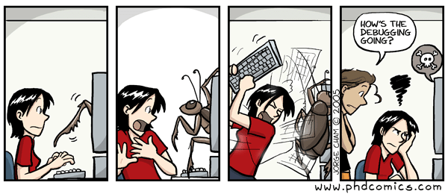
CSc 110, Autumn 2017
Lecture 21: Line-Based File Input
Adapted from slides by Marty Stepp and Stuart Reges

Slide 2
IMDb movies problem
Consider the following Internet Movie Database (IMDb) data:
1 9.1 196376 The Shawshank Redemption (1994)
2 9.0 139085 The Godfather: Part II (1974)
3 8.8 81507 Casablanca (1942)
Write a program that displays any movies containing a phrase:
Search word? part
Rank Votes Rating Title
2 139085 9.0 The Godfather: Part II (1974)
40 129172 8.5 The Departed (2006)
95 20401 8.2 The Apartment (1960)
192 30587 8.0 Spartacus (1960)
4 matches.
Is this a token or line-based problem?

Slide 3
"Chaining"
main should be a concise summary of your program.
It is bad if each function calls the next without ever returning (we call this chaining):
A better structure has main make most of the calls.
Functions must return values to main to be passed on later.
main
functionA
functionB
functionC
functionD
main
functionA
functionB
functionD
functionD

Slide 4
Bad IMDb "chained" code 1
# Displays IMDB's Top 250 movies that match a search string.
def main():
get_word()
# Asks the user for their search word and returns it.
def get_word():
search_word = input("Search word: ")
search_word = search_word.lower()
print()
file = open("imdb.txt")
search(file, search_word)
# Breaks apart each line, looking for lines that match the search word.
def search(file, search_word):
matches = 0
for line in file:
line_lower = line.lower() # case-insensitive match
if (search_word in line_lower):
matches += 1
print("Rank\tVotes\tRating\tTitle")
display(line)

Slide 5
Bad IMDb "chained" code 2
# Displays the line in the proper format on the screen.
def display(line):
parts = line.split()
rank = parts[0]
rating = parts[1]
votes = parts[2]
title = ""
for i in range(3, len(parts)):
title += parts[i] + " " # the rest of the line
print(rank + "\t" + votes + "\t" + rating + "\t" + title)

Slide 6
Better IMDb answer 1
# Displays IMDB's Top 250 movies that match a search string.
def main():
search_word = get_word()
file = open("imdb.txt")
line = search(file, search_word)
if (len(line) > 0):
print("Rank\tVotes\tRating\tTitle")
matches = 0
while (len(line) > 0):
display(line)
line = search(file, search_word)
matches += 1
print(str(matches) + " matches.")
# Asks the user for their search word and returns it.
def get_word():
search_word = input("Search word: ")
search_word = search_word.lower()
print()
return search_word
...

Slide 7
Better IMDb answer 2
...
# Breaks apart each line, looking for lines that match the search word.
def search(file, search_word):
for line in file:
line_lower = line.lower() # case-insensitive match
if (search_word in line):
return line
return "" # not found
# displays the line in the proper format on the screen.
def display(line):
parts = line.split()
rank = parts[0]
rating = parts[1]
votes = parts[2]
title = ""
for i in range(3, len(parts)):
title += parts[i] + " " # the rest of the line
print(rank + "\t" + votes + "\t" + rating + "\t" + title)

Slide 8
Survey Results

Slide 14
Least favorite
Favorite
Handwritten exams
Quizzes
Time of deadlines
Daily problems
Collaboration
Projects
Problem solving
Joy of getting a problem right
Programming
Resources
Cartoons
"The projects are probably one of the most satisfying pieces of schoolwork I've ever done. I just feel a real sense of accomplishment when I complete one."

