Slide 1
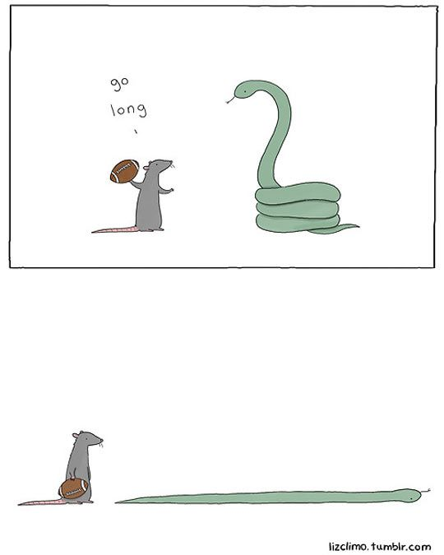
CSc 110, Autumn 2017
Lecture 26: Assertions
Adapted from slides by Marty Stepp and Stuart Reges
Notes:
1

Slide 2
Section attendance question
Read a file of section attendance (see next slide):
yynyyynayayynyyyayanyyyaynayyayyanayyyanyayna
ayyanyyyyayanaayyanayyyananayayaynyayayynynya
yyayaynyyayyanynnyyyayyanayaynannnyyayyayayny
And produce the following output:
Section 1
Student points: [20, 16, 17, 14, 11]
Student grades: [100.0, 80.0, 85.0, 70.0, 55.0]
Section 2
Student points: [16, 19, 14, 14, 8]
Student grades: [80.0, 95.0, 70.0, 70.0, 40.0]
Section 3
Student points: [16, 15, 16, 18, 14]
Student grades: [80.0, 75.0, 80.0, 90.0, 70.0]
Students earn 3 points for each section attended up to 20.

Slide 3
Section input file
student | 123451234512345123451234512345123451234512345
week | 1 2 3 4 5 6 7 8 9
 | yynyyynayayynyyyayanyyyaynayyayyanayyyanyayna ayyanyyyyayanaayyanayyyananayayaynyayayynynya yyayaynyyayyanynnyyyayyanayaynannnyyayyayayny
section 1 section 2 section 3
Each line represents a section.
A line consists of 9 weeks' worth of data.
Each week has 5 characters because there are 5 students.
Within each week, each character represents one student.
a means the student was absent (+0 points)
n means they attended but didn't do the problems (+1 points)
y means they attended and did the problems (+3 points)

Slide 4
Logical assertions
assertion: A statement that is either true or false.
Examples:
Python was created in 1995.
The sky is purple.
23 is a prime number.
10 is greater than 20.
x divided by 2 equals 7. (depends on the value of x)
An assertion might be false ("The sky is purple" above), but it is still an assertion because it is a true/false statement.

Slide 5
Reasoning about assertions
Suppose you have the following code:
if x >= 3:
# Point A
x -= 1
else:
# Point B
x += 1
# Point C
# Point D
What do you know about x's value at the three points?
Is x > 3? Always? Sometimes? Never?

Slide 6
Assertions in code
(SOMETIMES)
(ALWAYS)
(SOMETIMES)
(NEVER)
We can make assertions about our code and ask whether they are true at various points in the code.
Valid answers are ALWAYS, NEVER, or SOMETIMES.
number = input("Type a nonnegative number: ")
# Point A: is number < 0.0 here?
while number < 0.0:
# Point B: is number < 0.0 here?
number = input("Negative; try again: ")
# Point C: is number < 0.0 here?
# Point D: is number < 0.0 here?

Slide 7
Reasoning about assertions
Right after a variable is initialized, its value is known:
x = 3
# is x > 0? ALWAYS
In general you know nothing about parameters' values:
def mystery(a, b):
# is a == 10? SOMETIMES
But inside an if, while, etc., you may know something:
def mystery(a, b):
if a < 0:
# is a == 10? NEVER
...

Slide 8
Assertions and loops
At the start of a loop's body, the loop's test must be True:
while y < 10:
# is y < 10? ALWAYS
...
After a loop, the loop's test must be False:
while y < 10:
...
# is y < 10? NEVER
Inside a loop's body, the loop's test may become False:
while y < 10:
y += 1
# is y < 10? SOMETIMES

Slide 9
"Sometimes"
Things that cause a variable's value to be unknown (often leads to "sometimes" answers):
reading from input
reading a number from a random object
a parameter's initial value to a function
If you can reach a part of the program both with the answer being "yes" and the answer being "no", then the correct answer is "sometimes".
If you're unsure, "Sometimes" is a good guess.

Slide 10
Assertion example 1
Which of the following assertions are true at which point(s) in the code?
Choose ALWAYS, NEVER, or SOMETIMES.
 | SOMETIMES | SOMETIMES | ALWAYS
 | NEVER | SOMETIMES | SOMETIMES
 | SOMETIMES | NEVER | NEVER
 | SOMETIMES | SOMETIMES | NEVER
 | ALWAYS | NEVER | SOMETIMES
 | x < y | x == y | z == 0
Point A
Point B
Point C
Point D
Point E
def mystery(x, y):
z = 0
# Point A
while x >= y:
# Point B
x = x - y
z += 1
if x != y:
# Point C
z = z * 2
# Point D
# Point E
print(z)

Slide 11
Assertion example 2
Which of the following assertions are true at which point(s) in the code?
Choose ALWAYS, NEVER, or SOMETIMES.
 | SOMETIMES | ALWAYS | SOMETIMES
 | NEVER | SOMETIMES | SOMETIMES
 | NEVER | NEVER | ALWAYS
 | SOMETIMES | NEVER | SOMETIMES
 | ALWAYS | SOMETIMES | SOMETIMES
 | next == 0 | prev == 0 | next == prev
Point A
Point B
Point C
Point D
Point E
def mystery():
prev = 0
count = 0
next = input()
# Point A
while next != 0:
# Point B
if next == prev:
# Point C
count += 1
prev = next
next = input()
# Point D
# Point E
return count
Notes:
Observation: You can base your knowledge of variable B on variable A if B's value is related to A's.
In this slide, we know things about next, so we also know things about prev at certain points.

Slide 12
Assertion example 3
Which of the following assertions are true at which point(s) in the code?
Choose ALWAYS, NEVER, or SOMETIMES.
 | y > 0 | y % 2 == 0
Point A
Point B
Point C
Point D
Point E
Point F
Point G
 | y > 0 | y % 2 == 0
Point A | SOMETIMES | SOMETIMES
Point B | ALWAYS | SOMETIMES
Point C | ALWAYS | ALWAYS
Point D | ALWAYS | SOMETIMES
Point E | ALWAYS | NEVER
Point F | SOMETIMES | ALWAYS
Point G | NEVER | ALWAYS
# Assumes y >= 0, and returns x^y
def pow(x, y):
prod = 1
# Point A
while (y > 0):
# Point B
if (y % 2 == 0):
# Point C
x = x * x
y = y // 2
# Point D
else:
# Point E
prod = prod * x
y -= 1
# Point F
# Point G
return prod

