Slide 1
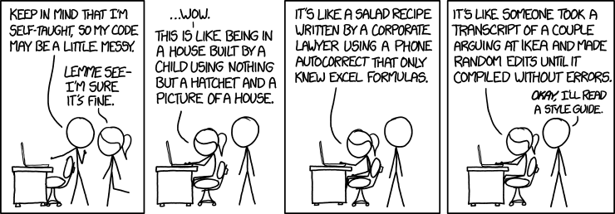
CSc 110, Autumn 2017
Lecture 27: Lists that change size and Tuples
Adapted from slides by Marty Stepp and Stuart Reges

Slide 2
List functions
Function | Description
append(x) | Add an item to the end of the list. Equivalent to a[len(a):] = [x].
extend(L) | Extend the list by appending all the items in the given list. Equivalent to a[len(a):] = L
insert(i, x) | Inserts an item at a given position. i is the index of the element before which to insert, so a.insert(0, x) inserts at the front of the list.
remove(x) | Removes the first item from the list whose value is x. Errs if there is no such item.
pop(i) | Removes the item at the given position in the list, and returns it. a.pop() removes and returns the last item in the list.
clear() | Remove all items from the list.
index(x) | Returns the index in the list of the first item whose value is x. Errs if there is no such item.
count(x) | Returns the number of times x appears in the list.
sort() | Sort the items of the list
reverse() | Reverses the elements of the list
copy() | Return a copy of the list.

Slide 3
Lists that change size
Sometimes we don't know how big we want our list to be when our program starts
It can be useful to create an empty list and fill it up.
data = []
data.append("hello")
data.append("world")
print(data) # ['hello', 'world']
How would we insert another word in the middle?

Slide 4
Exercise
Write a function called remove_duplicates that takes a sorted list of numbers and removes any duplicates. For example, if it is called on the following list:
data = [-2, 1, 1, 3, 3, 3, 4, 5, 6, 78, 78, 79]
after the call the list should be
data = [-2, 1, 3, 4, 5, 6, 78, 79]

Slide 5
Looping and removing
When you loop through a list and remove elements you change the length of the list. This means you need to change your upper bound as you are looping.
You must use a while loop when removing items from a list
A for i in range loop won't work as it can't adjust when the length of the list changes
A for num in data loop won't work as it cannot alter the list.

Slide 6
Solution
def remove_duplicates(data):
i = 0
while i < len(data) - 1:
if data[i] == data[i + 1]:
data.pop(i)
else: # we don't want to move on
i += 1 # to the next element if we
# remove as that will me we
# will skip the one that
# just moved back into the one
# we removed's place

Slide 7
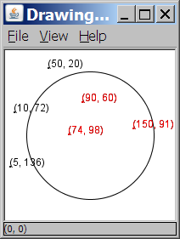
A programming problem
Given a file of cities' names and (x, y) coordinates:
Winslow 50 20
Tucson 90 60
Phoenix 10 72
Bisbee 74 98
Yuma 5 136
Page 150 91
Write a program to draw the cities on a DrawingPanel, then simulates an earthquake that turns all cities red that are within a given radius:
Epicenter x? 100
Epicenter y? 100
Affected radius? 75

Slide 8
A bad solution
lines = open("cities.txt").readlines()
names = [0] * len(lines)
x_coords = [0] * len(lines)
y_coords = [0] * len(lines)
for i in range(0, len(lines)):
parts = lines[i].split()
names[i] = parts[0]
x_coords[i] = parts[1] # read each city
y_coords[i] = parts[2]
...
parallel lists: 2+ lists with related data at same indexes.
Considered poor style.

Slide 9
Observations
The data in this problem is a set of points.
It would be better stored together

Slide 10
Tuples
A sequence similar to a list but it cannot be altered
Good for storing related data
We mainly store the same type of data in a list
We usually store related things in tuples
Creating tuples
name = (data, other_data, … , last_data)
tuple = ("Tucson", 80, 90)

Slide 11
Using tuples
You can access elements using [] notation, just like lists and strings
tuple = ("Tucson", 80, 90)
low = tuple[1]
You cannot update a tuple!
Tuples are immutable
You can loop through tuples
the same as lists
operation | call | result
len() | len((1, 2, 3)) | 3
+ | (1, 2, 3) + (4, 5, 6) | (1, 2, 3, 4, 5, 6)
* | ('Hi!',) * 4 | ('Hi!', 'Hi!', 'Hi!', 'Hi!')
in | 3 in (1, 2, 3) | True
for | for x in (1,2,3): print x, | 1 2 3
min() | min((1, 3)) | 1
max() | max((1, 3)) | 3

Slide 12
Days till
Write a function called days_till that accepts a start month and day and a stop month and day and returns the number of days between them
call return
days_till("december", 1, "december", 10) 9
days_till("novembeR", 15, "december", 10) 25
days_till("OCTober", 6, "december", 17) 72
days_till("october", 6, "ocTober", 1) 360

Slide 13
Days till solution
def days_till(start_month, start_day, stop_month, stop_day):
months = (('january', 31),('february', 28),('march', 31),('april', 30), ('may', 31),('june', 30),
('july', 31), ('august', 31),('september', 30), ('october', 31), ('november', 30), ('december', 31))
if start_month.lower() == stop_month.lower() and stop_day >= start_day:
return stop_day - start_day
days = 0
for i in range(0, len(months)):
month = months[i]
if month[0] == start_month.lower():
days = month[1] - start_day
i += 1
while months[i % 12][0] != stop_month.lower():
days += months[i % 12][1]
i += 1
days += stop_day
return days

