Slide 1
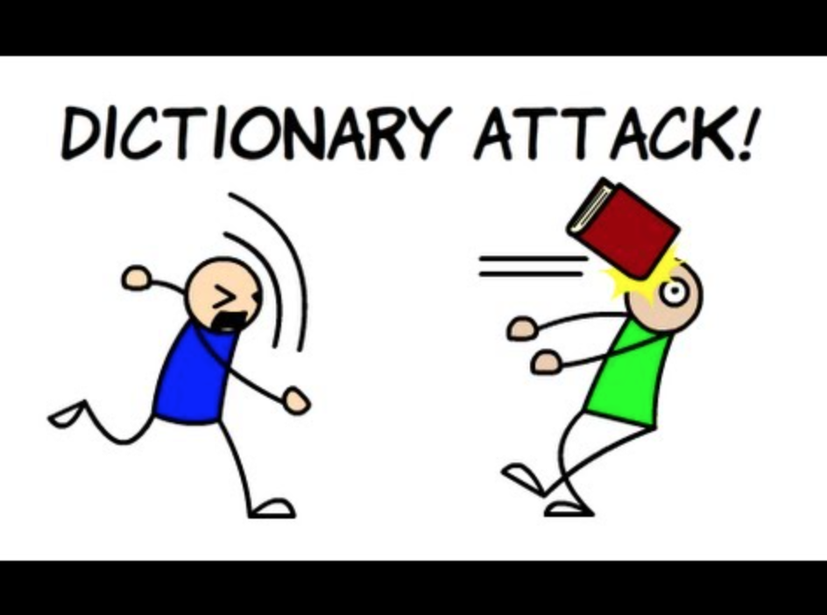
CSc 110, Autumn 2017
Lecture 31: Dictionaries
Adapted from slides by Marty Stepp and Stuart Reges

Slide 2
Exercise
Write a program to count the number of occurrences of each unique word in a large text file (e.g. Moby Dick ).
Allow the user to type a word and report how many times that word appeared in the book.
Report all words that appeared in the book at least 500 times.
What structure is appropriate for this problem?

Slide 3
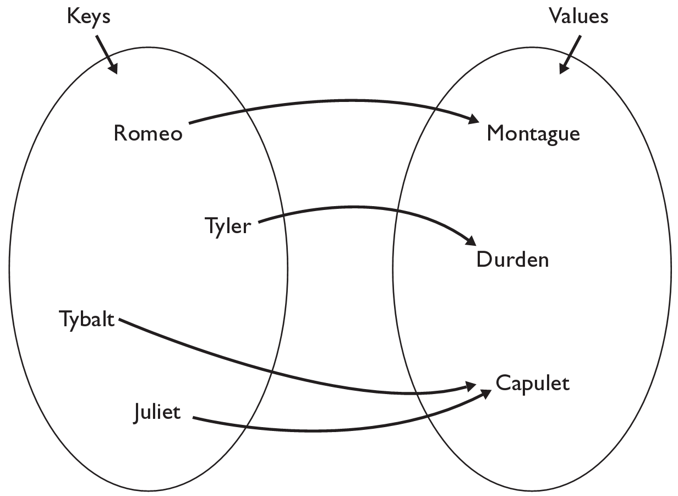
Dictionaries
dictionary: Holds a set of unique keys and a collection of values, where each key is associated with one value.
a.k.a. "map", "associative array", "hash"
basic dictionary operations:
Add a mapping from a key to a value.
Retrieve a value mapped to a key.
Remove a given key and its mapped value.

Slide 4
Creating dictionaries
Creating a dictionary
{key : value, …, key : value}
my_dict = {"Romeo": "Montague",
"Tyler" :"Durden",
"Tybalt" : "Capulet",
"Juliet" :"Capulet" }
my_dict[key] = value
adds a mapping from the given key to the given value; if the key already exists, replaces its value with the given one
Accessing values:
my_dict[key]
returns the value mapped to the given key (error if key not found)
my_dict["Juliet"] produces "Capulet"

Slide 5
Using dictionaries
A dictionary allows you to get from one half of a pair to the other.
Remembers one piece of information about every index (key).
Later, we can supply only the key and get back the related value:
Allows us to ask: What is Suzy's phone number?
# key value
my_dict["Suzy"] = "206-685-2181"
Dictionary
my_dict["Suzy"]
Dictionary
"206-685-2181"

Slide 6
Dictionaries and tallying
a dictionary can be thought of as generalization of a tallying list
the "index" (key) doesn't have to be an int
count digits: 22092310907
# (Roosevelt), (L)andon, (I)ndependent
count votes: "RLLLLLLRRRRRLLLLLLRLRRIRLRRIRLLRIR"
index | 0 | 1 | 2 | 3 | 4 | 5 | 6 | 7 | 8 | 9
value | 3 | 1 | 3 | 0 | 0 | 0 | 0 | 1 | 0 | 2
"R"
15
key | "R" | "L" | "I"
value | 15 | 15 | 3
"L"
3
"I"
15
keys
values

Slide 7
Dictionary operations
items() | return a new view of the dictionary’s items ((key, value) pairs)
pop(key) | removes any existing mapping for the given key and returns it (error if key not found)
popitem() | removes and returns an arbitrary (key, value) pair (error if empty)
keys() | returns the dictionary's keys
values() | returns the dictionary's values
You can also use in, len(), etc.

Slide 8
Looping over a set or dictionary?
You must use a for element in structure loop
needed because sets have no indexes; can't get element i
Example:
for item in a:
print(item)
Outputs:
the
happy
hello

Slide 9
items, keys and values
items function returns tuples of each key-value pair
can loop over the keys in a for loop
ages = {}
ages["Merlin"] = 4
ages["Chester"] = 2
ages["Purrcival"] = 12
for cat, age in ages.items():
print(cat + " -> " + str(age))
values function returns all values in the dictionary
no easy way to get from a value to its associated key(s)
keys function returns all keys in the dictionary

Slide 10
Exercise
Use word counts to figure out if a document is positive or negative
Count all of the positive words and count all of the negative words.
Whichever count is bigger is the sentiment of the document.
How do we know which words are positive and which are negative?

Slide 11
Exercise
Consider the following function:
def mystery(list1, list2):
result = {}
for i in range(0, len(list1)):
result[list1[i]] = list2[i]
result[list2[i]] = list1[i]
return result
What is returned after calls with the following parameters?
list1: [b, l, u, e] list2: [s, p, o, t]
dictionary returned:__________________________________________________________
list1: [k, e, e, p] list2: [s, a, f, e]
dictionary returned:__________________________________________________________
list1: [s, o, b, e, r] list2: [b, o, o, k, s]
dictionary returned:__________________________________________________________

