Slide 1
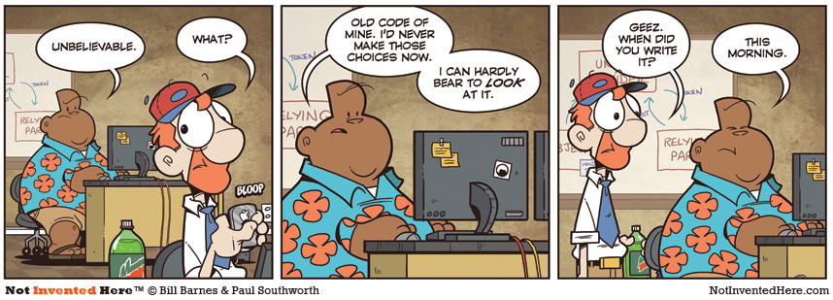
CSc 110, Autumn 2017
Lecture 33: 2D Structures
Adapted from slides by Marty Stepp and Stuart Reges

Slide 2
Exercise
We would like to store data for the class so that we can:
Access the entire class list easily
Access a section list easily
What structure is appropriate for this problem?
Sometimes it can be helpful to store a structure inside another structure

Slide 3
What is the right structure?
You want to store a bunch of colors so you can later choose one at random.
Batting order of a baseball team.
Students names and their grades on a project.
Friends names and their phone numbers
Height, width and location of a sports field.
Movies a person has watched.
Items in a shopping cart.
A student's grades.

Slide 4
What is the right structure?
The grades for all students in a class
All books in a store arranged by category
Many recipes each containing many steps
Phone numbers that have been called this month on a phone plan divided by area and country code for billing simplicity

