Slide 1
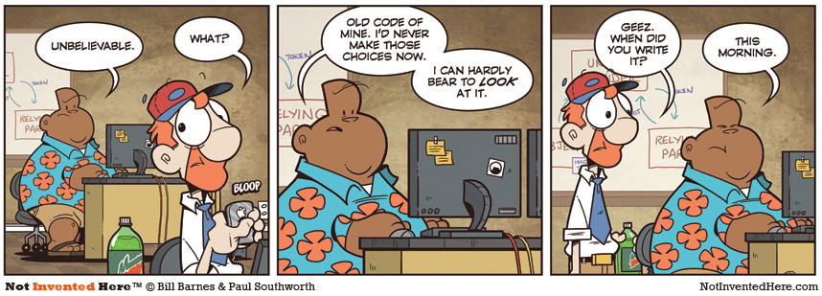
CSc 110, Autumn 2017
Lecture 33: 2D Structures
Adapted from slides by Marty Stepp and Stuart Reges

Slide 2
2d Structure Review
Given the following structure:
grades = {'Ali':[10, 16, 20, 13, 3, 17],
'Ken':[9, 16, 8, 19, 20, 20],
'Daniel':[8, 10, 20, 20, 20, 20]}
How can I access Ken's grade on project 3?
How can I find out how many students are in my class / grades?
How can I find out how many projects a student has done?

Slide 3
Exercise
What does the following code produce?
def main():
grades = {'Ali':[10, 16, 20, 13, 3, 17],
'Ken':[9, 16, 8, 19, 20, 20],
'Daniel':[8, 10, 20, 20, 20, 20]}
print(mystery(grades, 2))
def mystery(grades, i):
total = 0
for student in grades:
total += grades[student][i]
return total / len(grades)

Slide 4
Exercise
Write a function to calculate the average grade of all students on all assignments.
How can we get access to each grade?
How can we know how many grades we need to sum?

Slide 5
Exercise
Write a function that returns a list where each element in the list is the average score for that particular assignment number.

Slide 6
Exercise
Write a function that returns the project number that the student scored highest on.
Use the list sort function

