Slide 1
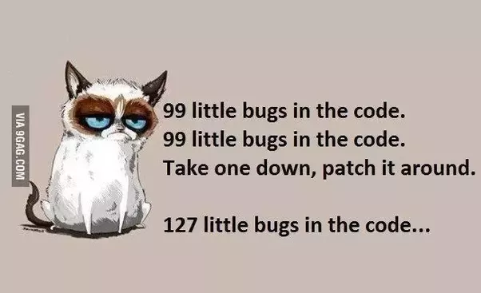
CSc 110, Autumn 2017
Lecture 37: searching and sorting
Adapted from slides by Marty Stepp and Stuart Reges

Slide 2
Using binary_search
# index 0 1 2 3 4 5 6 7 8 9 10 11 12 13 14 15
a = [-4, 2, 7, 9, 15, 19, 25, 28, 30, 36, 42, 50, 56, 68, 85, 92]
index1 = binary_search(a, 42)
index2 = binary_search(a, 21)
index3 = binary_search(a, 17, 0, 16)
index2 = binary_search(a, 42, 0, 10)
binary_search returns the index of the number
or
- (index where the value should be inserted + 1)

Slide 3
binary_search
Write the following two functions:
# searches an entire sorted list for a given value
# returns the index the value should be inserted at to maintain sorted order
# Precondition: list is sorted
binary_search(list, value)
# searches given portion of a sorted list for a given value
# examines min_index (inclusive) through max_index (exclusive)
# returns the index of the value or -(index it should be inserted at + 1)
# Precondition: list is sorted
binary_search(list, value, min_index, max_index)

Slide 4
Binary search code
# Returns the index of an occurrence of target in a,
# or a negative number if the target is not found.
# Precondition: elements of a are in sorted order
def binary_search(a, target, start, stop):
min = start
max = stop - 1
while min <= max:
mid = (min + max) // 2
if a[mid] < target:
min = mid + 1
elif a[mid] > target:
max = mid - 1
else:
return mid # target found
return -(min + 1) # target not found

Slide 5
Sorting
sorting: Rearranging the values in a list into a specific order (usually into their "natural ordering").
one of the fundamental problems in computer science
can be solved in many ways:
there are many sorting algorithms
some are faster/slower than others
some use more/less memory than others
some work better with specific kinds of data
some can utilize multiple computers / processors, ...
comparison-based sorting : determining order by comparing pairs of elements:
<, >, …

Slide 6
Sorting algorithms
bogo sort: shuffle and pray
bubble sort: swap adjacent pairs that are out of order
selection sort: look for the smallest element, move to front
insertion sort: build an increasingly large sorted front portion
merge sort: recursively divide the list in half and sort it
heap sort: place the values into a sorted tree structure
quick sort: recursively partition list based on a middle value
other specialized sorting algorithms:
bucket sort: cluster elements into smaller groups, sort them
radix sort: sort integers by last digit, then 2nd to last, then ...
...

Slide 7
Bogo sort
bogo sort: Orders a list of values by repetitively shuffling them and checking if they are sorted.
name comes from the word "bogus"
The algorithm:
Scan the list, seeing if it is sorted. If so, stop.
Else, shuffle the values in the list and repeat.
This sorting algorithm (obviously) has terrible performance!

Slide 8
Bogo sort code
# Places the elements of a into sorted order.
def bogo_sort(a):
while (not is_sorted(a)):
shuffle(a)
# Returns true if a's elements
#are in sorted order.
def is_sorted(a):
for i in range(0, len(a) - 1):
if (a[i] > a[i + 1]):
return False
return True
# Swaps a[i] with a[j].
def swap(a, i, j):
if (i != j):
temp = a[i]
a[i] = a[j]
a[j] = temp
# Shuffles a list by randomly swapping each
# element with an element ahead of it in the list.
def shuffle(a):
for i in range(0, len(a) - 1):
# pick a random index in [i+1, a.length-1]
range = len(a) - 1 - (i + 1) + 1
j = (random() * range + (i + 1))
swap(a, i, j)

Slide 9
Selection sort
selection sort: Orders a list of values by repeatedly putting the smallest or largest unplaced value into its final position.
The algorithm:
Look through the list to find the smallest value.
Swap it so that it is at index 0.
Look through the list to find the second-smallest value.
Swap it so that it is at index 1.
...
Repeat until all values are in their proper places.

Slide 10
Selection sort example
Initial list:
After 1st, 2nd, and 3rd passes:
index | 0 | 1 | 2 | 3 | 4 | 5 | 6 | 7 | 8 | 9 | 10 | 11 | 12 | 13 | 14 | 15 | 16
value | 22 | 18 | 12 | -4 | 27 | 30 | 36 | 50 | 7 | 68 | 91 | 56 | 2 | 85 | 42 | 98 | 25
index | 0 | 1 | 2 | 3 | 4 | 5 | 6 | 7 | 8 | 9 | 10 | 11 | 12 | 13 | 14 | 15 | 16
value | -4 | 18 | 12 | 22 | 27 | 30 | 36 | 50 | 7 | 68 | 91 | 56 | 2 | 85 | 42 | 98 | 25
index | 0 | 1 | 2 | 3 | 4 | 5 | 6 | 7 | 8 | 9 | 10 | 11 | 12 | 13 | 14 | 15 | 16
value | -4 | 2 | 12 | 22 | 27 | 30 | 36 | 50 | 7 | 68 | 91 | 56 | 18 | 85 | 42 | 98 | 25
index | 0 | 1 | 2 | 3 | 4 | 5 | 6 | 7 | 8 | 9 | 10 | 11 | 12 | 13 | 14 | 15 | 16
value | -4 | 2 | 7 | 22 | 27 | 30 | 36 | 50 | 12 | 68 | 91 | 56 | 18 | 85 | 42 | 98 | 25

Slide 11
Selection sort code
# Rearranges the elements of a into sorted order using
# the selection sort algorithm.
def selection_sort(a):
for i in range(0, len(a) - 1):
# find index of smallest remaining value
min = i
for j in range(i + 1, len(a)):
if (a[j] < a[min]):
min = j
# swap smallest value its proper place, a[i]
swap(a, i, min)

Slide 12
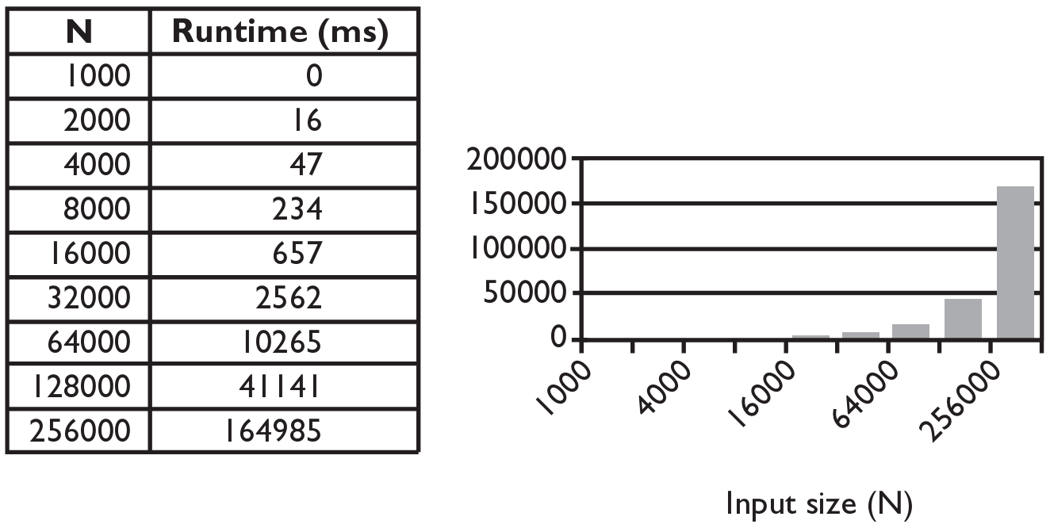
Selection sort runtime (Fig. 13.6)
How many comparisons does selection sort have to do?

Slide 13
Similar algorithms
bubble sort: Make repeated passes, swapping adjacent values
slower than selection sort (has to do more swaps)
insertion sort: Shift each element into a sorted sub-list
faster than selection sort (examines fewer values)
index | 0 | 1 | 2 | 3 | 4 | 5 | 6 | 7 | 8 | 9 | 10 | 11 | 12 | 13 | 14 | 15 | 16
value | 22 | 18 | 12 | -4 | 27 | 30 | 36 | 50 | 7 | 68 | 91 | 56 | 2 | 85 | 42 | 98 | 25
index | 0 | 1 | 2 | 3 | 4 | 5 | 6 | 7 | 8 | 9 | 10 | 11 | 12 | 13 | 14 | 15 | 16
value | 18 | 12 | -4 | 22 | 27 | 30 | 36 | 7 | 50 | 68 | 56 | 2 | 85 | 42 | 91 | 25 | 98
22
50
91
98
index | 0 | 1 | 2 | 3 | 4 | 5 | 6 | 7 | 8 | 9 | 10 | 11 | 12 | 13 | 14 | 15 | 16
value | -4 | 12 | 18 | 22 | 27 | 30 | 36 | 50 | 7 | 68 | 91 | 56 | 2 | 85 | 42 | 98 | 25
sorted sub-list (indexes 0-7)
7

