Slide 1
CSc 110, Spring 2017
Introduction to Programming I
Lecture 1: Introduction; Basic Python Programs
Adapted from slides by Marty Stepp and Stuart Reges

Slide 2
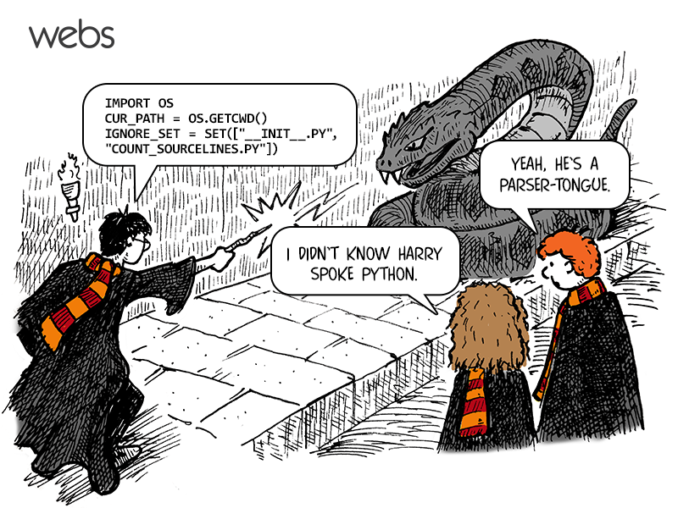
CSc 110: Introduction to Computer Programming I

Slide 3
Course Staff
Allison Obourn (aeobourn@cs.arizona.edu)
B.S. M.S. Computer Science and Engineering - University of Washington
Lecturer - University of Washington
Janalee O’Bagy (jobagy@cs.arizona.edu)
B.S. Math, Ph.D. Computer Science – University of Arizona
Academia – University of Virginia
Industry
High Availability Systems Architect (clients such as Apple, Inc.)
Software Developer (part of a team that implemented a soft real-time version of Java)
Independent Futures Trader (S&P mini-Futures)
Section Leaders
Your primary point of contact
Ask them about their experiences in CSc

Slide 4
Computer Science
CS is about PROCESS – describing how to accomplish tasks
Algorithm: a step-by-step procedure for solving a problem
Computers are “brainless” machines that execute specific instructions; they have perfect memories
Our task is to develop those very specific instructions for the problem at hand
Computers are a tool
Currently the best implementation platform
What kinds of problems can they solve?
Science?
More like engineering, art, magic…
Hypothesis creation, testing, refinement important

Slide 5
Take this course if you…
… like solving problems
… like building things
… (will) work with data sets or very large data sets
… are curious about how Facebook, Google, etc work
… have never written a computer program before
… are shopping around for a major
110 is a good predictor of who will enjoy and succeed in CSc

Slide 6
Programming
program: A set of instructions to be carried out by a computer
program execution: The act of carrying out the instructions contained in a program.
programming language: A set of rules used to describe computations in a format that is readable by humans.

Slide 7
Programming
A programming language specification consists of two parts
syntax: specifies the sequences of symbols that are valid programs in the language
semantics: specifies the meaning of a sequence of symbols
Example of syntax and semantics from math:
(3,8)
a point in a coordinate plane

Slide 8
Some modern languages
procedural languages: programs are a series of commands
Pascal (1970): designed for education
C (1972): low-level operating systems and device drivers
functional programming: functions map inputs to outputs
Lisp (1958) / Scheme (1975), ML (1973), Haskell (1990)
object-oriented languages: programs use interacting "objects"
Smalltalk (1980): first major object-oriented language
C++ (1985): "object-oriented" improvements to C
successful in industry; used to build major OSes such as Windows
Python (1991):
The language taught in this course

Slide 9
Why Python?
Expressive language
expresses complex ideas in a simple way
strong philosophy
well-designed
Object-oriented
Pre-written software
Widely used

Slide 10
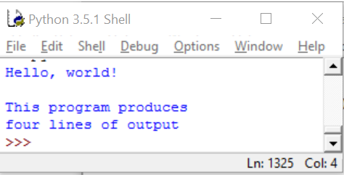
A Python program
print("Hello, world!")
print()
print("This program produces")
print("four lines of output")
Its output:
Hello, world!
This program produces
four lines of output
console: Text box into which the program's output is printed.

Slide 11
print
Used to print a line of output on the console
Two ways to use print :
print("…text…")
Prints the given message as output.
print()
Prints a blank line of output.
Notes:
11

Slide 12
Strings and escape sequences

Slide 13
Strings
string: A sequence of characters
Starts and ends with a " quote " character or a ' quote ' character.
The quotes do not appear in the output when printed
Examples: "hello" "This is a string. It's very long!" 'Here is "another" with quotes in'
Syntax Rules:
Strings surrounded by " " or ' ' may not span multiple lines "This is not a legal String."
Strings surrounded by " " may not contain a " character. "This is not a "legal" String either."
Strings surrounded by ' ' may not contain a ' character. 'This is not a 'legal' String either.‘
Strings surrounded by 3 " may span lines.
"""I can span multiple lines because I'm surrounded by 3 double quotes""""
Notes:
13

Slide 14
Problem: What if you want to have both double and single quotes in the output?
Consider printing the following output:
She said, “Who’s there?”
The syntax rules tell us the following is not correct:
print("She said, "Who’s there?")
We need a new convention to express this, i.e., more syntax and semantics.

Slide 15
Escape sequences
escape sequence: A sequence of characters used to represent certain special characters in a string.
\t tab character
\n new line character
\" quotation mark character
\\ backslash character
Example: print("\\hello\nhow\tare \"you\"?\\\\")
Output: \hello how are "you"?\\

Slide 16
Questions
What is the output of the following print statements?
print("She said, \"Who’s there?\"")
print("\\\\")
print("'")
print("\"\"\"")
print("C:\nin\the directory")
Write a print statement to produce this output:
/ \ // \\ /// \\\

Slide 17
Answers
Output of each print statement:
"She said, Who’s there?"
\\
'
"""
C:
in he directory
print statement to produce the line of output:
print("/ \\ // \\\\ /// \\\\\\")

Slide 18
Questions
What print statements will generate this output?
This quote is from
Irish poet Oscar Wilde:
"Music makes one feel so romantic
- at least it always gets on one's nerves –
which is the same thing nowadays."
What print statements will generate this output?
A "quoted" String is
'much' better if you learn
the rules of "escape sequences."
Also, "" represents an empty String.
Don't forget: use \" instead of " !
'' is not the same as "

Slide 19
Answers
print statements to generate the output:
print("This quote is from")
print("Irish poet Oscar Wilde:”)
print()
print("\"Music makes one feel so romantic")
print("- at least it always gets on one's nerves -")
print("which is the same thing nowadays.\"")
print statements to generate the output:
print("A \"quoted\" String is")
print("'much' better if you learn")
print("the rules of \"escape sequences.\"")
print()
print("Also, \"\" represents an empty String.")
print("Don't forget: use \\\" instead of \" !")
print("'' is not the same as \"")

Slide 20
Keywords
keyword: An identifier that you cannot use because it already has a reserved meaning in Python.
and del from not while
as elif global or with
assert else if pass yield
break except import print
class exec in raise
continue finally is return
def for lambda try

