Slide 1
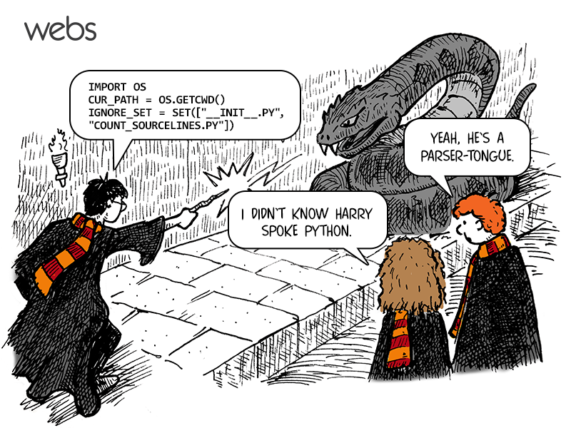
CSc 110, Spring 2017
Lecture 2: Functions
Adapted from slides by Marty Stepp and Stuart Reges

Slide 2
Review
From last lecture: print, strings, escape sequences.
What is the output of the following statement?
print("Who said,\"To thine own self be true.\"?")
Write a print statement to produce this output:
/ \ // \\ /// \\\

Slide 3
Comments
comment: A note written in source code by the programmer to describe or clarify the code.
Comments are not executed when your program runs.
Syntax:
# comment text
Python statement # comment text
Examples:
# This is a one-line comment.
# This is a very long
# multi-line comment.
print("Hello!") # Output a greeting

Slide 4
Comments example
# Suzy Student
# CSc 110
# Displays lyrics
# first part
print("When I first got into magic")
print("it was an underground phenomenon")
print()
# second part
print("Now everybody's like")
print("pick a card, any card")

Slide 5
functions

Slide 6
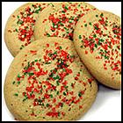
Algorithms
algorithm: A list of steps for solving a problem.
Example algorithm: "Bake sugar cookies"
Mix the dry ingredients.
Cream the butter and sugar.
Beat in the eggs.
Stir in the dry ingredients.
Set the oven temperature.
Set the timer for 10 minutes.
Place the cookies into the oven.
Allow the cookies to bake.
Mix ingredients for frosting.
Spread frosting and sprinkles onto the cookies.

Slide 7
Problems with this algorithm
lack of structure: Many steps; tough to follow at a glance.
What if there is batter for 24 cookies and the baking sheet fits only 12?
Mix the dry ingredients.
Cream the butter and sugar.
Beat in the eggs.
Stir in the dry ingredients.
Set the oven temperature.
Set the timer for 10 minutes.
Place the first batch of cookies into the oven.
Allow the cookies to bake.
Set the oven temperature.
Set the timer for 10 minutes.
Place the second batch of cookies into the oven.
Allow the cookies to bake.
Mix ingredients for frosting.
Spread frosting and sprinkles on the cookies
Repetition: Steps are listed twice

Slide 8
Structured algorithms
structured algorithm: Decomposed into related tasks.
1 Make the batter.
Mix the dry ingredients.
Cream the butter and sugar.
Beat in the eggs.
Stir in the dry ingredients.
2 Bake the cookies.
Set the oven temperature.
Set the timer for 10 minutes.
Place the cookies into the oven.
Allow the cookies to bake.
3 Decorate the cookies.
Mix the ingredients for the frosting.
Spread frosting and sprinkles onto the cookies.

Slide 9
Removing repetition
A well-structured algorithm can describe repeated steps easily.
1 Make the batter.
Mix the dry ingredients.
...
2a Bake the cookies (first batch).
Set the oven temperature.
Set the timer for 10 minutes.
...
2b Bake the cookies (second batch).
Repeat Step 2a
3 Decorate the cookies.
Mix the ingredients for the frosting.
…

Slide 10
functions
function: A named sequence of statements.
supports the creation of well-structured programs
eliminates repetition by code reuse
procedural decomposition: dividing a problem or sequence of statements into functions
Example: def print_warning(): print("This product causes cancer") print("in lab rats and humans.")

Slide 11
Declaring a function
Gives your function a name so it can be executed
Syntax: def name(): statement statement ... Statement
Function names: Consist of upper and lower case letters, "_", and digits 0 through 9.
Example: def print_warning(): print("This product causes cancer") print("in lab rats and humans.")
Space is part of the syntax.
Statements in a function
must have the same level of indentation.

Slide 12
Calling a function
Executes the statements within a function
Syntax:
name()
You can call the same function many times if you like.
Example:
print_warning() #using underscores makes names readable
Output:
This product causes cancer
in lab rats and humans.

Slide 13
Using functions
1. Design (think about) the algorithm.
Look at the structure and identify which statements are repeated.
Decide what are the important overall tasks.
2. Declare (write down) the functions.
Arrange statements into groups and give each group a name.
3. Call (run) the function.

Slide 14
Program with functions
rap() # Calling (running) the rap function
print()
rap() # Calling the rap function again
# This function prints the lyrics to my favorite song.
def rap():
print("Now this is the story all about how")
print("My life got flipped turned upside-down")
Output:
Now this is the story all about how
My life got flipped turned upside-down
Now this is the story all about how
My life got flipped turned upside-down

Slide 15
Functions calling functions
def message1():
print("This is message1.")
def message2():
print("This is message2.")
message1()
print("Done with message2.")
message1()
message2()
print("All done.")
Output:
This is message1.
This is message2.
This is message1.
Done with message2.
All done.

Slide 16
Control flow
When a function is called, the program's execution...
"jumps" into that function, executing its statements, then
"jumps" back to the point where the function was called.
message1()
message2()
print("All done.")
...
def message1():
print("This is message1.")
def message2():
print("This is message2.")
message1()
print("Done with message2.")
def message1():
print("This is message1.")

Slide 17
Structure of a program
Best practice for well-structured programs: all code should be placed inside a function.
def message1():
print("This is message1.")
def message2():
print("This is message2.")
message1()
print("Done with message2.")
message1()
message2()
print("Done with all.")
def main():
message1()
message2()
print("Done with all.")
def message1():
print("This is message1.")
def message2():
print("This is message2.")
message1()
print("Done with message2.")
main()
Use a function called main.

Slide 18
When to use functions (besides main)
Place statements into a function if:
The statements are related structurally, and/or
The statements are repeated.
You should not create functions for:
An individual print statement.
Unrelated or weakly related statements. (Consider splitting them into two smaller functions.)

Slide 19
Drawing complex figures with functions

Slide 20
Problem
Write a program to print these figures using functions.
______
/ \
/ \
\ /
\______/
\ /
\______/
+--------+
______
/ \
/ \
| STOP |
\ /
\______/
______
/ \
/ \
+--------+

Slide 21
Development strategy
______
/ \
/ \
\ /
\______/
\ /
\______/
+--------+
______
/ \
/ \
| STOP |
\ /
\______/
______
/ \
/ \
+--------+
Approach – simply get this to print correctly
First version (unstructured):
Start IDLE. File->open -> new
Copy the expected output into it, surrounding each line with print syntax.
Run it to verify the output.

Slide 22
Program version 1
def main():
print(" ______")
print(" / \\")
print("/ \\")
print("\\ /")
print(" \\______/")
print()
print("\\ /")
print(" \\______/")
print("+--------+")
print()
print(" ______")
print(" / \\")
print("/ \\")
print("| STOP |")
print("\\ /")
print(" \\______/")
print()
print(" ______")
print(" / \\")
print("/ \\")
print("+--------+")
main()

Slide 23
Development strategy 2
______
/ \
/ \
\ /
\______/
\ /
\______/
+--------+
______
/ \
/ \
| STOP |
\ /
\______/
______
/ \
/ \
+--------+
Second version (structured, with repetition):
Identify the structure of the output.
Divide the code into functions based on this structure.

Slide 24
Output structure
______
/ \
/ \
\ /
\______/
\ /
\______/
+--------+
______
/ \
/ \
| STOP |
\ /
\______/
______
/ \
/ \
+--------+
The structure of the output:
initial "egg" figure
second "teacup" figure
third "stop sign" figure
fourth "hat" figure
This structure can be represented by functions:
egg
tea_cup
stop_sign
hat

Slide 25
Program version 2
def main():
egg()
tea_cup()
stop_sign()
hat()
def egg():
print(" ______")
print(" / \\")
print("/ \\")
print("\\ /")
print(" \\______/")
print()
def tea_cup():
print("\\ /")
print(" \\______/")
print("+--------+")
print()
def stop_sign():
print(" ______")
print(" / \\")
print("/ \\")
print("| STOP |")
print("\\ /")
print(" \\______/")
print()
def hat():
print(" ______")
print(" / \\")
print("/ \\")
print("+--------+")

Slide 26
Development strategy 3
______
/ \
/ \
\ /
\______/
\ /
\______/
+--------+
______
/ \
/ \
| STOP |
\ /
\______/
______
/ \
/ \
+--------+
Third version (structured, without repetition):
Identify repetition in the output, and create functions to eliminate as much as possible.
Add comments to the program.

Slide 27
Repetition in the output
______
/ \
/ \
\ /
\______/
\ /
\______/
+--------+
______
/ \
/
| STOP |
\ /
\______/
______
/ \
/ \
+--------+
The redundancy in the output:
egg top: reused on stop sign, hat
egg bottom: reused on teacup, stop sign
divider line: used on teacup, hat
This redundancy can be fixed by functions:
egg_top
egg_bottom
line

Slide 28
Program version 3
# Draws a teacup figure.
def tea_cup():
egg_bottom()
line()
print()
# Draws a stop sign figure.
def stop_sign():
eggTop()
print("| STOP |")
egg_bottom()
print()
# Draws a figure that looks sort of like a hat.
def hat():
egg_top()
line()
# Draws a line of dashes.
def line():
print("+--------+")
# Suzy Student, CSc 110, Spring 2094
# Prints several figures, with functions for structure and redundancy.
def main():
egg()
tea_cup()
stop_sign()
hat()
# Draws the top half of an an egg figure.
def egg_top():
print(" ______")
print(" / \\")
print("/ \\")
# Draws the bottom half of an egg figure.
def egg_bottom():
print("\\ /")
print(" \\______/")
# Draws a complete egg figure.
def egg():
egg_top()
egg_bottom()
print()

