Slide 1
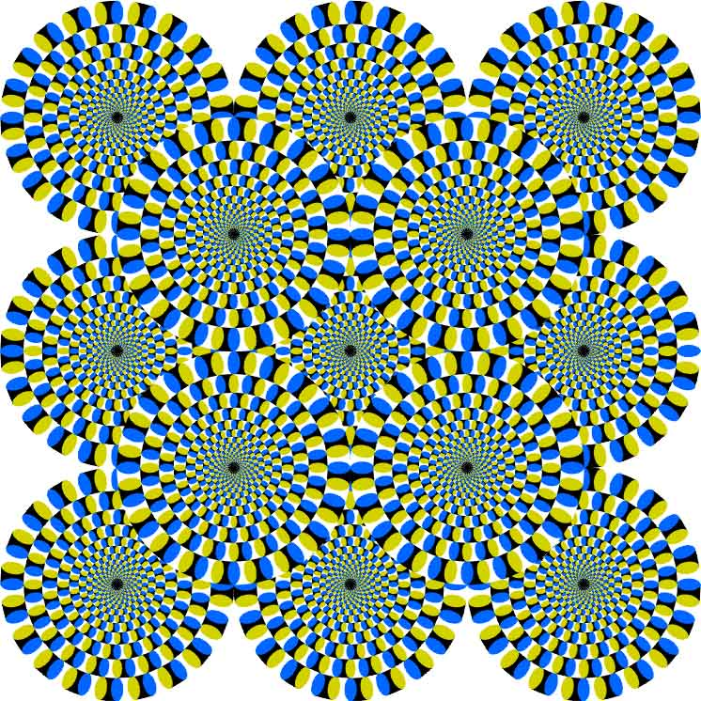
CSc 110, Spring 2017
Lecture 6: Parameters (cont.) and Graphics
Adapted from slides by Marty Stepp and Stuart Reges

Slide 2
Multiple parameters
A function can accept multiple parameters. (separated by , )
When calling it, you must pass values for each parameter.
Declaration:
def <name>(<name>, ..., <name>):
<statement>(s)
Call:
<name>(<exp>, <exp>, ..., <exp>)

Slide 3
Multiple parameters example
def main():
print_number(4, 9)
print_number(17, 6)
print_number(8, 0)
print_number(0, 8)
def print_number(number, count):
for i in range(0, count):
print(number, end="")
print()
Output:
444444444
171717171717
00000000
Modify the stars program to draw boxes with parameters.

Slide 4
Stars solution
# Prints several lines and boxes made of stars.
# Third version with multiple parameterized methods.
def main():
line(13)
line(7)
line(35)
print()
box(10, 3)
box(5, 4)
box(20, 7)
# Prints the given number of
#stars plus a line break.
def line(count):
for i in range(0, count):
print("*", end="")
print()
# Prints a box of stars of the given size.
def box(width, height):
line(width)
for line in range(0, height - 2):
print("*", end="")
for space in range(0, width - 2):
print(" ", end="")
print("*")
line(width)

Slide 5
Stars solution
# Prints several lines and boxes made of stars.
# Third version with multiple parameterized methods.
def main():
line(13)
line(7)
line(35)
print()
box(10, 3)
box(5, 4)
box(20, 7)
# Prints the given number of
#stars plus a line break.
def line(count):
for i in range(0, count):
print("*", end="")
print()
# Prints a box of stars of the given size.
def box(width, height):
line(width)
for line in range(0, height - 2):
print("*", end="")
for space in range(0, width - 2):
print(" ", end="")
print("*")
line(width)

Slide 6
Strings as parameters
say_hello("Allison")
teacher = "Bictolia"
say_hello(teacher)
def say_hello(name):
print("Welcome, " + name)
Output:
Welcome, Allison
Welcome, Bictolia
Modify the stars program to use string parameters. Use a function named repeat that prints a string many times.

Slide 7
Stars solution
# Prints several lines and boxes made of stars.
# Fourth version with String parameters.
def main():
line(13)
line(7)
line(35)
print()
box(10, 3)
box(5, 4)
box(20, 7)
# Prints the given number of
# stars plus a line break.
def line(count):
repeat("*", count)
print()
# Prints a box of stars of the given size.
def box(width, height):
line(width)
for line in range(height – 2):
print("*", end="")
repeat(" ", width - 2)
print("*")
line(width)
# Prints the given String the given
# number of times.
def repeat(s, times):
for i in range(0, times):
print(s, end="")

Slide 8
Value semantics
value semantics: When numbers and strings are passed as parameters, their values are copied.
Modifying the parameter will not affect the variable passed in.
def strange(x):
x = x + 1
print("1. x = " + x)
x = 23
strange(x)
print("2. x = " + x)
...
Output:
1. x = 24
2. x = 23

Slide 9
A "Parameter Mystery" problem
def main():
x = 9
y = 2
z = 5
mystery(z, y, x)
mystery(y, x, z)
def mystery(x, z, y):
print(str(z) + " and " + str(y - x))
Notes:
Output:
2 and 4
9 and 3

Slide 10
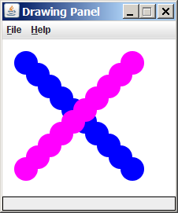
Graphical objects
We will draw graphics in Python using a new kind of object:
DrawingPanel: A window on the screen.
Not part of Python; provided by the instructor. See class web site.

Slide 11
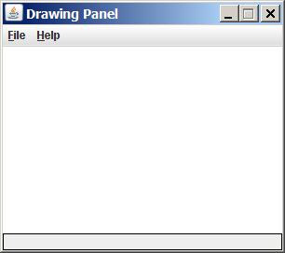
DrawingPanel
Import the program that implements DrawingPanel
from drawingpanel import *
To create a window:
<name> = DrawingPanel(<width>, <height>)
<name> = DrawingPanel(<width>, <height>, background="color")
Example:
panel = DrawingPanel(300, 200)
The window has nothing on it.
We can draw shapes and lines on it.
If passed the optional third parameter
it will have a background color

Slide 12
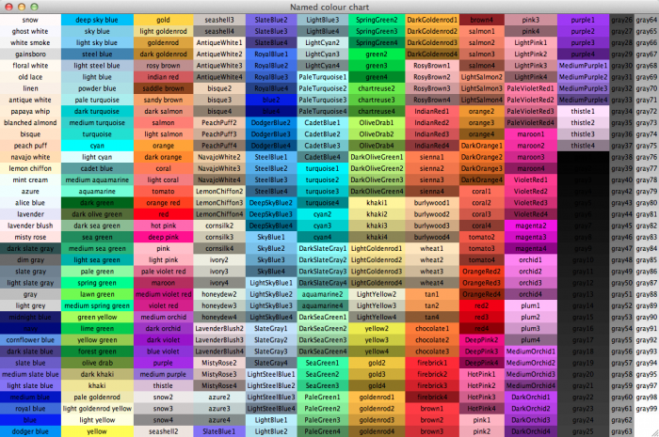
Named colors
Chart credit Smith.edu

Slide 13
Custom colors
You can construct custom colors using hex.
# followed by six numbers 0 – 9 and letters A – F
A is 10, B is 11 and so on
#000000 is black
#FFFFFF is white
Colors get darker as the number gets lower
The first two digits are the amount of red, the next two green, the last two blue
panel = DrawingPanel(80, 50, background="#3367D3")

Slide 14
Coordinate system
Each (x, y) position is a pixel ("picture element").
(0, 0) is at the window's top-left corner.
x increases rightward and the y increases downward.
The rectangle from (0, 0) to (200, 100) looks like this:
(0, 0) x+
(200, 100)
y+

Slide 15
Drawing shapes
panel.canvas.create_line(x1, y1, x2, y2, fill="color")
line between points (x1, y1), (x2, y2) in color
panel.canvas.create_oval(x1, y1, x2, y2, outline="color")
outline largest oval that fits in a box with top-left at (x1, y1) and lower right at (x2, y2) outlined in color
panel.canvas.create_rectangle(x1, y1, x2, y2, outline="color")
outline of rectangle with top-left at (x1, y1) and bottom right at (x2, y2) outlined in color
panel.canvas.create_text(x, y, text="string")
text centered vertically and horizontally around (x, y)

Slide 16
Filled in shapes
To draw a shape with a fill set its fill instead of outline.
from drawingpanel import * # so I can use Graphics
def main():
p = DrawingPanel(150, 70)
# inner red fill
p.canvas.create_rectangle(20, 10, 120, 60, fill="red")
This will automatically fill the shape but give it a black border. To remove the border add width=0.
p.canvas.create_rectangle(20, 10, 120, 60, fill="red", width=0)

Slide 17
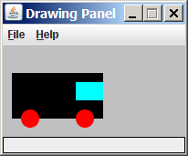
Superimposing shapes
When two shapes occupy the same pixels, the last one drawn is seen.
from drawingpanel import *
def main():
p = DrawingPanel(200, 100, background="light gray")
p.canvas.create_rectangle(10, 30, 110, 80, fill="black")
p.canvas.create_oval(20, 70, 40, 90, fill="red", width=0)
p.canvas.create_oval(80, 70, 100, 90, fill="red", width=0)
p.canvas.create_rectangle(80, 40, 110, 60, fill="cyan", width=0)

Slide 18
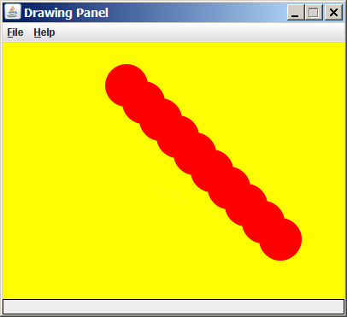
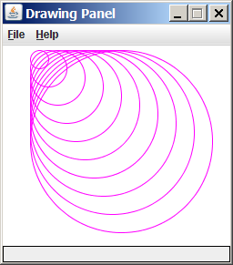
Drawing with loops
The x1, y1, x2, y2 expression can use any variable.
panel = DrawingPanel(400, 300, background="yellow")
for i in range(1, 11):
panel.canvas.create_oval (100 + 20 * i, 5 + 20 * i,
150 + 20 * i, 55 + 20 * i
fill="red", width=0)
panel = DrawingPanel(250, 220)
for i in range(1, 11):
panel.canvas.create_oval (30, 5, 30 + 20 * i,
5 + 20 * i, fill="magenta")

Slide 19
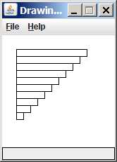
Loops that begin at 0
Beginning a loop at 0 can make coordinates easier to compute.
Example:
Draw ten stacked rectangles starting at (20, 20), height 10, width starting at 100 and decreasing by 10 each time:
panel = DrawingPanel(160, 160)
for i in range(0, 10):
panel.canvas.create_rectangle (20, 20 + 10 * i,
120 – 10 * i, 30 + 10 * i)

Slide 20
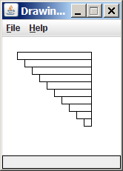
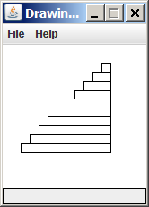
Drawing w/ loops questions
Code from previous slide:
panel = DrawingPanel(160, 160)
for i in range(0, 10):
panel.canvas.create_rectangle (20, 20 + 10 * i,
120 – 10 * i, 30 + 10 * i)
Write variations of the above program that draw the figures at right as output.

Slide 21
Drawing w/ loops answers
Solution #1:
panel = DrawingPanel(160, 160)
for i in range(0, 10):
panel.canvas.create_rectangle (20 + 10 * i, 20 + 10 * i,
120, 30 + 10 * i)
Solution #2:
panel = DrawingPanel(160, 160)
for i in range(0, 10):
panel.canvas.create_rectangle (110 – 10 * i, 20 + 10 * i,
120, 30 + 10 * i)

Slide 22
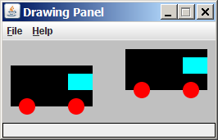
Parameterized figures
Modify the car-drawing function so that it can draw many cars, such as in the following image.
Top-left corners: (10, 30), (150, 10)
Hint: We must modify our draw_car function to accept x/y coordinates as parameters.

Slide 23
Parameterized answer
def main():
panel = DrawingPanel(260, 100, background="light gray")
draw_car(panel, 10, 30)
draw_car(panel, 150, 10)
def draw_car(p, x, y):
p.canvas.create_rectangle(x, y, 100 + x, 50 + y, fill="black")
p.canvas.create_oval(x + 10, y + 40, x + 30, y + 60, fill="red", width=0)
p.canvas.create_oval(x + 70, y + 40, x + 90, y + 60, fill="red", width=0)
p.canvas.create_rectangle(x + 70, y + 10, x + 100, y + 30, fill="cyan",
width=0)

Slide 24
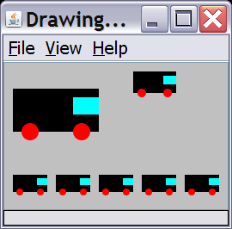
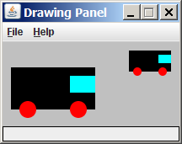
Drawing parameter question
Modify draw_car to allow the car to be drawn at any size.
Existing car: size 100. Second car: (150, 10), size 50.
Once you have this working, use a for loop with your function to draw a line of cars, like the picture at right.
Start at (10, 130), each size 40, separated by 50px.

Slide 25
Drawing parameter answer
def main():
panel = DrawingPanel(260, 100, background="light gray")
draw_car(panel, 10, 30, 100)
draw_car(panel, 150, 10, 50)
for i in range(0, 5):
draw_car(panel, 10 + i * 50, 130, 40);
def draw_car(p, x, y, size):
p.canvas.create_rectangle(x, y, x + size, y + size / 2, fill="black")
p.canvas.create_oval(x + size / 10, y + size / 10 * 4, x + size / 10 * 3, y +
size / 10 * 6, fill="red", width=0)
p.canvas.create_oval(x + size / 10 * 7, y + size / 10 * 4, x + size / 10 * 9,
y + size / 10 * 6, fill="red", width=0)
p.canvas.create_rectangle(x + size / 10 * 7, y + size / 10, x + size,
y + size / 10 * 3, fill="cyan", width=0)

Slide 26
Animation with sleep
DrawingPanel's sleep function pauses your program for a given number of milliseconds.
You can use sleep to create simple animations.
panel = DrawingPanel(250, 200)
for i in range(1, NUM_CIRCLES + 1):
panel.canvas.create_oval(15 * i, 15 * i, 30 + 15 * i, 30 + 15 * i)
panel.sleep(500)
Try adding sleep commands to loops in past exercises in this chapter and watch the panel draw itself piece by piece.

