Slide 1
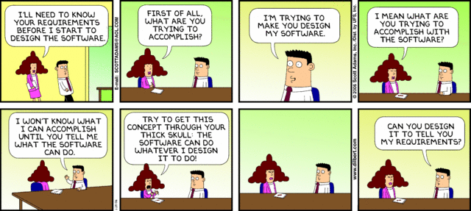
CSc 110, Spring 2017
Lecture 7: Graphics, return values and math

Slide 2
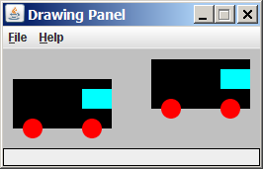
Parameterized figures
Modify the car-drawing function so that it can draw many cars, such as in the following image.
Top-left corners: (10, 30), (150, 10)
Hint: We must modify our draw_car function to accept x/y coordinates as parameters.

Slide 3
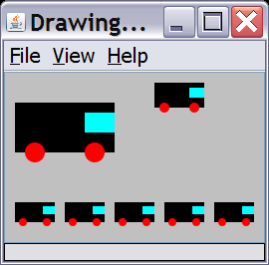
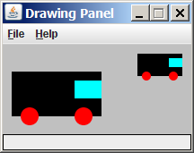
Drawing parameter question
Modify draw_car to allow the car to be drawn at any size.
Existing car: size 100. Second car: (150, 10), size 50.
Once you have this working, use a for loop with your function to draw a line of cars, like the picture at right.
Start at (10, 130), each size 40, separated by 50px.

Slide 4
Drawing parameter answer
def main():
panel = DrawingPanel(260, 100, background="light gray")
draw_car(panel, 10, 30, 100)
draw_car(panel, 150, 10, 50)
for i in range(0, 5):
draw_car(panel, 10 + i * 50, 130, 40);
def draw_car(p, x, y, size):
p.canvas.create_rectangle(x, y, x + size, y + size / 2, fill="black")
p.canvas.create_oval(x + size / 10, y + size / 10 * 4, x + size / 10 * 3, y +
size / 10 * 6, fill="red", width=0)
p.canvas.create_oval(x + size / 10 * 7, y + size / 10 * 4, x + size / 10 * 9,
y + size / 10 * 6, fill="red", width=0)
p.canvas.create_rectangle(x + size / 10 * 7, y + size / 10, x + size,
y + size / 10 * 3, fill="cyan", width=0)

Slide 5
Python's Math class
Method name | Description
ceil(value) | rounds up
floor(value) | rounds down
log(value, base) | logarithm
sqrt(value) | square root
sinh(value) cosh(value) tanh(value) | sine/cosine/tangent of an angle in radians
degrees(value) radians(value) | convert degrees to radians and back
Constant | Description
e | 2.7182818...
pi | 3.1415926...
from math import * necessary to use the above functions
Other math functions:
Function name | Description
abs(value) | absolute value
min(value1, value2) | smaller of two values
max(value1, value2) | larger of two values
round(value) | nearest whole number

Slide 6
No output?
Simply calling these functions produces no visible result.
sqrt(81) # no output
Math function calls use a Python feature called return values that cause them to be treated as expressions.
The program runs the function, computes the answer, and then "replaces" the call with its computed result value.
sqrt(81) # no output 9.0 # no output
To see the result, we must print it or store it in a variable.
result = sqrt(81)
print(result) # 9.0

Slide 7
Return
return: To send out a value as the result of a function.
Return values send information out from a function to its caller.
A call to the function can be used as part of an expression.
(Compare to parameters which send values into a function)
-42
abs(-42)
42
main
2.71
3
ceil(2.71)

Slide 8
Math questions
Evaluate the following expressions:
abs(-1.23)
sqrt(121.0) - sqrt(256.0)
round(pi) + round(e)
ceil(6.022) + floor(15.9994)
abs(min(-3, -5))
max and min can be used to bound numbers.
Consider a variable named age.
What statement would replace negative ages with 0?
What statement would cap the maximum age to 40?

Slide 9
Why return and not print?
It might seem more useful for the math methods to print their results rather than returning them. Why don't they?
Answer: Returning is more flexible than printing.
We can compute several things before printing:
sqrt1 = sqrt(100)
sqrt2 = sqrt(81)
print("Powers are " + str(sqrt1) + " and " + str(sqrt2))
We can combine the results of many computations:
k = 13 * sqrt(49) + 5 - ceil(17.8)

Slide 10
Quirks of real numbers
Some float values print poorly (too many digits).
result = 1.0 / 3.0
print(result) # 0.3333333333333
The computer represents floats in an imprecise way.
print(0.1 + 0.2)
Instead of 0.3, the output is 0.30000000000000004

Slide 11
Returning a value
def name(parameters):
statements
...
return expression
When Python reaches a return statement:
it evaluates the expression
it substitutes the return value in place of the call
it goes back to the caller and continues after the function call

Slide 12
Return examples
# Converts degrees Fahrenheit to Celsius.
def f_to_c(degrees_f):
degrees_c = 5.0 / 9.0 * (degrees_f - 32)
return degrees_c
# Computes triangle hypotenuse length given its side lengths.
def hypotenuse(a, b):
c = sqrt(a * a + b * b)
return c
You can shorten the examples by returning an expression:
def f_to_c(degrees_f):
return 5.0 / 9.0 * (degrees_f - 32)

Slide 13
Common error: Not storing
Many students incorrectly think that a return statement sends a variable's name back to the calling function.
def main():
slope(0, 0, 6, 3)
print("The slope is " + result); # ERROR: cannot find symbol: result
def slope(x1, x2, y1, y2):
dy = y2 - y1
dx = x2 - x1
result = dy / dx
return result

Slide 14
Fixing the common error
Returning sends the variable's value back. Store the returned value into a variable or use it in an expression.
def main():
s = slope(0, 0, 6, 3)
print("The slope is " + str(s))
def slope(x1, x2, y1, y2):
dy = y2 - y1
dx = x2 - x1
result = dy / dx
return result

Slide 15
Exercise
In physics, the displacement of a moving body represents its change in position over time while accelerating.
Given initial velocity v₀ in m/s, acceleration a in m/s², and elapsed time t in s, the displacement of the body is:
Displacement = v₀ t + ½ a t ²
Write a method displacement that accepts v₀, a, and t and computes and returns the change in position.
example: displacement(3.0, 4.0, 5.0) returns 65.0

Slide 16
Exercise solution
def displacement(v0, a, t):
d = v0 * t + 0.5 * a * (t ** 2)
return d

Slide 17
Exercise
If you drop two balls, which will hit the ground first?
Ball 1: height of 600m, initial velocity = 25 m/sec downward
Ball 2: height of 500m, initial velocity = 15 m/sec downward
Write a program that determines how long each ball takes to hit the ground (and draws each ball falling).
Total time is based on the force of gravity on each ball.
Acceleration due to gravity ≅ 9.81 m/s², downward
Displacement = v₀ t + ½ a t ²

Slide 18
Ball solution
# Simulates the dropping of two balls from various heights.
def main():
panel = DrawingPanel(600, 600)
ball1x = 100
ball1y = 0
v01 = 25
ball2x = 200
ball2y = 100
v02 = 15
# draw the balls at each time increment
for time in range(0, 60, 1):
disp1 = displacement(v01, time/10, 9.81)
panel.canvas.create_oval(ball1x, ball1y + disp1, ball1x + 10, ball1y + 10 + disp1)
disp2 = displacement(v02, time/10, 9.81)
panel.canvas.create_oval(ball2x, ball2y + disp2, ball2x + 10, ball2y + 10 + disp2)
panel.sleep(50) # pause for 50 ms
panel.canvas.create_rectangle(0, 0, 600, 600, fill="white", width=0)
...

