Slide 1
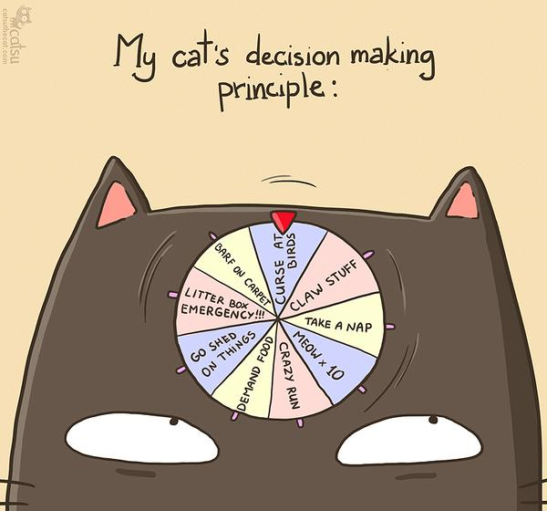
CSc 110, Spring 2017
Lecture 8: input; if/else
Adapted from slides by Marty Stepp and Stuart Reges

Slide 2
Returning a value (review)
def name(parameters):
statements
...
return expression
When Python reaches a return statement:
it evaluates the expression
it substitutes the return value in place of the call
it goes back to the caller and continues after the function call

Slide 3
Functions that return values (review)
Consider a function that prints the square of an integer
def square(n):
sq = n * n
print(sq)
Python also allow functions to return values
def square(n):
sq = n * n
return sq
The program runs the function, computes the answer, and then "replaces" the function call with its computed result value.
To see the result, we must print it or store it in a variable.
result = square(8)
print(result) # 64

Slide 4
Interactive Programs with input

Slide 5
Interactive programs
interactive program: Reads input from the console.
While the program runs, it asks the user to type input.
The input typed by the user is stored in variables in the code.
Can be tricky; users are unpredictable and misbehave.

Slide 6
input
input: A function that reads input from the user.
input: Returns a value of type string
Using the input function to read console input:
name = input(prompt)
Example:
user_name = input("What is your name? ")
The string the user types in is assigned to the variable user_name

Slide 7
input example
def main():
age = input("How old are you? ")
years = 65 - age
print(years + " years until retirement!")
Console (user input underlined):
How old are you?
age | 29
29
Traceback (most recent call last):
File "<pyshell#13>", line 1, in <module>
print(65 - age)
TypeError: unsupported operand type(s) for -: 'int' and 'str'
Notes:
It's also useful to write a program that prompts for multiple values, both on the same line or each on its own line.

Slide 8
input example
def main():
age = int(input("How old are you? "))
years = 65 - age
print(str(years) + " years until retirement!")
Console (user input underlined):
How old are you?
36 years until retirement!
age | 29
years | 36
29
Notes:
It's also useful to write a program that prompts for multiple values, both on the same line or each on its own line.

Slide 9
The if/else statement

Slide 10
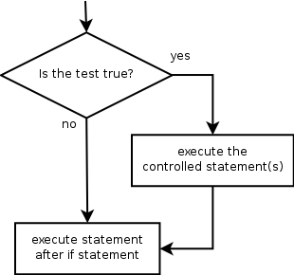
The if statement
Executes a block of statements only if a test is true
if (test):
statement
...
statement
Example:
gpa = float(input("gpa? "))
if (gpa >= 2.0):
print("Application accepted.")

Slide 11
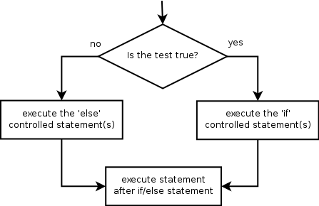
The if/else statement
Executes one block if a test is true, another if false
if (test):
statement(s)
else:
statement(s)
Example:
gpa = float(input("gpa? "))
if (gpa >= 2.0):
print("Welcome to Mars University!")
else:
print("Application denied.")

Slide 12
Relational Operators
if statements use logical tests.
if (test): ...
Test is a boolean expression that produces a literal value of True or False
Tests use relational operators Note the equals "==" !!
Operator | Meaning | Example | Value
== | equals | 1 + 1 == 2 | True
!= | does not equal | 3.2 != 2.5 | True
< | less than | 10 < 5 | False
> | greater than | 10 > 5 | True
<= | less than or equal to | 126 <= 100 | False
>= | greater than or equal to | 5.0 >= 5.0 | True
Notes:
Note that == tests equality, not = . The = is used for the assignment operator!

Slide 13
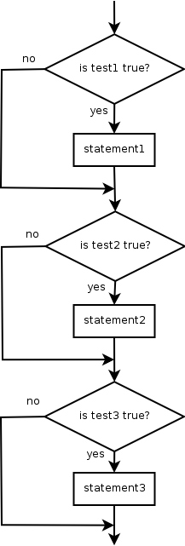
Misuse of if
What's wrong with the following code?
percent = float(input("What percentage did you earn? "))
if (percent >= 90):
print("You got an A!")
if (percent >= 80):
print("You got a B!")
if (percent >= 70):
print("You got a C!")
if (percent >= 60):
print("You got a D!")
if (percent < 60):
print("You got an F!")
...

Slide 14
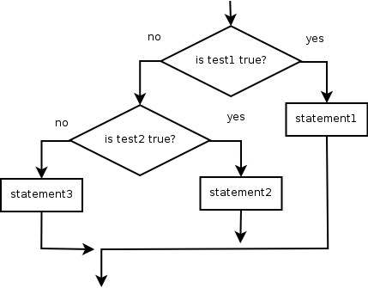
Nested if/else
Chooses between outcomes using many tests
if (test):
statement(s)
elif (test):
statement(s)
else:
statement(s)
Example:
if (x > 0):
print("Positive")
elif (x < 0):
print("Negative")
else:
print("Zero")

Slide 15
Corrected using nested if/else
Now only 1 path is taken
percent = float(input("What percentage did you earn? "))
if (percent >= 90):
print("You got an A!")
elif (percent >= 80):
print("You got a B!")
elif (percent >= 70):
print("You got a C!")
elif (percent >= 60):
print("You got a D!")
else (percent < 60):
print("You got an F!")

Slide 16
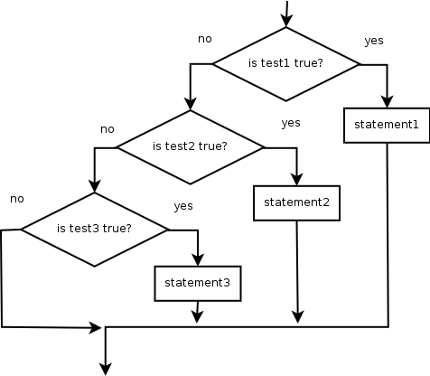
Nested if/else/if
If it ends with else, exactly one path must be taken.
If it ends with if, the code might not execute any path.
if (test):
statement(s)
elif (test):
statement(s)
elif (test):
statement(s)
Example:
if (place == 1):
print("Gold medal!")
elif (place == 2):
print("Silver medal!")
elif (place == 3):
print("Bronze medal.")

Slide 17
Nested if structures
exactly 1 path (mutually exclusive) if (test): statement(s) elif (test): statement(s) else: statement(s) | 0 or 1 path (mutually exclusive) if (test): statement(s) elif (test): statement(s) elif (test): statement(s)
0, 1, or many paths (independent tests; not exclusive) if (test): statement(s) if (test): statement(s) if (test): statement(s)

Slide 18
Which nested if/else?
(1) if/if/if (2) nested if/else (3) nested if/else/if
Whether a user is lower, middle, or upper-class based on income.
(2) nested if / else if / else
Whether you made the dean's list (GPA ≥ 3.8) or honor roll (3.5-3.8).
(3) nested if / else if
Whether a number is divisible by 2, 3, and/or 5.
(1) sequential if / if / if
Computing a grade of A, B, C, D, or F based on a percentage.
(2) nested if / else if / else if / else if / else

Slide 19
Factoring if/else code
factoring: Extracting common/repeated code.
Can reduce or eliminate repetition from if/else code.
Example:
if (a == 1):
print(a)
x = 3
b = b + x
elif (a == 2):
print(a)
x = 6
y = y + 10
b = b + x
else: # a == 3
print(a)
x = 9
b = b + x
print(a)
x = 3 * a
if (a == 2):
y = y + 10
b = b + x

Slide 20
The "dangling if" problem
What can be improved about the following code?
if (x < 0):
print("x is negative")
elif (x >= 0):
print("x is non-negative")
The second if test is unnecessary and can be removed:
if (x < 0):
print("x is negative")
else:
print("x is non-negative")
This is also relevant in functions that use if with return...

Slide 21
if/else with return
# Returns the larger of the two given integers.
def max(a, b):
if (a > b):
return a
else:
return b
Functions can return different values using if/else
Whichever path the code enters, it will return that value.
Returning a value causes a function to immediately exit.
All paths through the code should reach a return statement.

Slide 22
Nested if/else question
Write a program that produces output like the following:
This program reads data for two students and
computes their Computer Science GPAs
Enter next person's information:
CS 110 grade? A
CS 120 grade? B
Enter next person's information:
CS 110 grade? B
CS 120 grade? B
Person 1 GPA = 3.5
accepted
Person 2 GPA = 3.0
accepted
Difference = 0.5
Grade | GPA
A | 4.0
B | 3.0
C | 2.0
D | 1.0
Notes:
// This program computes two people's body mass index (BMI) and
// compares them. The code uses parameters, returns, and Scanner.
import java.util.*; // so that I can use Scanner
public class BMI {
public static void main(String[] args) {
System.out.println("This program reads in data for two people and");
System.out.println("computes their body mass index (BMI)");
System.out.println();
// finish me!
}
}

