Slide 1
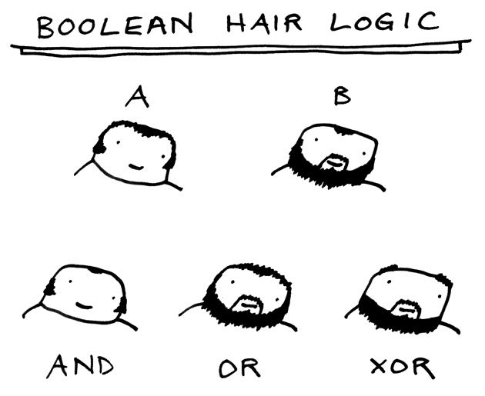
CSc 110, Spring 2017
Lecture 9: Advanced if/else; Cumulative sum
Adapted from slides by Marty Stepp and Stuart Reges

Slide 2
Nested if/else question
Write a program that produces output like the following:
This program reads data for two students and
computes their Computer Science GPAs
Enter next person's information:
CS 110 grade? A
CS 120 grade? B
Enter next person's information:
CS 110 grade? B
CS 120 grade? B
Person 1 GPA = 3.5
accepted
Person 2 GPA = 3.0
accepted
Difference = 0.5
Grade | GPA
A | 4.0
B | 3.0
C | 2.0
D | 1.0
Notes:
// This program computes two people's body mass index (BMI) and
// compares them. The code uses parameters, returns, and Scanner.
import java.util.*; // so that I can use Scanner
public class BMI {
public static void main(String[] args) {
System.out.println("This program reads in data for two people and");
System.out.println("computes their body mass index (BMI)");
System.out.println();
// finish me!
}
}

Slide 3
Factoring if/else code
factoring: Extracting common/redundant code.
Can reduce or eliminate redundancy from if/else code.
Example:
if (a == 1):
print(a)
x = 3
b = b + x
elif (a == 2):
print(a)
x = 6
y = y + 10
b = b + x
else: # a == 3
print(a)
x = 9
b = b + x
print(a)
x = 3 * a
if (a == 2):
y = y + 10
b = b + x

Slide 4
Advanced if/else

Slide 5
The "dangling if" problem
What can be improved about the following code?
if (x < 0):
print("x is negative")
elif (x >= 0):
print("x is non-negative")
The second if test is unnecessary and can be removed:
if (x < 0):
print("x is negative")
else:
print("x is non-negative")
This is also relevant in function that use if with return...

Slide 6
if/else with return
# Returns the larger of the two given integers.
def max(a, b):
if (a > b):
return a
else:
return b
Functions can return different values using if/else
Whichever path the code enters, it will return that value.
Returning a value causes a function to immediately exit.
All paths through the code should reach a return statement.

Slide 7
Relational Operators
if statements use logical tests.
if (test) :
These are boolean expressions.
relational operators produce boolean values of True or False
Operator | Meaning | Example | Value
== | equals | 1 + 1 == 2 | True
!= | does not equal | 3.2 != 2.5 | True
< | less than | 10 < 5 | False
> | greater than | 10 > 5 | True
<= | less than or equal to | 126 <= 100 | False
>= | greater than or equal to | 5.0 >= 5.0 | True
Notes:
Note that == tests equality, not = . The = is used for the assignment operator!

Slide 8
Logical operators
Tests can be combined using logical operators
logical operators produce Boolean values of True or False
"Truth tables" for each, used with logical values p and q:
Operator | Description | Example | Result
and | and | (2 == 3) and (-1 < 5) | False
or | or | (2 == 3) or (-1 < 5) | True
not | not | not (2 == 3) | True
p | q | p and q | p or q
True | True
True | False
False | True
False | False
p | not p
True
False

Slide 9
Evaluating logical expressions
Precedence:
1- arithmetic operators
2- relational operators
3- logical operators
Example:
5 * 7 >= 3 + 5 * (7 – 1) and 7 <= 11
5 * 7 >= 3 + 5 * 6 and 7 <= 11
35 >= 3 + 30 and 7 <= 11
35 >= 33 and 7 <= 11
True and True
True

Slide 10
Evaluating Logical expressions
What is the result of each of the following expressions?
x = 42
y = 17
z = 25
y < x and y <= z
x % 2 == y % 2 or x % 2 == z % 2
x <= y + z and x >= y + z
not(x < y and x < z)
(x + y) % 2 == 0 or not((z - y) % 2 == 0)
Answers: True, False, True, True, False

Slide 11
Using Logical operators
Determine if an integer specified by the user falls within the range of the variables high and low.
n = int(input("Enter a number: "))
if (n >= low and n <= high):
print(str(n) + " is in range")
Write a program that prompts the user for a number.
Print Fizz if the number is divisible by 3
Print Buzz if the number is divisible by 5
Print FizzBuzz if the number is divisible by 3 and 5

Slide 12
Cumulative algorithms

Slide 13
Adding many numbers
How would you find the sum of all integers from 1-10?
# This requires a lot of typing
sum = 1 + 2 + 3 + 4 + 5 + 6 + 7 + 8 + 9 + 10
print("The sum is " + str(sum))
What if we want the sum from 1 - 1,000,000? (Too much typing…) Or the sum up to any maximum?
How can we generalize the above code?

Slide 14
Cumulative sum loop
sum = 0
for i in range(1, 11):
sum = sum + i
print("The sum is " + str(sum))
cumulative sum: A variable that keeps a sum in progress and is updated repeatedly until summing is finished.
The sum in the above code is an attempt at a cumulative sum.
Cumulative sum variables must be declared outside the loops that update them, so that they will still exist after the loop.

Slide 15
Cumulative product
This cumulative idea can be used with other operators:
product = 1
for i in range(1, 21):
product = product * 2
print("2 ^ 20 = " + str(product))
How would we make the base and exponent adjustable?

Slide 16
input and cumulative sum
We can do a cumulative sum of user:
sum = 0
for i in range(1, 101):
next = int(input("Type a number: "))
sum = sum + next
}
print("The sum is " + str(sum))

Slide 17
Cumulative sum question
Modify the Receipt program we saw in lecture 3
Prompt for how many people, and each person's dinner cost.
Use functions to structure the solution.
Example log of execution:
How many people ate? 4
Person #1: How much did your dinner cost? 20.00
Person #2: How much did your dinner cost? 15
Person #3: How much did your dinner cost? 30.0
Person #4: How much did your dinner cost? 10.00
Subtotal: $75.0
Tax: $6.0
Tip: $11.25
Total: $92.25

Slide 18
Cumulative sum answer
# This program enhances our Receipt program using a cumulative sum.
def main():
subtotal = meals()
results(subtotal)
# Prompts for number of people and returns total meal subtotal.
def meals():
people = int(input("How many people ate? "))
subtotal = 0.0 # cumulative sum
for i in range(1, people + 1):
person_cost = float(input("Person #" + str(i) +
": How much did your dinner cost? "))
subtotal = subtotal + person_cost; # add to sum
return subtotal
...

Slide 19
Cumulative answer, cont'd.
# Calculates total owed, assuming 8% tax and 15% tip and prints a receipt
def results(subtotal):
tax = subtotal * .08
tip = subtotal * .15
total = subtotal + tax + tip
print("Subtotal: $" + str(subtotal))
print("Tax: $" + str(tax))
print("Tip: $" + str(tip))
print("Total: $" + str(total))

Slide 20
if/else, return question
Write a function count_factors that returns the number of factors of an integer.
count_factors(24) returns 8 because 1, 2, 3, 4, 6, 8, 12, and 24 are factors of 24.
Solution:
# Returns how many factors the given number has.
def count_factors(number):
count = 0
for i in range(1, number + 1):
if (number % i == 0):
count = count + 1 # i is a factor of number
return count

