Slide 1
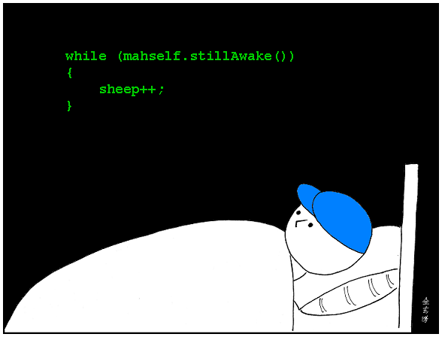
CSc 110, Spring 2017
Lecture 11: while Loops, Fencepost Loops, and Sentinel Loops
Adapted from slides by Marty Stepp and Stuart Reges

Slide 2
Strings and ACSII values (decimal)
All characters are assigned numbers internally by the computer, called ASCII values.
Examples:
'A' is 65, 'B' is 66, ' ' is 32
'a' is 97, 'b' is 98, '*' is 42
We can get the ASCII value of a String of length 1 using ord(str)
ord('a') is 97
The function chr(n) returns the character represented by the ASCII value n
chr(66) is 'B'
This is useful because you can do the following:
chr(ord('a') + 2) is 'c'

Slide 3
String question
A Caesar cipher is a simple encryption where a message is encoded by shifting each letter by a given amount.
e.g. with a shift of 3, A → D, H → K, X → A, and Z → C
Write a program that reads a message from the user and performs a Caesar cipher on its letters:
Your secret message: Brad thinks Angelina is cute
Your secret key: 3
The encoded message: eudg wklqnv dqjholqd lv fxwh

Slide 4
Functions traversing Strings
Write a function print_consonants that accepts a str as a parameter and prints out that str with all vowels removed For example, the call:
print_consonants("atmosphere")
should print:
tmsphr

Slide 5
Fencepost loops

Slide 6
A deceptive problem...
Write a method print_letters that prints each letter from a word separated by commas. For example, the call:
print_letters("Atmosphere")
should print:
A, t, m, o, s, p, h, e, r, e

Slide 7
Flawed solutions
def print_letters(word): for i in range(0, len(word)): print(str(word[i]) + ", ", end="") print() # end line
Output: A, t, m, o, s, p, h, e, r, e,
def print_letters(word): for i in range(0, len(word)): print(", " + str(word[i]), end="") print() # end line
Output: , A, t, m, o, s, p, h, e, r, e

Slide 8
Fence post analogy
We print n letters but need only n - 1 commas.
Similar to building a fence with wires separated by posts:
If we use a flawed algorithm that repeatedly places a post + wire, the last post will have an extra dangling wire.
for length of fence :
place a post.
place some wire.

Slide 9
Fencepost loop
Add a statement outside the loop to place the initial "post."
Also called a fencepost loop or a "loop-and-a-half" solution.
place a post.
for length of fence – 1:
place some wire.
place a post.

Slide 10
Fencepost method solution
def print_letters(word): print(word[0]) for i in range(1, len(word)): print(", " + word[i], end="") print() # end line
Alternate solution: Either first or last "post" can be taken out:
def print_letters(word): for i in range(0, len(word) - 1): print(word[i], end=", ") last = len(word) – 1
print(word[last]) # end line

Slide 11
Fencepost question
Write a function print_primes that prints all prime numbers up to a max.
Example: print_primes(50) prints
2, 3, 5, 7, 11, 13, 17, 19, 23, 29, 31, 37, 41, 43, 47
If the maximum is less than 2, print no output.
To help you, write a function count_factors which returns the number of factors of a given integer.
count_factors(20) returns 6 due to factors 1, 2, 4, 5, 10, 20.

Slide 12
Fencepost answer
# Prints all prime numbers up to the given max.
def print_primes(max):
if (max >= 2):
print("2", end="")
for i in range(3, max + 1):
if (count_factors(i) == 2):
print(", " + str(i))
print()
# Returns how many factors the given number has.
def count_factors(number):
count = 0
for i in range(1, number + 1):
if (number % i == 0):
count = count + 1 # i is a factor of number
return count

Slide 13
while loops

Slide 14
Categories of loops
definite loop: Executes a known number of times.
The for loops we have seen are definite loops.
Print "hello" 10 times.
Find all the prime numbers up to an integer n.
Print each odd number between 5 and 127.
indefinite loop: One where the number of times its body repeats is not known in advance.
Prompt the user until they type a non-negative number.
Print random numbers until a prime number is printed.
Repeat until the user has typed "q" to quit.

Slide 15
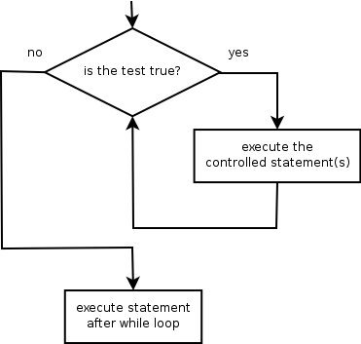
The while loop
while loop: Repeatedly executes its body as long as a logical test is true.
while (test):
statement(s)
Example:
num = 1 # initialization
while (num <= 200): # test
print(str(num), end=" ")
num = num * 2 # update
# output: 1 2 4 8 16 32 64 128

Slide 16
Example while loop
# finds the first factor of 91, other than 1
n = 91
factor = 2
while (n % factor != 0):
factor = factor + 1
print("First factor is " + str(factor))
# output: First factor is 7
while is better than for because we don't know how many times we will need to increment to find the factor.

Slide 17
Sentinel values
sentinel: A value that signals the end of user input.
sentinel loop: Repeats until a sentinel value is seen.
Example: Write a program that prompts the user for text until the user types "quit", then output the total number of characters typed.
(In this case, "quit" is the sentinel value.)
Type a word (or "quit" to exit): hello Type a word (or "quit" to exit): yay Type a word (or "quit" to exit): quit You typed a total of 8 characters.

Slide 18
Solution?
sum = 0
response = "dummy" # "dummy" value, anything but "quit"
while (response != "quit"):
response = input('Type a word (or "quit" to exit): ')
sum = sum + len(response)
print("You typed a total of " + str(sum) + " characters.")
This solution produces the wrong output. Why?
You typed a total of 12 characters.

Slide 19
The problem with our code
Our code uses a pattern like this:
sum = 0
while (input is not the sentinel) :
prompt for input; read input.
add input length to the sum.
On the last pass, the sentinel’s length (4) is added to the sum:
prompt for input; read input ("quit").
add input length (4) to the sum.
This is a fencepost problem.
Must read N lines, but only sum the lengths of the first N-1.

Slide 20
A fencepost solution
sum = 0.
prompt for input; read input. # place a "post"
while (input is not the sentinel):
add input length to the sum. # place a "wire"
prompt for input; read input. # place a "post"
Sentinel loops often utilize a fencepost "loop-and-a-half" style solution by pulling some code out of the loop.

Slide 21
Correct code
sum = 0
# pull one prompt ("fence post") out of the loop
response = input('Type a word (or "quit" to exit): ')
while (response != "quit"):
sum = sum + len(response) # moved to top of loop
response = input('Type a word (or "quit" to exit): ')
print("You typed a total of " + str(sum) + " characters.")

Slide 22
Sentinel as a constant
SENTINEL = "quit"
...
sum = 0
# pull one prompt ("fence post") out of the loop
response = input('Type a word (or "' + SENTINEL + '" to exit): ')
while (response != SENTINEL):
sum = sum + len(response) # moved to top of loop
response = input('Type a word (or "' + SENTINEL + '" to exit): ')
print("You typed a total of " + str(sum) + " characters.")

Slide 23
Strings answer
# This program reads a message and a secret key from the user and
# encrypts the message using a Caesar cipher, shifting each letter.
def main():
message = input("Your secret message: ")
message = message.lower()
key = int(input("Your secret key: "))
encode(message, key)
# This method encodes the given text string using a Caesar
# cipher, shifting each letter by the given number of places.
def encode(text, shift):
print("The encoded message: ")
for letter in text:
# shift only letters (leave other characters alone)
if (letter >= 'a' and letter <= 'z'):
letter = chr(ord(letter) + shift)
# may need to wrap around
if (letter > 'z'):
letter = chr(ord(letter) - 26)
elif (letter < 'a'):
letter = chr(ord(letter) + 26)
print(letter, end='')
print()

