Slide 1
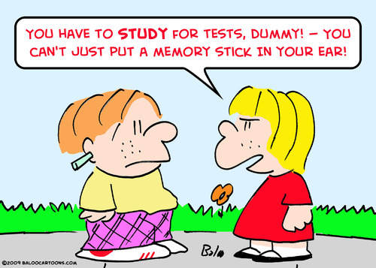
CSc 110, Spring 2017
Lecture 14: Boolean Logic and Midterm Review
Adapted from slides by Marty Stepp and Stuart Reges

Slide 2
Logic Question
Consider the statement:
It is not true that he took Art History and Physics 101
Is this an equivalent statement?
He did not take Art History or he did not take Physics 101

Slide 3
De Morgan's Laws
De Morgan's Laws: Rules used to negate boolean tests involving and and or.
Useful when you want the opposite of an existing test.
Example:
Original Expression | Negated Expression | Alternative
a and b | not a or not b | not(a and b)
a or b | not a and not b | not(a or b)
Original Code | Negated Code
if (x == 7 and y > 3): ... | If not(x == 7 and y > 3): if (x =! 7 or y <= 3):

Slide 4
Boolean practice questions
Write a function is_vowel(c) that returns True if the 1 character string c is a vowel (a, e, i, o, or u) or False otherwise. Ignore case.
is_vowel("q") returns False
is_vowel("A") returns True
is_vowel("e") returns True
Change the above function into is_non_vowel(c) that returns True if c is any character except a vowel and False otherwise.
is_non_vowel("q") returns True
is_non_vowel("A") returns False
is_non_vowel("e") returns False

Slide 5
Boolean practice answers
# Enlightened version. I have seen the true way (and false way)
def is_vowel(c):
c = c.lower() # allows testing for only lower case
return c == 'a' or c == 'e' or c =='i' or c == 'o' or c == 'u'
# Enlightened "Boolean Zen" version
def is_non_vowel(c):
c = c.lower()
return not(c == 'a' or c == 'e' or c =='i' or c == 'o' or c == 'u')
# or, return not is_vowel(c)

Slide 6
When to return?
Consider a function with a loop and a return value:
When and where should the function return its result?
Write a function seven that uses randint to draw up to ten lotto numbers from 1-30.
If any of the numbers is a lucky 7, the function should immediately return True. If none of the ten are 7 it should return False.
The function should print each number as it is drawn.
15 29 18 29 11 3 30 17 19 22 (first call)
29 5 29 4 7 (second call)

Slide 7
Flawed solution
# Draws 10 lotto numbers; returns True if one is 7.
def seven():
for i in range(1, 11):
num = randint(1, 30)
print(str(num) + " ", end='')
if (num == 7):
return True;
else:
return False;
The function always returns immediately after the first draw.
If the draw isn't a 7, we need to keep drawing (up to 10 times).

Slide 8
Returning at the right time
# Draws 10 lotto numbers; returns True if one is 7.
def seven():
for i in range(1, 11):
num = randint(1, 30)
print(str(num) + " ", end='')
if (num == 7): # found lucky 7; can exit now
return True
return False # if we get here, there was no 7
Returns True immediately if 7 is found.
If 7 isn't found, the loop continues drawing lotto numbers.
If all ten aren't 7, the loop ends and we return False.

Slide 9
Sidebar…
Write a function digit_sum(n) that accepts an integer parameter and returns the sum of its digits.
Assume that the number is non-negative.
Example: digit_sum(29107) returns 19
(19 is the sum of 2+9+1+0+7)
Hint: Use the % operator to extract a digit from a number.
Hint: Use the // operator to remove the last digit

Slide 10
Summing digits answer
def digit_sum(n):
sum = 0
while (n > 0):
sum = sum + (n % 10) # add last digit to sum
n = n // 10 # remove last digit from n
return sum

Slide 11
Boolean return questions
has_an_odd_digit : returns True if any digit of an integer is odd.
has_an_odd_digit(4822116) returns True
has_an_odd_digit(2448) returns False
all_digits_odd : returns True if every digit of an integer is odd.
all_digits_odd(135319) returns True
all_digits_odd(9174529) returns False
is_all_vowels : returns True if every char in a string is a vowel.
is_all_vowels("eIeIo") returns True
is_all_vowels("oink") returns False

Slide 12
Boolean return answers
def has_an_odd_digit(n):
while (n != 0):
if (n % 2 != 0): # check whether last digit is odd
return True
n = n // 10
return False
def all_digits_odd(n):
while (n != 0) :
if (n % 2 == 0): # check whether last digit is even
return False
n = n // 10
return True
def is_all_vowels(s):
for i in range(0, len(s)):
letter = s[i: i + 1]
if (not is_vowel(letter)):
return False
return True

Slide 13
Midterm
Rules
Not allowed: phones, watches, hats, books, notes, drinks
Have your student ID
Strategies
Practice (drill) on the problem types 1, 2 and 3 on the samples.
You will get partial credit. Write something on down paper.
Example:
Define a function mod5 that takes two integer parameters and returns 1 if both integers are divisible by 5.
def mod5(a,b):
if (a % 5 == 0

Slide 14
Drill
14 + 2 * 6 < 25 or 3 + 33 //5 + 2 > 6 % 8
8 // 7 * 3 //1.5 + 16 % 2 + 8

Slide 15
Drill
def mystery(a,b):
c = 5
if (b > a):
c = a + b
b = b + 10
if (b < a ):
b = b % 2
else:
a = a * c
print(str(a) + " " + str(b))
mystery(3,8)
mystery(6,6)
mystery(14,9)

