Slide 1
CSc 110, Sprint 2017
Lecture 16: Lists (cont.) and File Input

Slide 2
Weather question
Use a list to solve the weather problem:
How many days' temperatures? 7
Day 1's high temp: 45
Day 2's high temp: 44
Day 3's high temp: 39
Day 4's high temp: 48
Day 5's high temp: 37
Day 6's high temp: 46
Day 7's high temp: 53
Average temp = 44.6
4 days were above average.

Slide 3
Weather answer
# Reads temperatures from the user, computes average and # days above average.
def main():
days = int(input("How many days' temperatures? "))
temps = [0] * days # list to store days' temperatures
sum = 0
for i in range(0, days): # read/store each day's temperature
temps[i] = int(input(("Day " + (i + 1) + "'s high temp: ")))
sum = sum + temps[i]
average = sum / days
count = 0 # see if each day is above average
for i in range(0, days):
if (temps[i] > average):
count = count + 1
# report results
print("Average temp = " + str(average))
print(str(count) + " days above average")

Slide 4
Weather question 2
Modify the weather program to print the following output:
Type in a temperature or "done" to finish
Day 1's high temp: 45
Day 2's high temp: 44
Day 3's high temp: 39
Day 4's high temp: 48
Day 5's high temp: 37
Day 6's high temp: 46
Day 7's high temp: 53
Day 7's high temp: done
Average temp = 44.6
4 days were above average.

Slide 5
Problem
We don't know how many elements the list will have
We need a way to build a list while processing the input.
New method:
append(x) - add an item to the end of a list

Slide 6
Weather 2 answer
# Reads temperatures from the user, computes average and # days above average.
def main():
temps = []
avg = 0
day = 1
temp = input("Day " + str(day) + "'s high temperature: ")
while(temp != "done"):
avg = avg + int(temp)
temps.append(int(temp))
day = day + 1
temp = input("Day " + str(day) + "'s high temperature: ")
# counts days above average
avg = avg / len(temps)
above = 0
for number in temps:
if(number > avg):
above = above + 1
print("Average temperature = " + str(round(avg, 1)))
print(str(above) + " days above average.")
print()
print("Temperatures: " + str(temps))

Slide 7
Weather question 3
Modify the weather program to print the following output:
How many days' temperatures? 7
Day 1's high temp: 45
Day 2's high temp: 44
Day 3's high temp: 39
Day 4's high temp: 48
Day 5's high temp: 37
Day 6's high temp: 46
Day 7's high temp: 53
Average temp = 44.6
4 days were above average.
Temperatures: [45, 44, 39, 48, 37, 46, 53]
Two coldest days: 37, 39
Two hottest days: 53, 48

Slide 8
List functions
Function | Description
append(x) | Add an item to the end of the list. Equivalent to a[len(a):] = [x].
extend(L) | Extend the list by appending all the items in the given list. Equivalent to a[len(a):] = L
insert(i, x) | Inserts an item at a given position. i is the index of the element before which to insert, so a.insert(0, x) inserts at the front of the list.
remove(x) | Removes the first item from the list whose value is x. Errs if there is no such item.
pop(i) | Removes the item at the given position in the list, and returns it. a.pop() removes and returns the last item in the list.
clear() | Remove all items from the list.
index(x) | Returns the index in the list of the first item whose value is x. Errs if there is no such item.
count(x) | Returns the number of times x appears in the list.
sort() | Sort the items of the list
reverse() | Reverses the elements of the list
copy() | Return a copy of the list.

Slide 9
Weather answer 3
# Reads temperatures from the user, computes average and # days above average.
def main():
temps = []
avg = 0
day = 1
temp = input("Day " + str(day) + "'s high temperature: ")
while(temp != "done"):
avg = avg + int(temp)
temps.append(int(temp))
day = day + 1
temp = input("Day " + str(day) + "'s high temperature: ")
# counts days above average
avg = avg / len(temps)
above = 0
for number in temps:
if(number > avg):
above = above + 1
print("Average temperature = " + str(round(avg, 1)))
print(str(above) + " days above average.")
print()
print("Temperatures: " + str(temps))
temps.sort()
print("Two coldest: " + str(temps[0]) + ", " + str(temps[1]))
print("Two hottest: " + str(temps[-1]) + ", " + str(temps[-2]))

Slide 10
"list mystery" problem
traversal: A sequential processing of the elements of a list.
What element values are stored in the following list?
a = [1, 7, 5, 6, 4, 14, 11]
for i in range(0, len(a) – 1):
if (a[i] > a[i + 1]):
a[i + 1] = a[i + 1] * 2
index | 0 | 1 | 2 | 3 | 4 | 5 | 6
value
index | 0 | 1 | 2 | 3 | 4 | 5 | 6
value | 1 | 7 | 10 | 12 | 8 | 14 | 22

Slide 11
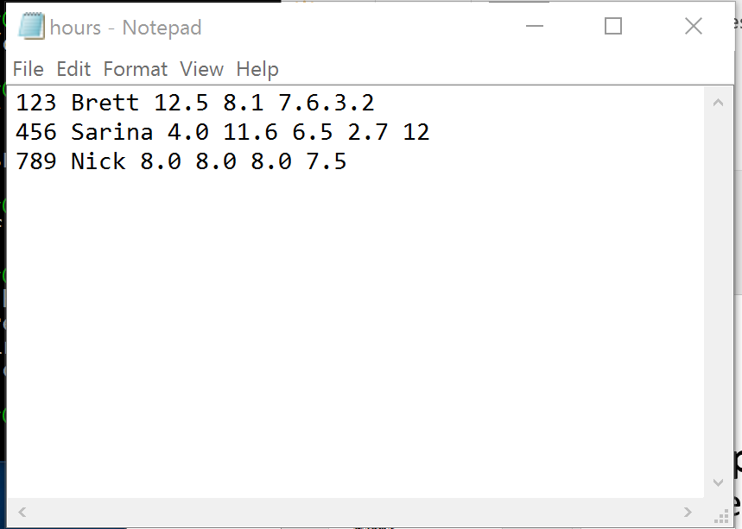
File Input
open(name) – a built-in function that opens the specified file and returns a file object. The type of name is str.
Example:
f = open("hours.txt")

Slide 12
File paths
absolute path: specifies a drive or a top "/" folder
C:/Documents/smith/hw6/input/data.csv
Windows can also use backslashes to separate folders.
relative path: does not specify any top-level folder
names.dat
input/kinglear.txt
Assumed to be relative to the current directory:
file = open("data/readme.txt")
If our program is in H:/hw6 , open will look for H:/hw6/data/readme.txt
NOTE: We will put files in the same directory as our Python programs.

Slide 13
File Input
Now we need a way to access the contents of the file.
f = open("hours.text")
read() – a method that reads a file and returns the contents as a string. Requires the "." notation for use.
Example:
f.read()
>>> f = open("hours.txt")
>>> f.read()
'123 Brett 12.5 8.1 7.6 3.2\n
456 Sarina 4.0 11.6 6.5 2.7 12\n
789 Nick 8.0 8.0 8.0 8.0 7.5\n'

Slide 14
More File methods
readline()- Reads the next line of a file and returns it as a string.
readlines()- Reads the contents of a file and returns it as a list.
What if there are no more lines?
>>> f = open("hours.txt")
>>> f.readline()
'123 Susan 12.5 8.1 7.6 3.2\n'
>>> f = open("hours.txt")
>>> f.readlines()
['123 Brett 12.5 8.1 7.6 3.2\n',
'456 Sarina 4.0 11.6 6.5 2.7 12\n',
'789 Nick 8.0 8.0 8.0 8.0 7.5\n']

Slide 15
Process a file one line at a time
Use readlines() to return the contents of the file as a list.
Loop through the list:
f = open("hours.txt")
hours = f.readlines() # hours is a list
for i in range(0, len(hours)):
print(hours[i])
Interesting output. Why?
>>>
...
123 Brett 12.5 8.1 7.6 3.2
456 Sarina 4.0 11.6 6.5 2.7 12
789 Nick 8.0 8.0 8.0 8.0 7.5

Slide 16
Process a file one line at a time
Use readlines() to return the contents of the file as a list
strip() – a method that removes newlines "\n"
f = open("hours.txt")
hours = f.readlines
for i in range(0, len(hours)):
print(hours[i].strip())
>>> for i in range(0, len(hours)):
... print(hours[i].strip()) # strip() removes \n
123 Brett 12.5 8.1 7.6 3.2
456 Sarina 4.0 11.6 6.5 2.7 12
789 Nick 8.0 8.0 8.0 8.0 7.5

Slide 17
File input question
We have a file weather.txt:
16.2
23.5
19.1
7.4
22.8
18.5
-1.8
14.9
Write a program that prints the change in temperature between each pair of neighboring days.
16.2 to 23.5, change = 7.3
23.5 to 19.1, change = -4.4
19.1 to 7.4, change = -11.7
7.4 to 22.8, change = 15.4
22.8 to 18.5, change = -4.3
18.5 to -1.8, change = -20.3
-1.8 to 14.9, change = 16.7
Notes:
8 temperatures in the file, but 7 lines of output. It's a fencepost problem in disguise.

Slide 18
File input answer
# Displays changes in temperature from data in an input file.
def main():
input = open("weather.txt")
lines = input.readlines()
prev = float(lines[0]) # fencepost
for i in range(1, len(lines)):
float(next) = lines[i]
print(str(prev) + " to " + str(next) + ", change = " +
str(next - prev))
prev = next

Slide 19
Gas prices question
Write a program that reads a file gasprices.txt
Format: Belgium $/gal
US $/gal
date
8.20
3.81
3/21/11
8.08
3.84
3/28/11
...
The program should print the average gas price over all data in the file for both countries:
Belgium average: 8.3 $/gal
USA average: 3.9 $/gal
Notes:
I don't usually have time to do this program in lecture. It's just here in case I have extra time, or for students to look at later.

Slide 20
Gas prices solution
def main():
file = open("gasprices.txt")
belgium = 0
usa = 0
count = 0
lines = file.readlines()
for i in range(0, len(lines), 3):
belgium = belguim + float(lines[i])
usa = usa + float(lines[i + 1])
print("Belgium average: " + str(belgium / count) + " $/gal")
print("USA average: " + str(usa / count) + " $/gal")

