Slide 1
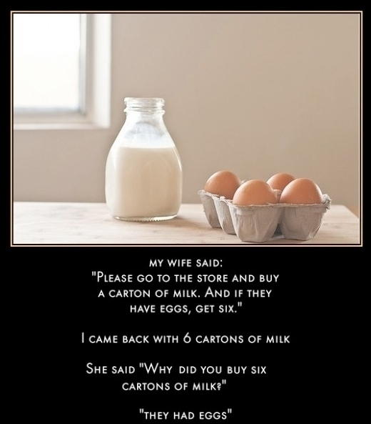
CSc 110, Spring 2017
Lecture 18: Line-Based File Input
Adapted from slides by Marty Stepp and Stuart Reges
Programming feel like that?

Slide 2
IMDb movies problem
Consider the following Internet Movie Database (IMDb) data:
1 9.1 196376 The Shawshank Redemption (1994)
2 9.0 139085 The Godfather: Part II (1974)
3 8.8 81507 Casablanca (1942)
Write a program that displays any movies containing a phrase:
Search word? part
Rank Votes Rating Title
2 139085 9.0 The Godfather: Part II (1974)
40 129172 8.5 The Departed (2006)
95 20401 8.2 The Apartment (1960)
192 30587 8.0 Spartacus (1960)
4 matches
Note: the file is imdb.txt

Slide 3
Pseudocode
ask the user for a search word
open the IMDb data file
create a list of the files contents
if search word is in the list of files contents
print the header for the output
set matches counter
for each line in the list
if the search word is in the line
increment the matches counter
print the line in the proper format
print the number of matches
1 9.1 196376 The Shawshank Redemption (1994
2 9.0 139085 The Godfather: Part II (1974)
3 8.8 81507 Casablanca (1942)
Rank Votes Rating Title
2 139085 9.0 The Godfather: …

Slide 4
Functions for imdb
Start with these:
get_phrase()
- use input() as usual
- returns a string
search_list(line_list, search_word)
- searches line_list to find search_word
- if finds search_word, returns the line
- if no match found, returns an empty string
We want to put in debugging prints statements
We want to know the structure of imdb.txt
(Let's take a look at it before writing the code.)

Slide 5
Remaining functions for imdb
search_line(line, search_word)
- searches string line to find search_word
- if finds search_word, returns the line
- if no match found, returns an empty string

Slide 6
Remaining functions for imdb
display(line)
- line is a string
A string in line looks like this:
'2 9.0 139085 The Godfather: Part II (1974)'
The structure of the output is:
Rank Votes Rating Title
2 139085 9.0 The Godfather: Part II (1974)
What does the method split() do?
-creates a list from a string
-by default uses whitespace (thiink spaces) to delimit the elements

Slide 7
Helpful strategies
Use print statements for debugging
Make your input file small to start with
Know the structure of your input file
Review the methods and functions for lists and strings

Slide 8
IMDb main
# Displays IMDB's Top 250 movies that match a search string.
def main():
search_word = get_phrase()
file = open("imdb.txt")
line_list = file.readlines()
line = search_list(line_list, search_word)
if (len(line) > 0):
print("Rank\tVotes\tRating\tTitle")
matches = 0
for a_line in line_list:
ans = search_line(a_line, search_word)
if (len(ans) > 0):
matches = matches + 1
display(a_line)
print(str(matches) + " matches.")
# Asks the user for their search word and returns it.
def get_phrase():
search_word = input("Search word: ")
search_word = search_word.lower()
print()
return search_word
...

Slide 9
IMDb functions
...
# Searches a file for a line that match the search word.
def search_list(line_list, search_word):
for line in line_list:
line_lower = line.lower() # case-insensitive match
if (search_word in line_lower):
return line
return "" # not found
# Looks for the search word in a single line.
def search_line(line, search_word):
line_lower = line.lower() # case-insensitive match
if (search_word in line_lower):
return line
return "" # not found
# displays the line in the proper format on the screen.
def display(line):
parts = line.split()
rank = parts[0]
rating = parts[1]
votes = parts[2]
title = ""
for i in range(3, len(parts)):
title = title + parts[i] + " " # the rest of the line
print(rank + "\t" + votes + "\t" + rating + "\t" + title)

Slide 10
"Chaining"
main should be a concise summary of your program.
It is bad if each function calls the next in a nested structure (we call this chaining):
A better structure has main make most of the calls.
Functions must return values to main to be passed on later.
main
functionA
functionB
functionC
functionD
main
functionA
functionB
functionD
functionD

Slide 11
File output
Notes:
11

Slide 12
Output to files
Open a file in write or append mode
'w' - write mode – replaces everything in the file
'a' – append mode – adds to the bottom of the file preserving what is already in it
name = open("filename", "w") # write
name = open("filename", "a") # append

Slide 13
Output to files
name.write(str) - writes the given string to the file
name.close() - closes file once writing is done
Example:
out = open("output.txt", "w")
out.write("Hello, world!\n")
out.write("How are you?")
out.close()
text = open("output.txt").read()
# Hello, world!\nHow are you?
Notes:
common PrintStream bug:
- declaring it in a method that gets called many times. This causes the file to be re-opened and wipes the past contents. So only the last line shows up in the file.

Slide 14
Removing short words
Write a program that reads a file, writes the file contents , and then creates a new file containing only the words greater than 3 characters.

Slide 15
Removing short words
def main():
file = open("poem.txt")
text = file.read()
print(text)
outfile = open("nosmallwords.txt", "w")
text = text.split()
for word in text:
if len(word) > 3:
print(word)
outfile.write(word)
outfile.close()
main()

