Slide 1
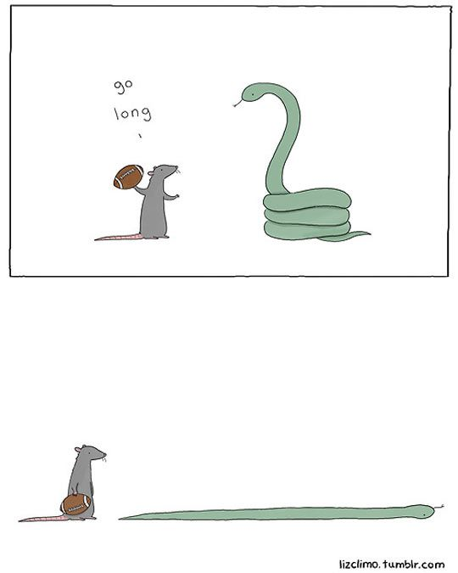
CSc 110, Spring 2017
Lecture 19: more with lists
Adapted from slides by Marty Stepp and Stuart Reges

Slide 2
"Programs must be written for people to read, and only incidentally for machines to execute." Abelson and Sussman, Structure and Interpretation of Programs
Notes:
2

Slide 3
Commenting Code
Comments are required for homework as follows:
- at the top of the program file
- before each function
- within a function when needed to clarify a point (see below)
# Continue to loop until the user guesses the correct answer,
# giving a clue each time
while (guess != correct_answer):
if (guess < correct_answer):
print("It's higher.")
else:
print("It's lower.")

Slide 4
Lists and assignment
Consider the following code:
a1 = [4, 15, 8]
a2 = a1 # a2 now refers to same list as a1
a2[0] = 7
print(a1) # [7, 15, 8]
index | 0 | 1 | 2
value | 4 | 15 | 8
index | 0 | 1 | 2
value | 7 | 15 | 8
a1
a2

Slide 5
Reference semantics
When a type has reference semantics, a variable holds a reference to a value rather than the value itself. Lists have reference semantics.
Assigning a list to a variable causes the variable to hold a reference to the list
Modifying a list element referenced by one variable will affect any other variables referencing the same list.
a1 = [4, 15, 8]
a2 = a1 # a2 now refers to same list as a1
a2[0] = 7
print(a1) # [7, 15, 8]
index | 0 | 1 | 2
value | 4 | 15 | 8
index | 0 | 1 | 2
value | 7 | 15 | 8
a1
a2

Slide 6
Consider the following interaction with Idle:
>>> a = [3, 7, 24]
>>> b = a
>>> print(b)
[3, 7, 24]
>>> b[0] = 88
>>> print(a)
[88, 7, 24]
>>> a[2] = 999
>>> print(b)
[88, 7, 999]
>>> a = [10, 20, 30]
>>> print(b)
[88, 7, 999]

Slide 7
Reference semantics vs. Value semantics
7
Notes:
7

Slide 8
Value semantics
When a type has value semantics, a variable holds a copy of a value.
ints, floats, strings and booleans in Python use value semantics.
When an int, float, string, or boolean value is assigned to a variable, its value is copied into memory set aside for the variable.
Assignment doesn't produces any sharing of data.
Modifying the value of one variable does not affect others.
x = 5
y = x
y = 17
x = 8

Slide 9
Integers as parameters
Function square squares its parameter.
def square(x):
x = x * x
The value of variable a (of type int) is passed as an argument.
def main():
a = 7
# can variable a be modified?
square(a)
print(str(a))
The variable a cannot be modified by square.
Notes:
It's basically not possible to write a swap method that accepts two ints.
swap can't escape from itself to modify the outside world.
(sort of like the villains in the holodeck on Star Trek; they can wreak havoc in their holo-world, but they can't leave and attack the real Enterprise outside.)

Slide 10
Lists as parameters
Reference semantics apply not only to assignment but also to parameter passing.
Changes made in the function are also seen by the caller.
def main():
iq = [126, 167, 95]
double_all(iq)
print(iq)
def double_all(a):
for i in range(0, len(a)):
a[i] = a[i] * 2
Output:
[252, 334, 190]
iq
index | 0 | 1 | 2
value | 126 | 167 | 95
index | 0 | 1 | 2
value | 252 | 334 | 190
a

Slide 11
Objects as parameters
Objects use reference semantics; the object is not copied. The parameter refers to the same object.
If the parameter is modified, it will affect the original object.
def main():
window = DrawingPanel(80, 50)
window.canvas.create_rectangle(0, 0, 80, 50, fill="yellow")
example(window)
def example(panel):
panel.canvas.create_rectangle(0, 0, 80, 50, fill="cyan") ...
window
panel
Notes:
Note: This is also the reason that it works when you pass the Graphics g as a parameter to a method, because it is drawing with the same pen object onto the same window.

Slide 12
Why reference semantics?
Reference semantics.
sharing. It's useful to share an object's data among functions and methods.
efficiency. Copying large amounts of data can be inefficient.
f = open("population_data.txt")
data = f.readlines() # data could be very large
process(data) # a reference to data is passed in
…

Slide 13
absolute_all
Write a function absolute_all that accepts a list of integers and modifies it so that all its values are positive.
a = [-2, 15, 25, -106]
absolute_all(a)
print(a) # [2, 15, 25, 106]

Slide 14
absolute_all
# Changes all values of the list to
# positive numbers.
def absolute_all(x):
for i in range(0, len(x)):
x[i] = abs(x[i])

Slide 15
rotate
Write a function rotate that takes a list and rotates the first element to the end of the list
a = [10, 20, 30, 40]
rotate(a)
print(a) # [20, 30, 40, 10]
Hint: Use list's append() method.

Slide 16
rotate
# Rotates the list a by putting its first
# element at the end of the list.
def rotate(x):
element = x.pop(0)
x.append(element)

Slide 17
Problem: concat
Write a function concat that accepts two lists and returns a new list containing all elements of the first list followed by all elements of the second.
Note that this function returns a new list.
a1 = [12, 34, 56]
a2 = [7, 8, 9, 10]
a3 = concat(a1, a2)
print(a3)
# [12, 34, 56, 7, 8, 9, 10]
Notes:
I probably won't reach this in lecture; it's here just in case.

Slide 18
concat: v1
# Returns a new list containing all elements of x
# followed by all elements of y.
def concat(x, y):
result = [0] * (len(x) + len(y))
for i in range(0, len(x)):
result[i] = x[i]
for i in range(0, len(y)):
result[len(x) + i] = y[i]
return result
Question: Can we make this simpler?

Slide 19
concat: v2
# Returns a new list containing all elements of x
# followed by all elements of y.
def concat(x, y):
result = []
for item in x:
result.append(item)
for item in y:
result.append(item)
return result

Slide 20
Problem: concat3
Write a function concat3 that concatenates three lists similarly.
a1 = [12, 34, 56]
a2 = [7, 8, 9, 10]
a3 = [444, 222, -1]
print(concat3(a1, a2, a3))
# [12, 34, 56, 7, 8, 9, 10, 444, 222, -1]
Notes:
I probably won't reach this in lecture; it's here just in case.

Slide 21
concat3: v1 and v2
# Returns a new list containing all elements of x, y, and z.
def concat3(x, y, z):
result = []
for item in x:
result.append(item)
for item in y:
result.append(item)
for item in z:
result.append(item)
return result
# Shorter version that calls concat.
def concat3(a1, a2, a3):
return concat(concat(a1, a2), a3)
"When you hit a problem, you can lean forward and type or sit back and think." -- Dr. Proebsting

Slide 22
List reversal question
Write a function that reverses the elements of a list.
For example, if the list initially is this:
[11, 42, -5, 27, 0, 89]
Then the list becomes:
[89, 0, 27, -5, 42, 11]
Hint: think about swapping various elements...

Slide 23
Algorithm idea
Swap pairs of elements from the edges; work inwards:
index | 0 | 1 | 2 | 3 | 4 | 5
value | 11 | 42 | -5 | 27 | 0 | 89
index | 0 | 1 | 2 | 3 | 4 | 5
value | 89 | 42 | -5 | 27 | 0 | 11
index | 0 | 1 | 2 | 3 | 4 | 5
value | 89 | 0 | -5 | 27 | 42 | 11
index | 0 | 1 | 2 | 3 | 4 | 5
value | 89 | 0 | 27 | -5 | 42 | 11

Slide 24
Swapping values
a = 7
b = 35
# swap a with b?
a = b
b = a
print(str(a) + " " + str(b))
What is wrong with this code? What is its output?
The red code should be replaced with:
temp = a
a = b
b = temp

Slide 25
Flawed algorithm
What's wrong with this code?
numbers = [11, 42, -5, 27, 0, 89]
# reverse the list
for i in range(0, len(numbers)):
temp = numbers[i]
numbers[i] = numbers[len(numbers) - 1 - i]
numbers[len(numbers) - 1 - i] = temp
The loop goes too far and un-reverses the array! Fixed version:
for i in range(0, len(numbers) // 2):
temp = numbers[i]
numbers[i] = numbers[len(numbers) - 1 - i]
numbers[len(numbers) - 1 - i] = temp

Slide 26
reverse
reverse – takes a list as a parameter and reverses it
numbers = [11, 42, -5, 27, 0, 89]
reverse(numbers)
Solution:
def reverse(numbers):
for i in range(0, len(numbers) // 2):
temp = numbers[i]
numbers[i] = numbers[len(numbers) - 1 - i]
numbers[len(numbers) - 1 - i] = temp

