Slide 1
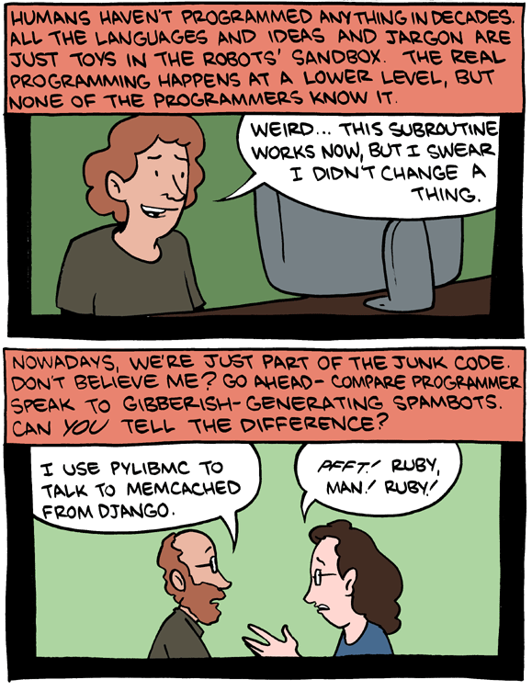
CSc 110, Spring 2017
Lecture 21: Reasoning about code
Adapted from slides by Marty Stepp and Stuart Reges
Punchline to a longer comic: http://www.smbc-comics.com/index.php?db=comics&id=2362#comic
Notes:
1

Slide 2
Catch-up

Slide 3
Augmented assignment
Augmented assignment is the combination, in a single statement, of a binary operation and an assignment statement. -- docs.python.org
Augmented Equivalent longer version
variable += value variable = variable + value
variable -= value variable = variable - value
variable *= value variable = variable * value
variable /= value variable = variable / value
variable %= value variable = variable % value
x += 3 # x = x + 3
gpa -= 0.5 # gpa = gpa - 0.5
number *= 2 # number = number * 2
Notes:
7.2.1. Augmented assignment statements
https://docs.python.org/3/reference/simple_stmts.html#index-14

Slide 4
Tally solution
Can we modify this to use augmented assignment?
# Returns the digit value that occurs most frequently in n.
# Breaks ties by choosing the smaller value.
def most_frequent_digit(n):
counts = [0] * 10
while (n > 0):
digit = n % 10 # pluck off a digit and tally it
counts[digit] = counts[digit] + 1
n = n // 10
...

Slide 5
Tally solution with augmented assignment
# Returns the digit value that occurs most frequently in n.
# Breaks ties by choosing the smaller value.
def most_frequent_digit(n):
counts = [0] * 10
while (n > 0):
digit = n % 10 # pluck off a digit and tally it
counts[digit] += 1
n //= 10
...

Slide 6
Reasoning about code

Slide 7
Reasoning about code
We can ask when a certain condition holds at a particular point in code.
Consider this code:
if (x >= 3):
# --- Point A ---
x -= 1
else:
# --- Point B ---
x += 1
# --- Point C ---
# --- Point D ---
What do we know about x's value at each of the four points?
When is x > 3? Always? Sometimes? Never?

Slide 8
More reasoning about code
Consider the following condition at each point: when is number < 0?
(Always? Sometimes? Never?)
number = int(input("Type a nonnegative number: "))
# Point A: is number < 0 here?
while (number < 0):
# Point B: is number < 0 here?
number = int(input("Negative; try again: "))
# Point C: is number < 0 here?
# Point D: is number < 0 here?
Notes:
Sometimes, always, sometimes, never

Slide 9
Reasoning about code
Right after a variable is initialized, its value is known:
x = 3
# is x > 0?
In general we know nothing about parameters' values:
def mystery(a, b):
# is a == 10?
But inside an if, while, etc., we may know something:
def mystery(a, b):
if (a < 0):
# is a == 10?
...
Notes:
Always, Sometimes, Never

Slide 10
Reasoning about loops
At the start of a loop's body, the loop's test must be True:
while (y < 10):
# is y < 10?
...
After a loop, the loop's test must be False:
while (y < 10):
...
# is y < 10?
Inside a loop's body, the loop's test may become False:
while (y < 10):
y += 1
# is y < 10?
Notes:
Always, never, sometimes

Slide 11
"Sometimes"
Things that cause a variable's value to be unknown (often leads to “Sometimes" answers):
reading a value with input()
generating a number with random() or randint()
parameter initialization due to a function call
If you can reach a point in the program with the answer sometimes being "yes" and sometimes being "no", then the correct answer is "sometimes."

Slide 12
Practice example 1
def mystery(x, y):
z = 0
# Point A
while (x >= y):
# Point B
x = x - y
z += 1
if (x != y):
# Point C
z = z * 2
# Point D
# Point E
print(z)
When are the following conditions true at the indicated points in the code?
Choose ALWAYS, NEVER, or SOMETIMES.
 | x < y | x == y | z == 0
Point A
Point B
Point C
Point D
Point E

Slide 13
Practice example 2
def mystery():
prev = 0
count = 0
next = int(input())
# Point A
while (next != 0):
# Point B
if (next == prev):
# Point C
count += 1
prev = next
next = int(input())
# Point D
# Point E
return count
When are the following conditions true at the indicated points in the code?
Choose ALWAYS, NEVER, or SOMETIMES.
 | next == 0 | prev == 0 | next == prev
Point A
Point B
Point C
Point D
Point E
Notes:
Observation: You can base your knowledge of variable B on variable A if B's value is related to A's.
In this slide, we know things about next, so we also know things about prev at certain points.

Slide 14
Practice example 3
# Assumes y >= 0, and returns x^y
def pow(x, y):
prod = 1
# Point A
while (y > 0):
# Point B
if (y % 2 == 0):
# Point C
x = x * x
y = y // 2
# Point D
else:
# Point E
prod = prod * x
y -= 1
# Point F
# Point G
return prod
When are the following conditions true at the indicated points in the code?
Choose ALWAYS, NEVER, or SOMETIMES.
 | y > 0 | y % 2 == 0
Point A
Point B
Point C
Point D
Point E
Point F
Point G
 | y > 0 | y % 2 == 0
Point A | SOMETIMES | SOMETIMES
Point B | ALWAYS | SOMETIMES
Point C | ALWAYS | ALWAYS
Point D | ALWAYS | SOMETIMES
Point E | ALWAYS | NEVER
Point F | SOMETIMES | ALWAYS
Point G | NEVER | ALWAYS

Slide 15
Lists, indexes, and mappings

Slide 16
Count Vowels
Write a function vowel_count(s)that accepts a string s as a parameter and returns a list of integers representing the counts of each vowel of string s.
There are five vowels: a, e, i, o, u
What data mapping would help to count the vowels?
Write a helper function that returns a number representing the index of a vowel in the above mapping.
Notes:
Always, never, sometimes

Slide 17
Vowel helper function
# Maps the characters a,e,i,o,u to the numbers 0,1,2,3,4,
# respectively. If the parameter c is not a vowel, returns -1
def is_vowel(c):
if (c == "a"):
return 0
elif (c == "e"):
return 1
elif (c == "i"):
return 2
elif (c == "o"):
return 3
elif (c == "u"):
return 4
return -1 # parameter c is not a vowel

Slide 18
Count vowels
def main():
vlist = vowel_count("i think, therefore i am")
print("vlist = ", vlist)
# Return a list containing the counts of the number of vowels
# in string s
def vowel_count(s):
# indices of list vowels map to a, e, i, o, u
vowels = [0] * 5
s = s.lower()
for c in s:
i = is_vowel(c)
if (i >= 0):
vowels[i] += 1
return vowels

