Slide 1
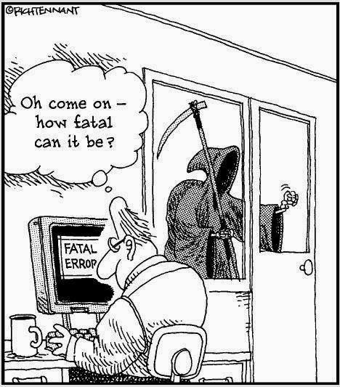
CSc 110, Spring 2017
Lecture 22: Testing
Thanks to Atif Memon from UMD for disaster examples

Slide 2
Count Vowels
Write a function vowel_count(s)that accepts a string s as a parameter and returns a list of integers representing the counts of each vowel of string s.
There are five vowels: a, e, i, o, u
What data mapping would help to count the vowels?
Write a helper function that returns a number representing the index of a vowel in the above mapping.
Notes:
Always, never, sometimes

Slide 3
Vowel helper function
# Maps the characters a,e,i,o,u to the numbers 0,1,2,3,4,
# respectively. If the parameter c is not a vowel, returns -1
def is_vowel(c):
if (c == "a"):
return 0
elif (c == "e"):
return 1
elif (c == "i"):
return 2
elif (c == "o"):
return 3
elif (c == "u"):
return 4
return -1 # parameter c is not a vowel

Slide 4
Count vowels
def main():
vlist = vowel_count("i think, therefore i am")
print("vlist = ", vlist)
# Return a list containing the counts of the number of vowels
# in string s
def vowel_count(s):
# indices of list vowels map to a, e, i, o, u
vowels = [0] * 5
s = s.lower()
for c in s:
i = is_vowel(c)
if (i >= 0):
vowels[i] += 1
return vowels

Slide 5
Count Vowels
Consider an alternative for function is_vowel(c)
Look at this string: v = "aeiou"
What does v.find("e") return?
Previous call to is_vowel(c):
i = is_vowel(c)
Now becomes:
i = "aeiou".find(c)
Notes:
Always, never, sometimes

Slide 6
Why talk about testing?
Software engineers spend a lot of time testing and debugging.
There are positions specifically titled "Software Engineer in Test."
Game development companies have "play testers."
Software testing is expensive but necessary.
Terrible things can happen if software isn't tested thoroughly.

Slide 7
Why talk about testing?
Mars Climate Orbiter
Purpose: to study the Martian climate and to serve as a relay for the Mars Polar Lander
Disaster: Bad trajectory caused it to disintegrate in the upper atmosphere of Mars
Why: Software bug - failure to convert English units to metric values (pound-seconds vs. newton-seconds)

Slide 8
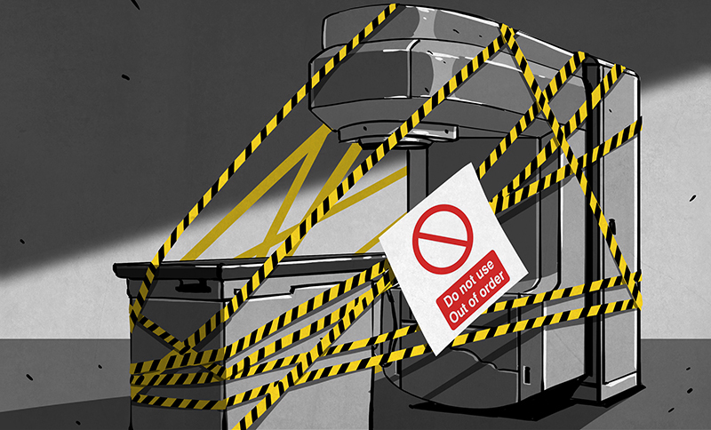
Why talk about testing?
THERAC-25 Radiation Therapy
1985 to 1987: two cancer patients at the East Texas Cancer Center in Tyler received fatal radiation overdose (a total of 6 accidents)
Why: Software bug - mishandled race condition (i.e., miscoordination between concurrent tasks)

Slide 9
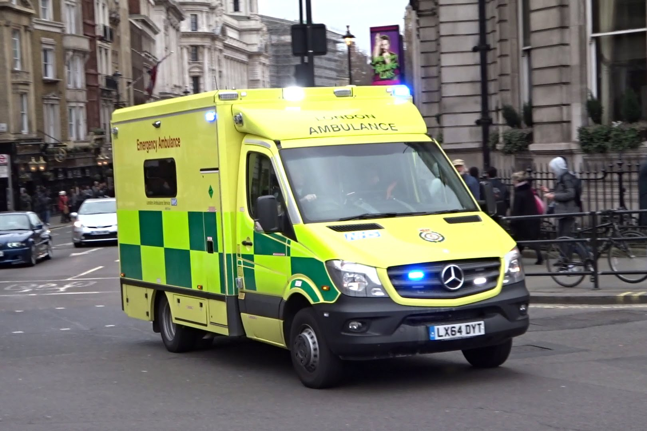
Why talk about testing?
London Ambulance Service
Purpose: automate many of the human-intensive processes of manual dispatch systems associated with ambulance services in the UK – functions: Call taking
Failure of the London Ambulance Service on 26 and 27 November 1992
Load increased, emergencies accumulated, system made incorrect allocations

Slide 10
Industry comparison
“If the automobile industry had developed like the software industry, we would all be driving $25 cars that get 1,000 miles to the gallon.”
“Yeah, and if cars were like software, they would crash twice a day for no reason, and when you called for service, they’d tell you to reinstall the engine.”
A million lines of code is like a machine with a million moving parts

Slide 11
Types of testing: Black box testing
Testing that verifies the code does what the specification requires
The testing is not dependent on the internal structure of the code
Recall testing your code for Gradanator
The specification gave values to enter and the responses to expect
This was a very repetitious task (as you know!)
Could we automate this task?

Slide 12
Black box testing example
Function: remove_bad_pairs(plist) - accepts a list of integers and removes any adjacent pair of integers in the list if the left element of the pair is larger that the right element of the pair.
Consider passing in the following list: [3, 7, 9, 2, 5, 5, 8, 5, 6, 3, 4, 7, 3, 1]
Think of the list as being paired as follows.
[3, 7, 9, 2, 5, 5, 8, 5, 6, 3, 4, 7, 3, 1]
The pairs below are "bad" because the left of the pair is greater than the right:
9, 2 8, 5, 6, 3 3, 1
The function would modify the list as follows:
[3, 7, 5, 5, 4, 7]

Slide 13
Black box testing example – cont.
Function: remove_bad_pairs(plist)
If the list has an odd length, the last element is not part of a pair and is also considered "bad". It would be removed. The list
[10, 20, 2, 5, 4]
would be modified to become
[10, 20, 2, 5]
If an empty list is passed in, the list should still be empty after the call.

Slide 14
What should we test for?
Removing one pair: [9, 2] → []
Removing multiple pairs in a row: [5, 3, 8, 1, 7, 0]→[]
The empty list: [] → []
List of an odd size: [10] → []
List containing an equal pair: [2, 4, 8, 8]→[2, 4, 8, 8]
List containing negative numbers: [-2, -3, 7, 8]→[7, 8]

Slide 15
Black box testing – 1 Manually in Idle
>>> pl = [9, 2]
>>> remove_bad_pairs(pl)
[]
>>> pl
[]
>>> pl = [5, 3, 8, 1, 7, 0]
>>> remove_bad_pairs(pl)
[]
>>> pl
[]
>>> pl = []
>>> remove_bad_pairs(pl)
[]
>>> pl
[]
>>> pl = [10]
>>> remove_bad_pairs(pl)
[]

Slide 16
Black box testing – 1 Manually in Idle
>>> pl = [10]
>>> remove_bad_pairs(pl)
[]
>>> pl
[]
>>> pl = [2, 4, 8, 8]
>>> remove_bad_pairs(pl)
[2, 4, 8, 8]
>>> pl
[2, 4, 8, 8]
>>> pl = [-2, -3, 7, 8]
>>> remove_bad_pairs(pl)
[7, 8]
>>> pl
[7, 8]

Slide 17
Black box testing – 2 Coded with test calls
Manual testing is tedious, expensive, and error-prone.
Let's automate this.
Let's write a program to make these calls.
Programmer changes the implementation of remove_bad_pairs(plist)
Let's see if the new version works.

Slide 18
Black box testing – 3 Further automation
The program which called tests was better, but let's automate further.
Remove the repetition of testing the outcome
A test harness:
Automate the testing process
Execute the test suite (set of test cases)
Report the outcome

Slide 19
Types of testing: White box testing
In contrast to Black box testing, consider White box testing which has these characteristics:
Bases tests on the structure of the code
Ensures that all paths through the code are executed
Requires programming knowledge

Slide 20
What should you test?
Focus on edge cases
Common edge cases
1, 0, -1
Empty list
Range out of bounds
Make sure every path is taken in the code.
Tester must understand all language functionality and concepts.
What is wrong with the version of remove_bad_pairs(plist) on the next slide?

Slide 21
White box testing example
#Version of the function with an error
def remove_bad_pairs(pairs_list):
if (len(pairs_list) % 2 != 0):
pairs_list.remove(pairs_list[-1])
i = 0
while (i < len(pairs_list)):
if (i % 2 != 0 and pairs_list[i - 1] > pairs_list[i]):
list.remove(i-1)
list.remove(i)
else:
i +=2

Slide 22
White box test a more complex problem
Consider the following Internet Movie Database (IMDb) data:
1 9.1 196376 The Shawshank Redemption (1994)
2 9.0 139085 The Godfather: Part II (1974)
3 8.8 81507 Casablanca (1942)
Write a program that displays any movies containing a phrase:
Search word? part
Rank Votes Rating Title
2 139085 9.0 The Godfather: Part II (1974)
40 129172 8.5 The Departed (2006)
95 20401 8.2 The Apartment (1960)
192 30587 8.0 Spartacus (1960)
4 matches.

Slide 23
Types of testing
Unit test: verifies correctness of a small piece of testable code in isolation
Integration test: verifies different small already tested components of the program work together correctly
Regression testing: a complete retesting of a modified program
Stress testing: tests the behavior under peak user volumes
Performance, security, usability and many more

Slide 24
Test driven development
A software engineering philosophy
Tests are written before the code is written

