Slide 1
CSc 110, Spring 2017
Lecture 28: Sets and Dictionaries
Adapted from slides by Marty Stepp and Stuart Reges

Slide 2
Mountain peak
Write a program that reads elevation data from a file, draws it on a DrawingPanel and finds the path from the highest elevation to the edge of the region.
Data:
34 76 87 9 34 8 22 33 33 33 45 65 43 22
5 7 88 0 56 76 76 77 4 45 55 55 4 5
…

Slide 3
Mountain peak
data =
[ [34, 76, 87, 9, 34, 8, 22, 33, 33, 33, 45, 65, 43, 22]
[5, 7, 88, 0, 56, 76, 76, 77, 4, 45, 55, 55, 4, 5]
...
]
Next steps:
4) Find the peak
5) Find the steepest path down
6) Draw the path in yellow

Slide 4
4) Find the peak
data =
[ [34, 76, 87, 9, 34, 8, 22, 33, 33, 33, 45, 65, 43, 22]
[5, 7, 88, 0, 56, 76, 76, 77, 4, 45, 55, 55, 4, 5]
...
]
Find the largest elevation in the list of lists. Write find_peak(data)
Return a tuple of the location in the 2d list

Slide 5
5) Find the steepest path
data =
[['2537', '2483', '2475', '2480', '2518', '2532', '2480', '2478', '2431']
['2541', '2549', '2614', '2700', '2647', '2746', '2690', '2621', '2550']
['2525', '2525', '2640', '2769', '2802', '2883', '2856', '2694', '2631']
['2514', '2505', '2526', '2614', '2717', '2715', '2867', '2836', '2771']
['2506', '2482', '2480', '2528', '2518', '2561', '2586', '2662', '2654']
['2527', '2477', '2464', '2459', '2452', '2475', '2480', '2500', '2518']
['2544', '2505', '2488', '2454', '2442', '2445', '2446', '2467', '2470']
['2528', '2486', '2464', '2446', '2434', '2436', '2442', '2444', '2450']
['2464', '2505', '2482', '2456', '2433', '2463', '2462', '2489', '2467']
['2532', '2541', '2519', '2515', '2496', '2502', '2529', '2519', '2553']]
How do we determine the steepest path?
We would need to compare the peak to each neighbor.

Slide 6
5) Find the steepest path down
data =
[['2537', '2483', '2475', '2480', '2518', '2532', '2480', '2478', '2431']
['2541', '2549', '2614', '2700', '2647', '2746', '2690', '2621', '2550']
['2525', '2525', '2640', '2769', '2802', '2883', '2856', '2694', '2631']
['2514', '2505', '2526', '2614', '2717', '2715', '2867', '2836', '2771']
['2506', '2482', '2480', '2528', '2518', '2561', '2586', '2662', '2654']]
...
]
We will simplify this problem.
Look at only three neighbors:
up
down
front
If peak is at location data[r][c], define each above.

Slide 7
5) Find the steepest path down
data =
[['2537', '2483', '2475', '2480', '2518', '2532', '2480', '2478', '2431']
['2541', '2549', '2614', '2700', '2647', '2746', '2690', '2621', '2550']
['2525', '2525', '2640', '2769', '2802', '2883', '2856', '2694', '2631']
['2514', '2505', '2526', '2614', '2717', '2715', '2867', '2836', '2771']
...]
Compare and find the smallest of the three to create the next
path element.
What happens if there are ties?

Slide 8
5) Find the steepest path down
Rules for ties.
If up == down but < front, choose randomly between them.
up = 2550
down = 2550
front = 2690
If front ties with up or down, choose front.
up = 2690 up = 2550
down = 2550 down = 2690
front = 2550 front = 2550

Slide 9
5) Pseudocode for find_path
initialize current location ⬅ (this is both a row and column)
make an empty list for path
while location is still within the list bounds
assign up, front and down
if (up < down and up < front)
append up location to path
else if (down < up and down < front)
append down location to path
else if (down == up and up < front)
chose randomly between down and up
append one of them to path
else
append front location to path
update current location based on the chosen next location for path
return path

Slide 10
6) Pseudocode for draw_path
For each tuple in the path
Using the column and row given in the tuple, draw
a rectangle that is one pixel wide and filled in with yellow

Slide 11
l
Write a function print_rlist(rlist)that takes a rectangular list as a parameter and prints it out as a grid.
For example, given the list defined below:
grid = [[8,2,7,8,2,1], [1,5,1,7,4,7],
[5,9,6,7,3,2], [7,8,7,7,7,9],
[4,2,6,9,2,3], [2,2,8,1,1,3]]
The call print_rlist(grid) prints the following output:
8 2 7 8 2 1
1 5 1 7 4 7
5 9 6 7 3 2
7 8 7 7 7 9
4 2 6 9 2 3
2 2 8 1 1 3

Slide 12
Exercise
Write a program that counts the number of unique words in a large text file (say, Moby Dick or the King James Bible).
Store the words in a structure and report the # of unique words.
Once you've created this structure, allow the user to search it to see whether various words appear in the text file.
What structure is appropriate for this problem? List? Tuple?

Slide 13
Sets
set: A collection of unique values (no duplicates allowed)
Sets are not indexed. They do not have an order.
The following operations can be performed efficiently on sets:
add, remove, search (contains)
"the"
"of"
"if"
"to" in set
"to"
"down"
"from"
true
"by"
"she"
"be" in set
"you"
false
"in"
"why"
"him"
set

Slide 14
Creating a set
Use the function set:
a = set()
Use {value, …, valuen}:
b = {"the", "hello", "happy"}
a.add(val) | adds element val to a
a.discard(val) | removes val from a if present
a.pop() | removes and returns a random element from a
a - b | returns a new set containing values in a but not in b
a | b | returns a new set containing values in either a or b
a & b | returns a new set containing values in both a and b
a ^ b | returns a new set containing values in a or b but not both
You can also use in, len(), etc.

Slide 15
Looping over a set?
You must use a for element in structure loop
needed because sets have no indexes; can't get element i
Example:
for item in a:
print(item)
Outputs:
the
happy
hello

Slide 16
Exercise
Write a program to count the number of occurrences of each unique word in a large text file (e.g. Moby Dick ).
Allow the user to type a word and report how many times that word appeared in the book.
Report all words that appeared in the book at least 500 times.
What structure is appropriate for this problem?

Slide 17
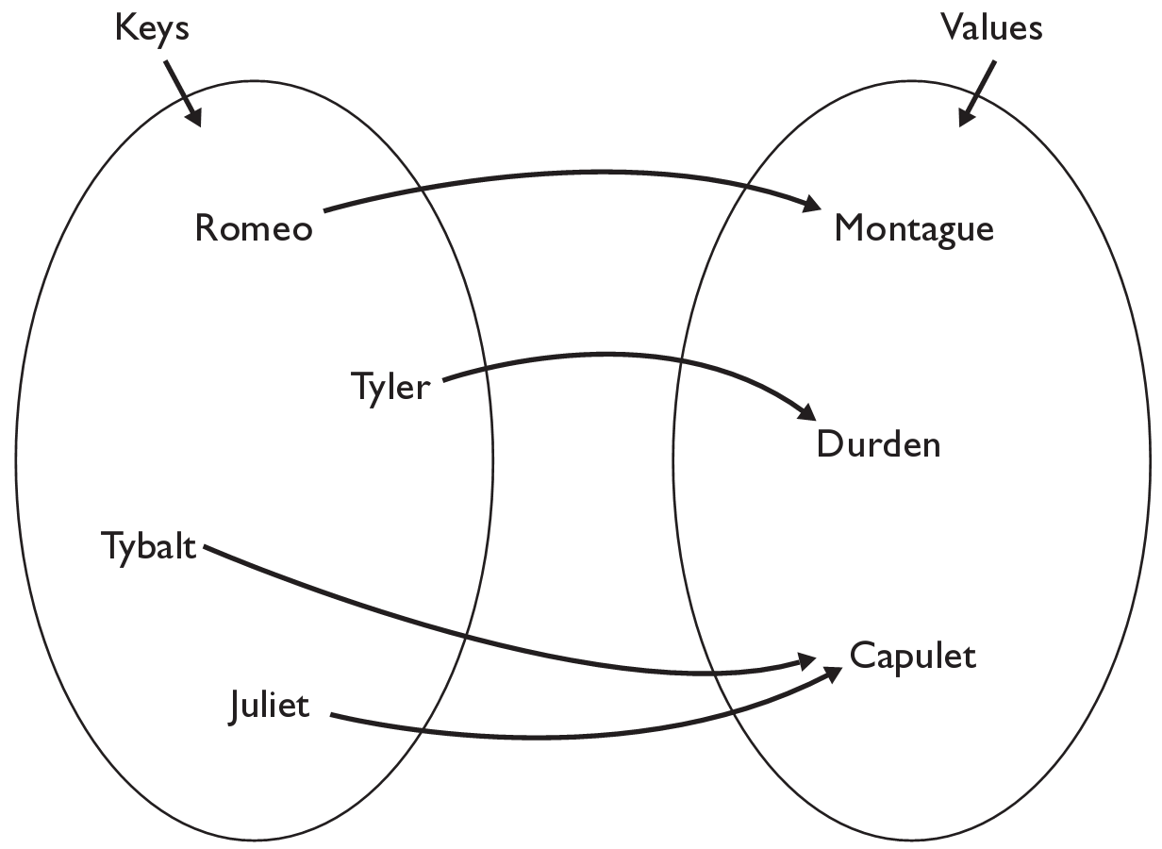
Dictionaries
dictionary: Holds a set of unique keys and a collection of values, where each key is associated with one value.
a.k.a. "map", "associative array", "hash"
basic dictionary operations:
Add a mapping from a key to a value.
Retrieve a value mapped to a key.
Remove a given key and its mapped value.

Slide 18
Creating dictionaries
Creating a dictionary
{key : value, …, keyn : valuen}
my_dict = {"Romeo": "Montague",
"Tyler" :"Durden",
"Tybalt" : "Capulet",
"Juliet" :"Capulet" }
my_dict[key] = value
adds a mapping from the given key to the given value; if the key already exists, replaces its value with the given one
Accessing values:
my_dict[key]
returns the value mapped to the given key (error if key not found)
my_dict["Juliet"] produces "Capulet"

Slide 19
Using dictionaries
A dictionary allows you to get from one half of a pair to the other.
Remembers one piece of information about every index (key).
Later, we can supply only the key and get back the related value:
Allows us to ask: What is Suzy's phone number?
# key value
my_dict["Suzy"] = "206-685-2181"
Dictionary
my_dict["Suzy"]
Dictionary
"206-685-2181"

Slide 20
Maps and tallying
a map can be thought of as generalization of a tallying list
the "index" (key) doesn't have to be an int
count digits: 22092310907
# (Roosevelt), (L)andon, (I)ndependent
count votes: "RLLLLLLRRRRRLLLLLLRLRRIRLRRIRLLRIR"
index | 0 | 1 | 2 | 3 | 4 | 5 | 6 | 7 | 8 | 9
value | 3 | 1 | 3 | 0 | 0 | 0 | 0 | 1 | 0 | 2
"R"
15
key | "R" | "L" | "I"
value | 15 | 15 | 3
"L"
3
"I"
15
keys
values

Slide 21
Dictionary methods
items() | return a new view of the dictionary’s items ((key, value) pairs)
pop(key) | removes any existing mapping for the given key and returns it (error if key not found)
popitem() | removes and returns an arbitrary (key, value) pair (error if empty)
keys() | returns the dictionary's keys
values() | returns the dictionary's values
You can also use in, len(), etc.

Slide 22
items, keys and values
items function returns tuples of each key-value pair
can loop over the keys in a for loop
ages = {}
ages["Merlin"] = 4
ages["Chester"] = 2
ages["Percival"] = 12
for cat, age in ages.items():
print(cat + " -> " + str(age))
values function returns all values in the dictionary
no easy way to get from a value to its associated key(s)
keys function returns all keys in the dictionary

