Slide 1
CSc 110, Spring 2017
Lecture 29: Sets and Dictionaries
Adapted from slides by Marty Stepp and Stuart Reges

Slide 2
Exercise
Write a program that counts the number of unique words in a large text file (say, Moby Dick or the King James Bible).
Store the words in a structure and report the # of unique words.
Once you've created this structure, allow the user to search it to see whether various words appear in the text file.
What structure is appropriate for this problem? List? Tuple?

Slide 3
Unique Words
# outputs the number unique words in a file
def main():
all_words = file_to_words("mobydick.txt")
print("unique word count " + str(len(all_words)))
# creates and returns a set containing all of the words from the
# file with the passed in name stripped of punctuation.
def file_to_words(file_name):
file = open(file_name)
words = file.read()
# get rid of punctuation
words = words.replace(",", "")
words = words.replace(".", "")
words = words.replace("!", "")
words = words.split()
s = set()
for word in words:
s.add(word.lower())
return s
main()

Slide 4
Exercise
Write a program to count the number of occurrences of each unique word in a large text file (e.g. Moby Dick ).
Allow the user to type a word and report how many times that word appeared in the book.
Report all words that appeared in the book at least 500 times.
What structure is appropriate for this problem?

Slide 5
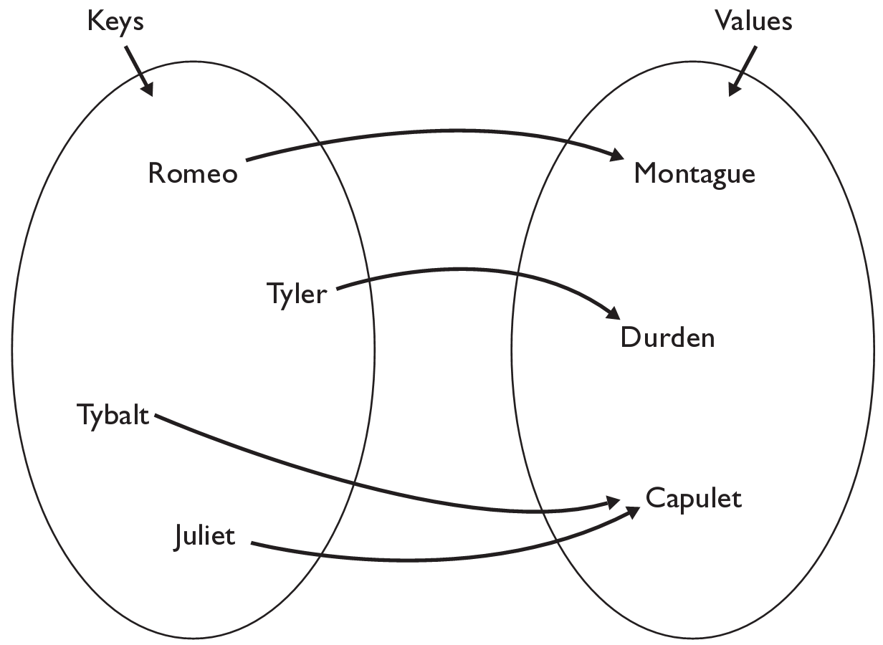
Dictionaries
dictionary: Holds a collection of zero or more key/value pairs
a.k.a. "map", "associative array", "hash"
basic dictionary operations:
Add a mapping from a key to a value.
Retrieve a value mapped to a key.
Remove a given key and its mapped value.

Slide 6
Creating dictionaries
Creating a dictionary
{key : value, …, keyn : valuen}
names = {"Romeo" : "Montague",
"Tyler" : "Durden",
"Tybalt" : "Capulet",
"Juliet" : "Capulet" }
dictionary[key] = value
adds a mapping from the given key to the given value; if the key already exists, replaces its value with the given one
Accessing values:
dictionary[key]
retuns the value mapped to the given key (error if key not found)
names["Juliet"] produces "Capulet"

Slide 7
Using dictionaries
A dictionary allows you to get from one half of a pair to the other.
Associates one piece of information for every key.
Using the key as an index produces the related value:
Allows us to ask: What is Suzy's phone number?
# key value
phones["Suzy"] = "206-685-2181"
Dictionary
phones["Suzy"]
Dictionary
"206-685-2181"

Slide 8
Lists must be indexed by integers
count digits: 22092310907
Dictionaries can be indexed by integers, strings, tuples and more
# (R)oosevelt, (L)andon, (I)ndependent
count votes: "RLLLLLLRRRRRLLLLLLRLRRIRLRRIRLLRIRR"
index | 0 | 1 | 2 | 3 | 4 | 5 | 6 | 7 | 8 | 9
value | 3 | 1 | 3 | 0 | 0 | 0 | 0 | 1 | 0 | 2
"R"
15
key | "R" | "L" | "I"
value | 16 | 15 | 3
"L"
3
"I"
16
keys
values

Slide 9
Checking for a key with the in operator
The in operator returns True if the dictionary contains the specified key and False otherwise.
>>> ages = {}
>>> ages["Joe"] = 10
>>> ages
{'Joe': 10}
>>> "Joe" in ages
True
>>> "Tom" in ages
False

Slide 10
Looping through dictionaries
The for loop can be used to loop through the keys in a dictionary
ages = {}
ages["Merlin"] = 4
ages["Chester"] = 2
ages["Percival"] = 12
for name in ages:
print(name, ages[name])
Output:
Merlin 4
Chester 2
Percival 12

Slide 11
Example
Write a function count_chars that takes a string and returns a dictionary of the counts of all characters in the string.
Using a dictionary:
The keys will be the characters
The values will be the counts.

Slide 12
Example
Write a function count_chars that takes a string and returns a dictionary of the counts of all characters in the string.
Using the name counts for the dictionary, to update the count,
we use the following:
counts[c] = counts[c] + 1
What happens the first time we encounter a new character c?
Must check first to see if it's there.

Slide 13
Dictionary methods
items() | returns a sequence of tuples (key, value) representing the key/value pairs
pop(key) | removes any existing mapping for the given key and returns it (error if key not found)
popitem() | removes and returns an arbitrary (key, value) pair (error if empty)
keys() | returns the dictionary's keys
values() | returns the dictionary's values
You can also use len(), etc.

Slide 14
items, keys and values
The items method can be used to loop through all the key/value pairs in a dictionary
ages = {}
ages["Merlin"] = 4
ages["Chester"] = 2
ages["Percival"] = 12
for tup in ages.items():
print(tup[0] + " -> " + str(tup[1]))
values function returns all values in the dictionary
no easy way to get from a value to its associated key(s)
keys function returns all keys in the dictionary

