Slide 1
CSc 110, Spring 2017
Lecture 30: 2D Structures
Adapted from slides by Marty Stepp and Stuart Reges

Slide 2
Set creation, operations and methods
Use the function set:
a = set()
Use {value, …, valuen}:
b = {"the", "hello", "happy"}
a.add(val) | adds element val to a
a.discard(val) | removes val from a if present
a.pop() | removes and returns a random element from a
a - b | returns a new set containing values in a but not in b
a | b | returns a new set containing values in either a or b
a & b | returns a new set containing values in both a and b
a ^ b | returns a new set containing values in a or b but not both
You can also use in, len(), etc.

Slide 3
Dictionary methods
items() | return a new view of the dictionary’s items ((key, value) pairs)
pop(key) | removes any existing mapping for the given key and returns it (error if key not found)
popitem() | removes and returns an arbitrary (key, value) pair (error if empty)
keys() | returns the dictionary's keys
values() | returns the dictionary's values
You can also use in, len(), etc.

Slide 4
What is the right structure?
You want to store a bunch of colors so you can later choose one at random.
Batting order of a baseball team.
Students names and their grades on a project.
Friends names and their phone numbers
Height, width and location of a sports field.
Movies a person has watched.
Items in a shopping cart.
A student's grades.

Slide 5
What is the right structure?
The grades for all students in a class
All books in a store arranged by category
Many recipes each containing many steps
Phone numbers that have been called this month on a phone plan divided by area and country code for billing simplicity

Slide 6
Exercise
Write a program that allows a user to ask the distance between two friends.
If person 1 and person 2 are friends then they are distance 0
If person 2 is friends with a friend of person 2 they are distance 1
What structure is appropriate for this problem?

Slide 7
Data - dot file format
graph {
Ashley -- Christopher
Ashley -- Emily
Ashley -- Joshua
Christopher -- Andrew
Emily -- Joshua
Jacob -- Christopher
Jessica -- Ashley
Sarah -- Andrew
Sarah -- Christopher
Sarah -- Emily
Stuart -- Jacob
}

Slide 8
Left blank

Slide 9
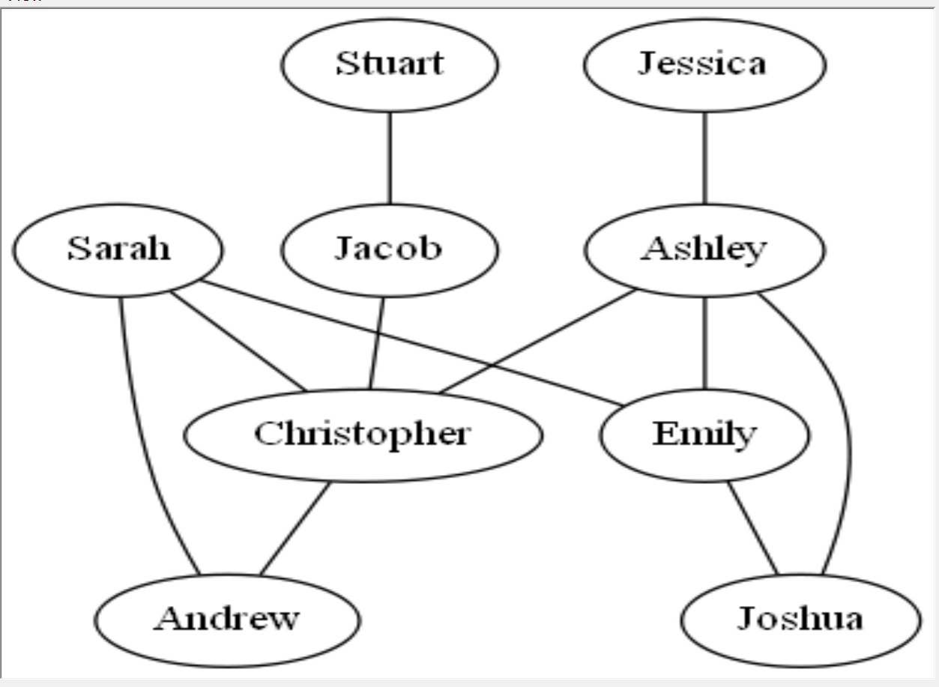

Slide 10
Ashley Christopher Emily Joshua Andrew
Jacob Jessica Sarah Stuart

Slide 11
# Reads in a dot file with friendship data
# Asks if two people are friends
def main():
file = open("friends.dot")
lines = file.readlines()
friends = create_set(lines)
for name in friends:
print(name, " : ", friends[name])
name1 = input("Enter a name: ")
name2 = input("Enter a name: ")
#Are name1 and name2 friends?

Slide 12
# creates and returns a dictionary mapping each person to a set
# of their friends. Creates an entry for 1 to 2 and 2 to 1.
def create_set(lines):
friends = {}
# skip the first and lst lines as they have dot syntax
for i in range(1, len(lines) - 1):
line = lines[i].split()
name1 = line[0]
name2 = line[2]
if (name1 not in friends):
friends[name1] = set()
friends[name1].add(name2)
if (name2 not in friends):
friends[name2] = set()
friends[name2].add(name1)
return friends

