Slide 1
CSc 110, Spring 2017
Lecture 31: 2D Structures
Adapted from slides by Marty Stepp and Stuart Reges

Slide 2
Exercise
Write a program that allows a user to ask the distance between two people in a network of friends.
If person 1 and person 2 are friends then they are at distance 1
If person 2 is friends with a friend of person 2 they are at distance 2

Slide 3
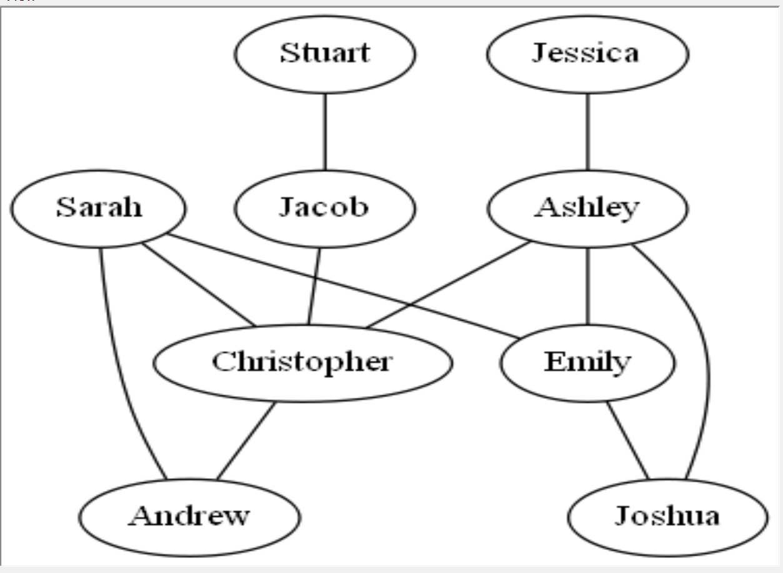
graph {
Ashley -- Christopher
Ashley -- Emily
Ashley -- Joshua
Christopher -- Andrew
Emily -- Joshua
Jacob -- Christopher
Jessica -- Ashley
Sarah -- Andrew
Sarah -- Christopher
Sarah -- Emily
Stuart -- Jacob
}
Name 2 friends at distance 1.
Which two people are at the greatest distance?

Slide 4
Ashley Christopher Emily
Christopher Ashley Ashley
Emily Jacob Joshua
Joshua Andrew Sarah
Jessica Sarah
Note: not all sets of friends shown.
graph {
Ashley -- Christopher
Ashley -- Emily
Ashley -- Joshua
Christopher -- Andrew
Emily -- Joshua
Jacob -- Christopher
Jessica -- Ashley
Sarah -- Andrew
Sarah -- Christopher
Sarah -- Emily
Stuart -- Jacob
}

Slide 5
# Reads in a dot file with friendship data
# Version 0: Asks if two people are friends
def main():
file = open("friends.dot")
lines = file.readlines()
friends = create_dict(lines)
for name in friends:
print(name, " : ", friends[name])
name1 = input("Enter a name: ")
name2 = input("Enter a name: ")
#Are name1 and name2 friends?

Slide 6
# creates and returns a dictionary mapping each person to a
# set of their friends. Creates an entry for name1 to name2
# and name2 to name1.
def create_dict(lines):
friends = {}
# skip the first and lst lines as they have dot syntax
for i in range(1, len(lines) - 1):
line = lines[i].split()
name1 = line[0]
name2 = line[2]
if (name1 not in friends):
friends[name1] = set()
friends[name1].add(name2)
if (name2 not in friends):
friends[name2] = set()
friends[name2].add(name1)
return friends

Slide 7
friends dictionary
The content of the friends dictionary is:
{
Stuart : {'Jacob'}
Jacob : {'Stuart', 'Christopher'}
Ashley : {'Christopher', 'Emily', 'Joshua', 'Jessica'}
Sarah : {'Christopher', 'Andrew', 'Emily'}
Jessica : {'Ashley'}
Andrew : {'Christopher', 'Sarah'}
Emily : {'Ashley', 'Joshua', 'Sarah'}
Joshua : {'Ashley', 'Emily'}
Christopher : {'Jacob', 'Ashley', 'Andrew', 'Sarah'}
}

Slide 9
Pseudocode for finding the distance – Version1
initialize a current set of friends to name1
initialize distance to zero
while name2 not found in current set of friends
increment the distance
make a new set of friends from the current set using the dictionary
to reference the sets of friends
set the current set of friends to the union of the current set and new set of friends
print the distance

Slide 10
Sarah to Joshua
This works but what if we looked for someone out of the friend network?
What is the problem with current_friends?
new_friends
{'Christopher', 'Andrew', 'Emily'}
current_friends
{'Christopher', 'Sarah', 'Andrew', 'Emily'}
new_friends
{'Sarah', 'Ashley', 'Andrew', 'Emily', 'Jacob', 'Joshua', 'Christopher'}
current_friends
{'Ashley', 'Jacob', 'Joshua', 'Sarah', 'Andrew', 'Emily', 'Christopher'}
distance is: 2
We are never removing names that we have already seen.

Slide 11
Pseudocode for finding the distance – Version2
initialize a current set of friends to name1
Initialize a set of already seen friends to name1
initialize distance to zero
while name2 not found in current set of friends and length of current friends not zero
increment the distance
make a new set of friends from the current set using the dictionary
to reference the sets of friends
already seen friends is assigned to the union of itself and current friends
set the current set of friends to the new set of friends minus the already seen friends
if the length of the current set of friends is not zero
print the distance
else
print not connected

Slide 12
# Reads in a dot file with friendship data – Version2
def main():
file = open("friends.dot")
lines = file.readlines()
friends = create_dict(lines)
name1 = input("Enter a name: ")
name2 = input("Enter a name: ")
#Are name1 and name2 friends?
current_friends = {name1}
already_seen = {name1}
distance = 0
# stops when the friend is found or there is no possibility of a connection
while(name2 not in current_friends and len(current_friends) != 0):
distance += 1
new_friends = set()
# builds up a set of the friends of the current friends
for friend in current_friends:
new_friends = new_friends | friends[friend]
already_seen = already_seen | current_friends
# replaces current friends and gets rid of friends looked at before
current_friends = new_friends - already_seen
if(len(current_friends) != 0):
print("found at distance " + str(distance))
else:
print("sorry they are not connected")

