Slide 1
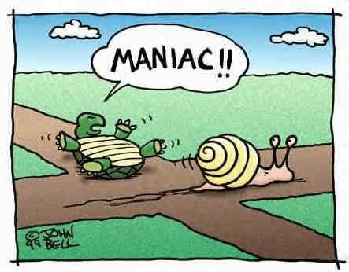
CSc 110, Spring 2017
Lecture 38: Critters
Adapted from slides by Marty Stepp and Stuart Reges

Slide 2
Calling overridden methods
Subclasses can call overridden methods with super
super(ClassName, self).method(parameters)
Example:
class Rabbit(Critter):
def __init__(self):
super(Rabbit,self).__init__()
self.__moves = 0
self.__hungry = False
What class is Rabbit inheriting from? _____________________
What method did Rabbit override above? _________________
What code creates an instance of the class Rabbit? _________________________
What code would cause the __str__ method of a class to be called? _______________________

Slide 3
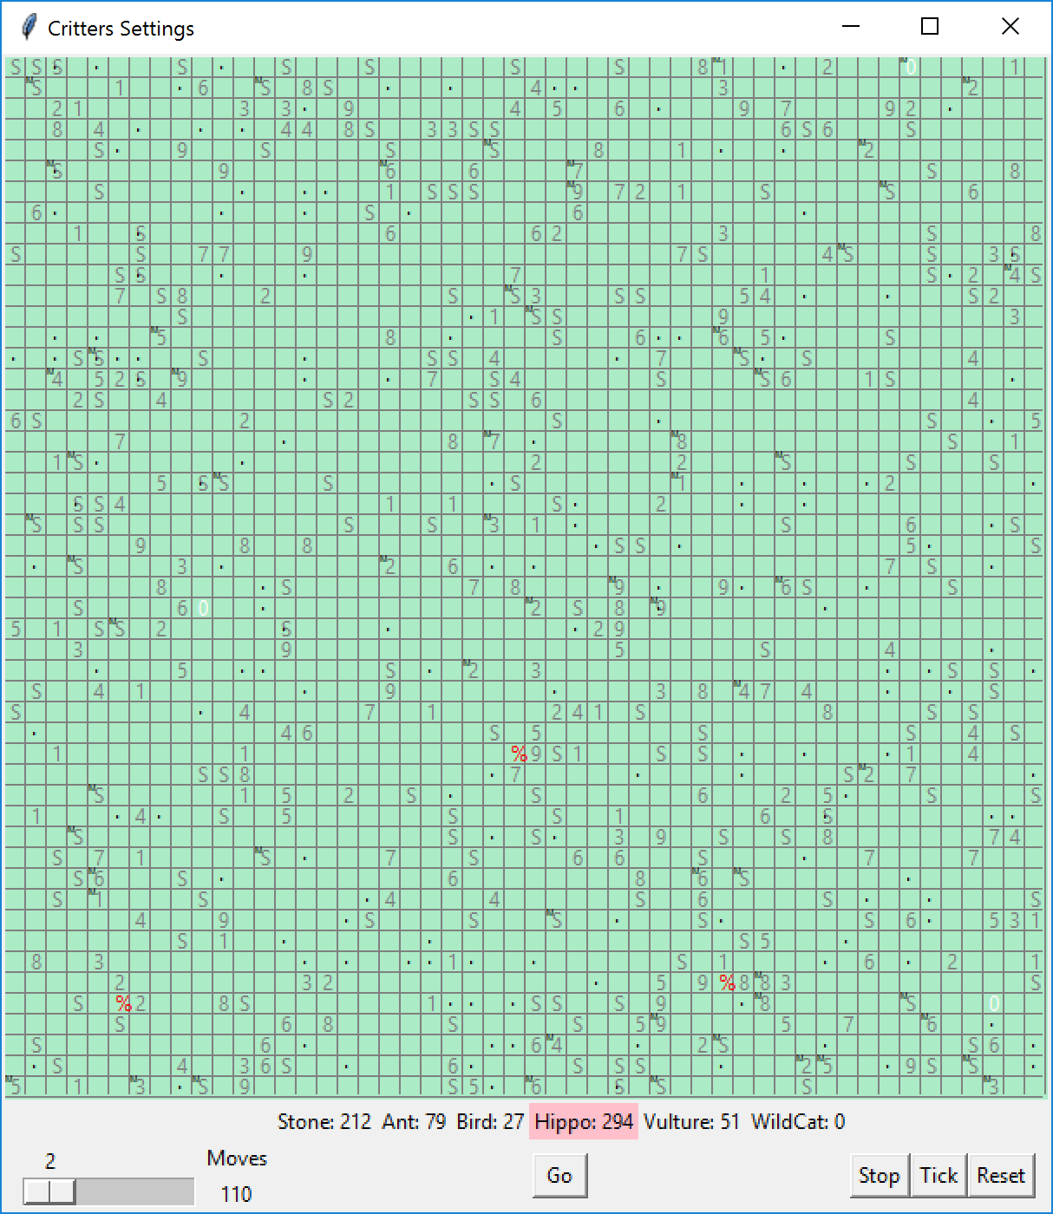
CSc 110 Critters
Ant
Bird
Hippo
Vulture
WildCat (creative)
behavior:
eat eating food
fight animal fighting
get_color color to display
get_move movement
__str__ a single character to display

Slide 4
Inherit from the Critter class
Syntax: class name(Critter):
class NewAnimal(Critter):
def eat()
# returns True or False
def fight(opponent)
# ROAR, POUNCE, SCRATCH
def get_color()
# returns a string for the color, e.g., "blue"
def get_move()
# returns NORTH, SOUTH, EAST, WEST, CENTER
def __str__()

Slide 5
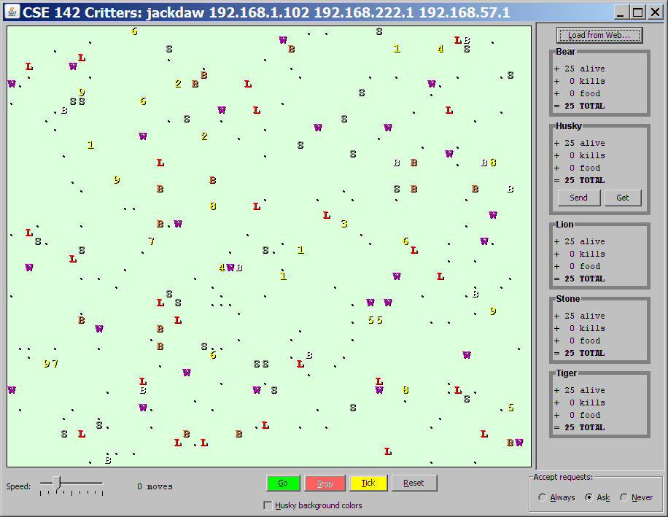
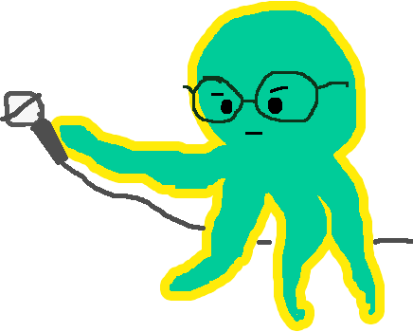
How the simulator works
"Go" → loop:
move each animal (get_move)
if they collide, fight
if they find food, eat
The simulator keeps score based on:
How many animals of that kind are still alive
How much food they have eaten
How many other animals they have beaten in a fight
Simulator is in control!
get_move is one move at a time
(no loops)
Keep state (attributes)
to remember for future moves
Next move?
%

Slide 6
Development Strategy
Simulator helps you debug
smaller width/height
fewer animals
"Tick" instead of "Go"
Write your own main
call your animal's methods and print what they return

Slide 7
The Critter class
class Critter():
def eat(self):
return False
def fight(self, opponent):
return ATTACK_FORFEIT
def get_color(self):
return "grey"
def get_move(self):
return DIRECTION_CENTER
def __str__(self):
return "?"

Slide 8
The Critter class constants
# Constants for attacks, directions
ATTACK_POUNCE = 0
ATTACK_ROAR = 1
ATTACK_SCRATCH = 2
ATTACK_FORFEIT = 3
DIRECTION_NORTH = 0
DIRECTION_SOUTH = 1
DIRECTION_EAST = 2
DIRECTION_WEST = 3
DIRECTION_CENTER = 4

Slide 9
Critter exercise: Cougar
Write a critter class Cougar:
Method | Behavior
__init__
eat | Always eats.
fight | Always pounces.
get_color | Blue if the Cougar has never fought; red if he has.
get_move | Walks west until he finds food; then walks east until he finds food; then goes west and repeats.
__str__ | "C"

Slide 10
Critter exercise: Cougar
We need to know two things about its state:
Has it ever fought?
How much food it has eaten? Needed in order to return the correct direction. (West/Eat/East/Eat/West/Eat/East, and so on)
Two instance variables
fought (of type bool)
eaten (of type int)
Method eat: increment eaten every time eat is called
Method get_move: Walks west until he finds food; then walks east until he finds food; then goes west until west and repeats.
if eaten is even, walk west else walk east

Slide 11
The Cougar class
from Critter import *
class Cougar(Critter):
# returns a Cougar
def __init__(self):
super(Cougar,self).__init__() # call the superclass constructor
self.__fought = False
self.__eaten = 0
# returns "C" as a representation of the cougar
def __str__(self):
return "C"
# returns that the critter does want to eat
def eat(self):
self.__eaten += 1
return True

Slide 12
The Cougar class- cont.
# returns the pounce attack
def fight(self, opponent):
self.__fought = True
return ATTACK_POUNCE
# returns west until the critter eats, returns east until it
# eats again and then repeats
def get_move(self):
if(self.__eaten % 2 == 0):
return DIRECTION_WEST
else:
return DIRECTION_EAST
# returns blue if the critter has never fought and red if it has
def get_color(self):
if(not self.__fought):
return "blue"
else:
return "red"

Slide 13
Debugging: Cougar
Start small. Run the Cougar class.
In idle, create a Cougar object
Call the methods to verify the behavior

Slide 14
Debugging Cougar
>>> c = Cougar()
>>> c.get_color()
'blue'
>>> c.get_move()
3
>>> c.eat()
True
>>> c.get_move()
2
>>> c.fight()
Traceback (most recent call last):
File "<pyshell#5>", line 1, in <module>
c.fight()
TypeError: fight() missing 1 required positional argument: 'opponent'
>>>

Slide 15
Debugging: Cougar
Add Stone and Cougar to the list of methods Critters.py
Use a small grid size, few animals
Go tick by tick
Simulator actions on each tick for each animal:
Move the animal (call get_move) in a random order
If moved to occupied square, call both animials fight methods
If moved onto food, call the animal's eat method.
What the scores mean:
How many animals of the class are alive
How much food they have eaten
How many other animals they have destroyed in a fight

Slide 16
Ideas for state
You must not only have the right state, but update that state properly when relevant actions occur.
Counting is helpful:
How many total moves has this animal made?
How many times has it eaten? Fought?
Remembering recent actions in attributes is helpful:
Which direction did the animal move last?
How many times has it moved that way?
Did the animal eat the last time it was asked?
How many steps has the animal taken since last eating?
How many fights has the animal been in since last eating?

Slide 17
Critter exercise: Aardvark
Write a critter class Aardvark:
Method | Behavior
__init__
eat | Eats 3 pieces of food and then stops
fight | randomly chooses between pouncing and roaring
get_color | pink if hungry and red if full
get_move | walks up two and then down two
__str__ | "a" if hungry "A" otherwise

Slide 18
Critter exercise: Aardvark
We need to know two things about its state:
How much food has it eaten?
How many moves has it taken?
Instance variables:
eaten (of type int)
moves (of type int)
Method eat: increment eaten every time eat is called, return False after 3
Method get_move: Walks up two and then down two
N N S S N N S S N N S S
1 2 3 4 1 2 3 4 1 2 3 4 ← use logic as in Rabbit

