Slide 1
CSc 110, Spring 2017
Lecture 40: Sorting
Adapted from slides by Marty Stepp and Stuart Reges

Slide 2
Searching
How many items are examined worse case for sequential search?
How many items are examined worst case for binary search?
An algorithm's efficiency can be expressed in terms of being proportional to its __________ size.
Why is sequential search also known as linear search?

Slide 3
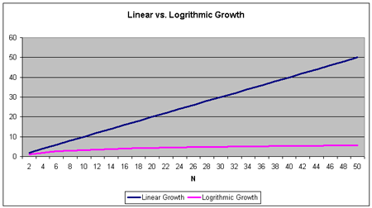
Linear vs. Logarithmic Growth

Slide 4
Sorting
sorting: Rearranging the values in a list into a specific order (usually into their "natural ordering").
one of the fundamental problems in computer science
can be solved in many ways:
there are many sorting algorithms
some are faster/slower than others
some use more/less memory than others
some work better with specific kinds of data
some can utilize multiple computers / processors, ...
comparison-based sorting : determining order by comparing pairs of elements:
<, >, …

Slide 5
Sorting algorithms
bogo sort: shuffle and pray
selection sort: look for the smallest element, move to front
bubble sort: swap adjacent pairs that are out of order
insertion sort: build an increasingly large sorted front portion
merge sort: recursively divide the list in half and sort it
heap sort: place the values into a sorted tree structure
quick sort: recursively partition list based on a middle value
other specialized sorting algorithms:
bucket sort: cluster elements into smaller groups, sort them
radix sort: sort integers by last digit, then 2nd to last, then ...
...

Slide 6
Bogo sort
bogo sort: Orders a list of values by repetitively shuffling them and checking if they are sorted.
name comes from the word "bogus"
The algorithm:
Scan the list, seeing if it is sorted. If so, stop.
Else, shuffle the values in the list and repeat.
This sorting algorithm (obviously) has terrible performance!

Slide 7
Bogo sort code
# Places the elements of a into sorted order.
def bogo_sort(a):
while (not is_sorted(a)):
shuffle(a)
# Returns true if a's elements
#are in sorted order.
def is_sorted(a):
for i in range(0, len(a) - 1):
if (a[i] > a[i + 1]):
return False
return True

Slide 8
Selection sort
10 13 8 2 4 7

Slide 9
Selection sort
selection sort: Orders a list of values by repeatedly putting the smallest or largest unplaced value into its final position.
The algorithm:
Look through the list to find the smallest value.
Swap it so that it is at index 0.
Look through the list to find the second-smallest value.
Swap it so that it is at index 1.
...
Repeat until all values are in their proper places.

Slide 10
Selection sort example
Initial list:
After 1st, 2nd, and 3rd passes:
index | 0 | 1 | 2 | 3 | 4 | 5 | 6 | 7 | 8 | 9 | 10 | 11 | 12 | 13 | 14 | 15 | 16
value | 22 | 18 | 12 | -4 | 27 | 30 | 36 | 50 | 7 | 68 | 91 | 56 | 2 | 85 | 42 | 98 | 25
index | 0 | 1 | 2 | 3 | 4 | 5 | 6 | 7 | 8 | 9 | 10 | 11 | 12 | 13 | 14 | 15 | 16
value | -4 | 18 | 12 | 22 | 27 | 30 | 36 | 50 | 7 | 68 | 91 | 56 | 2 | 85 | 42 | 98 | 25
index | 0 | 1 | 2 | 3 | 4 | 5 | 6 | 7 | 8 | 9 | 10 | 11 | 12 | 13 | 14 | 15 | 16
value | -4 | 2 | 12 | 22 | 27 | 30 | 36 | 50 | 7 | 68 | 91 | 56 | 18 | 85 | 42 | 98 | 25
index | 0 | 1 | 2 | 3 | 4 | 5 | 6 | 7 | 8 | 9 | 10 | 11 | 12 | 13 | 14 | 15 | 16
value | -4 | 2 | 7 | 22 | 27 | 30 | 36 | 50 | 12 | 68 | 91 | 56 | 18 | 85 | 42 | 98 | 25

Slide 11
Selection sort code
# Rearranges the elements of a into sorted order using
# the selection sort algorithm.
def selection_sort(a):
for i in range(0, len(a) - 1):
# find index of smallest remaining value
min = i
for j in range(i + 1, len(a)):
if (a[j] < a[min]):
min = j
# swap smallest value its proper place, a[i]
swap(a, i, min)
def swap(a, i, j):
if (i != j):
temp = a[i]
a[i] = a[j]
a[j] = temp

Slide 12
Selection sort runtime
How many comparisons does selection sort have to do?
First round (N-1)
Second round (N-2)
Third round (N-3)
…
2
1
or
(N-1) + (N-2) + (N-3) + …. + 2 + 1 = N(N-1)/2
Selection sort examines a number of elements in proportional to N²

Slide 13
Similar algorithms
bubble sort: Make repeated passes, swapping adjacent values
slower than selection sort (has to do more swaps)
index | 0 | 1 | 2 | 3 | 4 | 5 | 6 | 7 | 8 | 9 | 10 | 11 | 12 | 13 | 14 | 15 | 16
value | 22 | 18 | 12 | -4 | 27 | 30 | 36 | 50 | 7 | 68 | 91 | 56 | 2 | 85 | 42 | 98 | 25
index | 0 | 1 | 2 | 3 | 4 | 5 | 6 | 7 | 8 | 9 | 10 | 11 | 12 | 13 | 14 | 15 | 16
value | 18 | 12 | -4 | 22 | 27 | 30 | 36 | 7 | 50 | 68 | 56 | 2 | 85 | 42 | 91 | 25 | 98
22
50
91
98

Slide 14
Bubble sort
bubble sort: Orders a list of values by repeatedly comparing adjacent values, swapping if the values are out of order.
The algorithm for a list of size N:
Compare the first two adjacent values.
Swap if the second is smaller than the first.
Repeat until the the end of the list .
Largest value is now at position N
Decrement N by 1 and repeat.

Slide 15
Bubble sort runtime
How many comparisons does selection sort have to do?
First round (N-1)
Second round (N-2)
Third round (N-3)
…
2
1
or
(N-1) + (N-2) + (N-3) + …. + 2 + 1 = N(N-1)/2
Bubble sort examines a number of elements in proportional to N²

Slide 16
Similar algorithms
insertion sort: Shift each element into a sorted sub-list
faster than selection sort (examines fewer values)
index | 0 | 1 | 2 | 3 | 4 | 5 | 6 | 7 | 8 | 9 | 10 | 11 | 12 | 13 | 14 | 15 | 16
value | 22 | 18 | 12 | -4 | 27 | 30 | 36 | 50 | 7 | 68 | 91 | 56 | 2 | 85 | 42 | 98 | 25
index | 0 | 1 | 2 | 3 | 4 | 5 | 6 | 7 | 8 | 9 | 10 | 11 | 12 | 13 | 14 | 15 | 16
value | -4 | 12 | 18 | 22 | 27 | 30 | 36 | 50 | 7 | 68 | 91 | 56 | 2 | 85 | 42 | 98 | 25
sorted sub-list (indexes 0-7)
7

Slide 17
Merge sort
merge sort: Repeatedly divides the data in half, sorts each half, and combines the sorted halves into a sorted whole.
The algorithm:
Divide the list into two roughly equal halves.
Sort the left half.
Sort the right half.
Merge the two sorted halves into one sorted list.
Often implemented recursively.
An example of a "divide and conquer" algorithm.
Invented by John von Neumann in 1945

Slide 18
Merge sort example
index | 0 | 1 | 2 | 3 | 4 | 5 | 6 | 7
value | 22 | 18 | 12 | -4 | 58 | 7 | 31 | 42
split
22 | 18 | 12 | -4
58 | 7 | 31 | 42
split
split
22 | 18
12 | -4
58 | 7
31 | 42
split
split
split
split
22
18
12
-4
58
7
31
42
merge
merge
merge
merge
18 | 22
-4 | 12
7 | 58
31 | 42
merge
merge
-4 | 12 | 18 | 22
7 | 31 | 42 | 58
merge
-4 | 7 | 12 | 18 | 22 | 31 | 42 | 58

Slide 19
Merge halves code
# Merges the left/right elements into a sorted result.
# Precondition: left/right are sorted
def merge(result, left, right):
i1 = 0 # index into left list
i2 = 0 # index into right list
for i in range(0, len(result)):
if (i2 >= len(right) or (i1 < len(left) and left[i1] <= right[i2])):
result[i] = left[i1] # take from left
i1 += 1
else:
result[i] = right[i2] # take from right
i2 += 1

Slide 20
Merge sort code
# Rearranges the elements of a into sorted order using
# the merge sort algorithm.
def merge_sort(a):
if (len(a) >= 2):
# split list into two halves
left = a[0, len(a)//2]
right = a[len(a)//2, len(a)]
# sort the two halves
merge_sort(left)
merge_sort(right)
# merge the sorted halves into a sorted whole
merge(a, left, right)

Slide 21
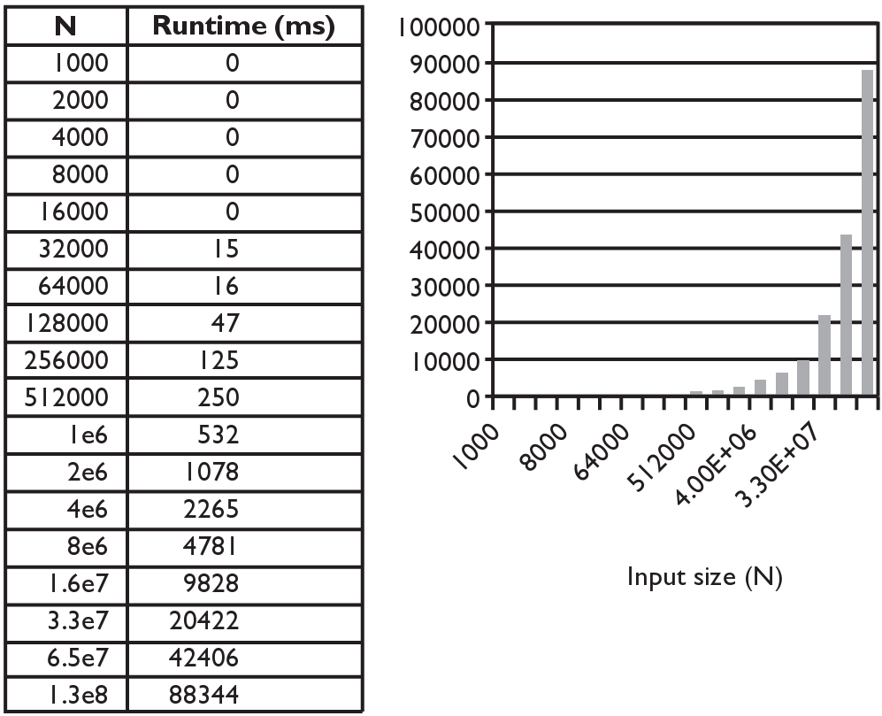
Merge sort runtime
How many comparisons does merge sort have to do?

