Slide 1
CSc 453 Lexical Analysis (Scanning)
Saumya Debray
The University of Arizona
Tucson

Slide 2
Overview
tokens
source
program
lexical analyzer
(scanner)
syntax analyzer
(parser)
symbol table
manager
Main task: to read input characters and group them into “tokens.”
Secondary tasks:
Skip comments and whitespace;
Correlate error messages with source program (e.g., line number of error).

Slide 3
Overview (cont’d)
Token
sequence
Input file
keywd_int
identifier: “main”
left_paren
keywod_int
identifier: “argc”
comma
keywd_char
star
star
identifier: “argv”
right_paren
left_brace
keywd_int
…
/ | * | p | g | m | . | c | * | / | \n | i | n
t |  | m | a | i | n | ( | i | n | t |  | a
r | g | c | , | c | h | a | r | * | * | a | r
g | v | ) | { | \n | \t | i | n | t |  | x | ,
Y | ; | \n | \t | f | l | o | a | t |  | w | ;
lexical
analyzer
. . .

Slide 4
Implementing Lexical Analyzers
Different approaches:
Using a scanner generator, e.g., lex or flex. This automatically generates a lexical analyzer from a high-level description of the tokens.
(easiest to implement; least efficient)
Programming it in a language such as C, using the I/O facilities of the language.
(intermediate in ease, efficiency)
Writing it in assembly language and explicitly managing the input.
(hardest to implement, but most efficient)

Slide 5
Lexical Analysis: Terminology
token: a name for a set of input strings with related structure.
Example: “identifier,” “integer constant”
pattern: a rule describing the set of strings associated with a token.
Example: “a letter followed by zero or more letters, digits, or underscores.”
lexeme: the actual input string that matches a pattern.
Example: count

Slide 6
Examples
Input: count = 123
Tokens:
identifier : Rule: “letter followed by …”
Lexeme: count
assg_op : Rule: =
Lexeme: =
integer_const : Rule: “digit followed by …”
Lexeme: 123

Slide 7
Attributes for Tokens
If more than one lexeme can match the pattern for a token, the scanner must indicate the actual lexeme that matched.
This information is given using an attribute associated with the token.
Example: The program statement
count = 123
yields the following token-attribute pairs:
⟨identifier, pointer to the string “count”⟩
⟨assg_op, ⟩
⟨integer_const, the integer value 123⟩

Slide 8
Specifying Tokens: regular expressions
Terminology:
alphabet : a finite set of symbols
string : a finite sequence of alphabet symbols
language : a (finite or infinite) set of strings.
Regular Operations on languages:
Union: R ∪ S = { x | x ∈ R or x ∈ S}
Concatenation: RS = { xy | x ∈ R and y ∈ S}
Kleene closure: R* = R concatenated with itself 0 or more times
= {ε} ∪ R ∪ RR ∪ RRR ∪
= strings obtained by concatenating a finite
number of strings from the set R.

Slide 9
Regular Expressions
A pattern notation for describing certain kinds of sets over strings:
Given an alphabet Σ:
ε is a regular exp. (denotes the language {ε})
for each a ∈ Σ, a is a regular exp. (denotes the language {a})
if r and s are regular exps. denoting L(r) and L(s) respectively, then so are:
(r) | (s) ( denotes the language L(r) ∪ L(s) )
(r)(s) ( denotes the language L(r)L(s) )
(r)* ( denotes the language L(r)* )

Slide 10
Common Extensions to r.e. Notation
One or more repetitions of r : r+
A range of characters : [a-zA-Z], [0-9]
An optional expression: r?
Any single character: .
Giving names to regular expressions, e.g.:
letter = [a-zA-Z_]
digit = 0 | 1 | 2 | 3 | 4 | 5 | 6 | 7 | 8 | 9
ident = letter ( letter | digit )*
Integer_const = digit+

Slide 11
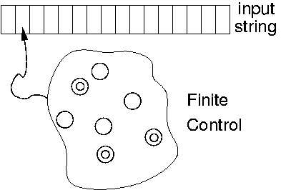
Recognizing Tokens: Finite Automata
A finite automaton is a 5-tuple (Q, Σ, δ, q₀, F), where:
Σ is a finite alphabet;
Q is a finite set of states;
δ : Q × Σ → Q is the transition function;
q₀ ∈ Q is the initial state; and
F ⊆ Q is a set of final states.

Slide 12
Finite Automata: An Example
A (deterministic) finite automaton (DFA) to match C-style comments:

Slide 13
Formalizing Automata Behavior
To formalize automata behavior, we extend the transition function to deal with strings:
δ* : Q × Σ* → Q
δ*(q, ε) = q
δ*(q, aw) = δ*(r, w) where r = δ(q, a)
The language accepted by an automaton M is
L(M) = { w | δ*(q₀, w) ∈ F }.
A language L is regular if it is accepted by some finite automaton.

Slide 14
Finite Automata and Lexical Analysis
The tokens of a language are specified using regular expressions.
A scanner is a big DFA, essentially the “aggregate” of the automata for the individual tokens.
Issues:
What does the scanner automaton look like?
How much should we match? (When do we stop?)
What do we do when a match is found?
Buffer management (for efficiency reasons).

Slide 15
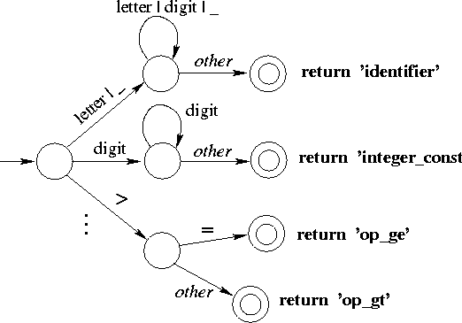
Structure of a Scanner Automaton

Slide 16
How much should we match?
In general, find the longest match possible.
E.g., on input 123.45, match this as
num_const(123.45)
rather than
num_const(123), “.”, num_const(45).

Slide 17
How much should we match?
Need to be careful when specifying tokens under “longest match possible” policy:
Pattern
Input program
COMMENT ″/*″(.|\n)*″*/″
(.|\n)*
float area() { /* area of a circle */
float r, a;
scanf(“%”, &r); /* radius */
a = 3.1416*r*r;
return a;
}

Slide 18
Handling Reserved Words
Hard-wire them directly into the scanner automaton:
harder to modify;
increases the size and complexity of the automaton;
performance benefits unclear (fewer tests, but cache effects due to larger code size).
Fold them into “identifier” case, then look up a keyword table:
simpler, smaller code;
table lookup cost can be mitigated using perfect hashing.

Slide 19
Implementing Finite Automata 1
Encoded as program code:
each state corresponds to a (labeled code fragment)
state transitions represented as control transfers.
E.g.:
while ( TRUE ) {
…
state_k: ch = NextChar(); /* buffer mgt happens here */
switch (ch) {
case … : goto ...; /* state transition */
…
}
state_m: /* final state */
copy lexeme to where parser can get at it;
return token_type;
…
}

Slide 20
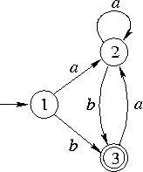
Direct-Coded Automaton: Example
int scanner()
{ char ch;
while (TRUE) {
ch = NextChar( );
state_1: switch (ch) { /* initial state */
case ‘a’ : goto state_2;
case ‘b’ : goto state_3;
default : Error();
}
state_2: …
state_3: switch (ch) {
case ‘a’ : goto state_2;
default : return SUCCESS;
}
} /* while */
}

Slide 21
Implementing Finite Automata 2
Table-driven automata (e.g., lex, flex):
Use a table to encode transitions:
next_state = T(curr_state, next_char);
Use one bit in state no. to indicate whether it’s a final (or error) state. If so, consult a separate table for what action to take.
T | next input character
Current state

Slide 22
Table-Driven Automaton: Example
#define isFinal(s) ((s) < 0)
int scanner()
{ char ch;
int currState = 1;
while (TRUE) {
ch = NextChar( );
if (ch == EOF) return 0; /* fail */
currState = T [currState, ch];
if (IsFinal(currState)) {
return 1; /* success */
}
} /* while */
}
T |  | input
 |  | a | b
state | 1 | 2 | 3
 | 2 | 2 | 3
 | 3 | 2 | -1

Slide 23
What do we do on finding a match?
A match is found when:
The current automaton state is a final state; and
No transition is enabled on the next input character.
Actions on finding a match:
if appropriate, copy lexeme (or other token attribute) to where the parser can access it;
save any necessary scanner state so that scanning can subsequently resume at the right place;
return a value indicating the token found.

