Slide 1
CSc 453 Runtime Environments
Saumya Debray
The University of Arizona
Tucson

Slide 2
Issues
Managing the relationship between source program names and runtime data objects.
Managing allocation/deallocation of, and access to, data objects at runtime
Managing different activations of a procedure.
In general, several different activations of a procedure may be “alive” at the same time.

Slide 3
Flow of Control Assumptions
Sequential control flow:
At each step during execution, control is at some specific point in the program.
no program level parallelism.
Procedure execution:
Each execution of a procedure starts at the beginning of the procedure body.
After the procedure has executed, control returns to the point immediately after the call site.
no coroutining (Icon) or backtracking (Icon, Prolog).

Slide 4
Procedure Activation Characteristics
Our procedure execution assumptions imply that the lifetimes of any two procedure activations are either nested or disjoint.
This implies that procedure activations can be managed using a control stack:
push a node for an activation at entry to the procedure;
pop the node when returning from the procedure.

Slide 5
Bindings of Names

Slide 6
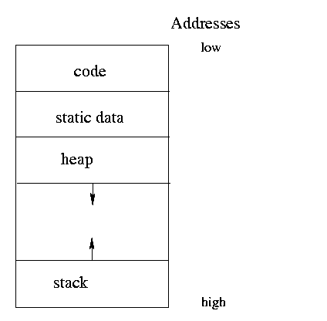
Runtime Memory Organization
Runtime memory is organized to hold the components of an executing program, e.g.:

Slide 7
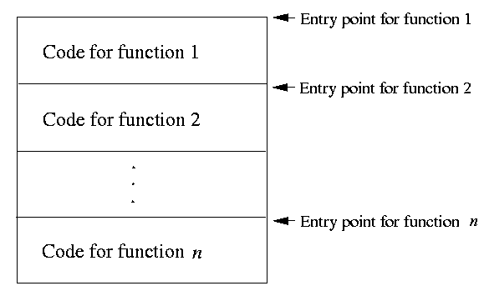
Organization of Code Area
Usually, code is generated a function at a time.
Within a function, the compiler has freedom to organize the code in any way.
Careful code layout can improve cache performance and increase speed.

Slide 8
Activation Records
An activation record contains information needed to manage a single activation of a procedure, e.g.:
saved machine state (PC, registers, return address);
actual parameter values;
local and temporary variables.
The contents of an activation record may be spread across the stack frame and registers.

Slide 9
Activation Records: Layout
Some aspects of activation record layout, e.g., location of actual parameters and some machine state info, are specified by the calling convention.
The compiler decides the layout for local variables and temporaries:
the amount of storage needed for an object is determined by its type;
storage layout must conform to any alignment restrictions of the underlying architecture.

Slide 10
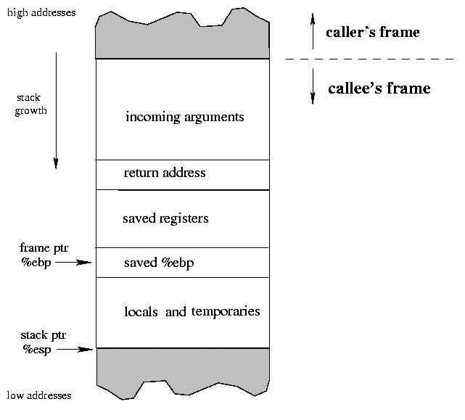
Example: Stack Frame for an x86

Slide 11
Activation Records: Allocation Strategies
Static Allocation (Fortran 77):
all storage allocated by the compiler;
no recursion, dynamic memory allocation;
Stack Allocation (C, C++, Java):
activation records organized as a stack;
cannot be used if values of locals must be retained when an activation ends, or if a called invocation outlives the caller.
Heap Allocation (Lisp, Scheme):
activation records allocated, deallocated in any order;
some form of garbage collection or compaction needed to reclaim space.

Slide 12
Procedure Calls and Returns
Calling sequence: handles a call to a procedure:
loads actual parameters where callee can find them;
saves machine state (return address, …);
branches to callee;
allocates an activation record.
Return sequence: handles the return from a procedure call:
loads the return value where the caller can find it;
deallocates the activation record;
restores machine state (saved registers, PC, etc.);
branches back to caller.

Slide 13
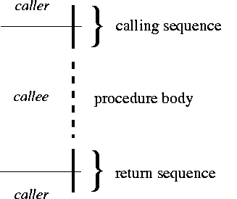
Procedure Calls and Returns: cont’d
Structure of code executed for a procedure call:

Slide 14
Calling Conventions
A calling convention for an architecture and/or language specifies how values are communicated between procedures:
register usage (caller vs. callee saved registers, …);
argument and return value placement.
E.g.: on the x86 [C calling convention]: an integer return value is placed in register eax.
We can have multiple calling conventions, e.g.: __cdecl, __stdcall, __fastcall in MS Windows.

Slide 15
Caller vs. Callee Saved Registers
A calling convention typically divides registers into two classes:
caller-saved: registers whose values will be overwritten by a function call;
E.g.: On the x86 [C calling convention]: ebx, ecx, edx are caller-saved.
callee-saved: registers whose values will survive across a function call.
E.g.: On the x86 [C calling convention]: edi, esi, esp, ebp are callee-saved.
A function using a callee-saved register must save it on entry and restore it on exit.

Slide 16
Nested Functions
Some languages allow function definitions to be nested.
E.g.: GNU C allows definitions of the form
int foo(int x, int y)
{
int bar(int x) { return x*y; }
return bar(x) + bar(y);
}
Nested functions are typically able to access variables in enclosing scopes.
E.g.: the variable y above.

Slide 17
Accessing Non-Local Variables
Problem: In general, we may not know how far deep in the stack a variable in an enclosing scope may be.
E.g:
int p(int m)
{
int x; /* x is local to p, hence in p’s activation record */
int q(int n)
{
if (n > 0) return 2*q(n-1);
else return x+1;
}
printf(“%d\n”, q(m+2));
}

Slide 18
Accessing Non-Local Variables
Basic Idea: pass an access link at each call.
A procedure p’s access link is a pointer to the (most recent) activation record of the procedure q that encloses p’s definition.
The code to set up access links can be generated at compile time.
Using access links, at runtime the program can “walk up” the static nesting structure to access non-local variables.

Slide 19
Accessing Non-Local Variables
The nesting depth of a procedure:
The outermost scope (globals) has nesting depth 0.
Nesting depth increases by 1 when we enter a new scope, and decreases by 1 when we leave the scope.
Nesting depths are known at compile time.
Suppose a procedure p at nesting depth n_{p} refers to a variable x at nesting depth n_{x} (n_{x} ≤ n_{p}).
The code generated is as follows:
follow access links n_{p} – n_{x} times; (both n_{p}, n_{x} known at compile time);
access x within the stack frame reached. (x’s offset known at compile time).

