Slide 1
CSc 453 Lexical Analysis (Scanning)
Saumya Debray
The University of Arizona
Tucson

Slide 2
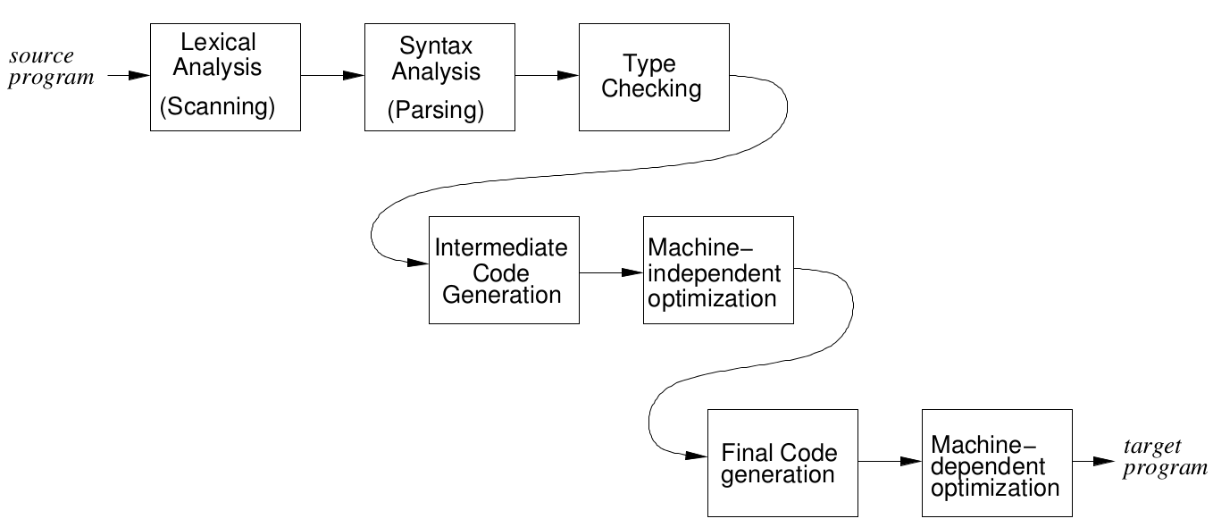
Overview

Slide 3
Overview
tokens
source
program
lexical analyzer
(scanner)
syntax analyzer
(parser)
symbol table
manager
Main task: to read input characters and group them into “tokens.”
Secondary tasks:
Skip comments and whitespace;
Correlate error messages with source program (e.g., line number of error).

Slide 4
Overview (cont’d)
Token
sequence
Input file
keywd_int
identifier: “main”
left_paren
keywod_int
identifier: “argc”
comma
keywd_char
star
star
identifier: “argv”
right_paren
left_brace
keywd_int
…
/ | * | p | g | m | . | c | * | / | \n | i | n
t |  | m | a | i | n | ( | i | n | t |  | a
r | g | c | , | c | h | a | r | * | * | a | r
g | v | ) | { | \n | \t | i | n | t |  | x | ,
Y | ; | \n | \t | f | l | o | a | t |  | w | ;
lexical
analyzer
. . .

Slide 5
Implementing Lexical Analyzers
Different approaches:
Using a scanner generator, e.g., lex or flex. This automatically generates a lexical analyzer from a high-level description of the tokens.
(easiest to implement; least efficient)
Programming it in a language such as C, using the I/O facilities of the language.
(intermediate in ease, efficiency)
Writing it in assembly language and explicitly managing the input.
(hardest to implement, but most efficient)

Slide 6
Lexical Analysis: Terminology
token: a name for a set of input strings with related structure.
Example: “identifier,” “integer constant”
pattern: a rule describing the set of strings associated with a token.
Example: “a letter followed by zero or more letters, digits, or underscores.”
lexeme: the actual input string that matches a pattern.
Example: count

Slide 7
Examples
Input: count = 123
Tokens:
identifier : Rule: “letter followed by …”
Lexeme: count
assg_op : Rule: =
Lexeme: =
integer_const : Rule: “digit followed by …”
Lexeme: 123

Slide 8
Attributes for Tokens
If a token can have multiple lexemes, the scanner must indicate the actual lexeme that matched.
This information is given using an attribute associated with the token.
Example: The program statement
count = 123
yields the following token-attribute pairs:
⟨identifier, pointer to the string “count”⟩
⟨assg_op, -⟩
⟨integer_const, the integer value 123⟩
Project Note: In flex-generated scanners, attributes are communicated to the parser using the variable yylval

Slide 9
Lexical analysis in compilers
Language specification
Language implementation
Specifies the tokens in the language:
pattern(s) defining each token
specified using regular expressions
any attributes associated with a token
regular expressions are matched using finite state machines (FSMs)
Compiler writer: maps regular expressions in language spec to FSMs
Compiler: uses FSMs to recognize tokens in the input character stream

Slide 10
Regular expressions
Regular expressions are a pattern notation for describing (certain kinds of) sets of strings over a finite alphabet
Pattern | matches | Strings
ε |  | the empty string ε
a (an input symbol) |  | the symbol a
r | s |  | x : x matches r or x matches s
rs |  | x₁x₂ : x₁ matches r and x₂ matches s
(r)* |  | x₁x₂…x_{n} (n ≥ 0) : each x_{i} matches r

Slide 11
Finite state machines
An abstract computational device that pattern- matches strings against regular expressions.
A finite state machine consists of:
a finite set of states
one initial state
≥ 0 final states
a state transition function T
T(q, a) gives the next state from a state q on input symbol a

Slide 12
Finite state machines: an example
A finite state machine to match C-style comments:
initial state
final state

Slide 13
Pattern matching using FSMs
A FSM M accepts a string x iff, starting from M’s initial state, the state transitions of M on the symbols of x cause M to end in a final state.
A string x matches a regular expression r iff a finite state machine¹ for r accepts x.
¹There may be more than one such machine.

Slide 14
Example: decimal integer constants
Regular expression:
(0|1|2|3|4|5|6|7|8|9) (0|1|2|3|4|5|6|7|8|9)*
Or, using extended notation: [0-9]+
Finite state machine:

Slide 15
Finite Automata and Lexical Analysis
The tokens of a language are specified using regular expressions.
A scanner is a big FSM, essentially the “aggregate” of the FSMs for the individual tokens.
Issues:
What does the scanner automaton look like?
How much should we match? (When do we stop?)
What do we do when a match is found?
Buffer management (for efficiency reasons).

Slide 16
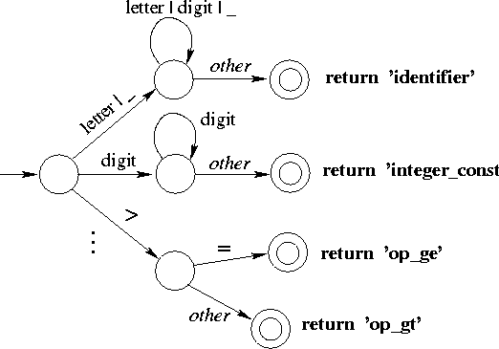
Structure of a Scanner Automaton

Slide 17
How much should we match?
In general, find the longest match possible.
E.g., on input 123.45, match this as
num_const(123.45)
rather than
num_const(123), “.”, num_const(45).

Slide 18
How much should we match?
Need to be careful when specifying tokens under “longest match possible” policy:
Pattern
Input program
COMMENT ″/*″(.|\n)*″*/″
(.|\n)*
float area() { /* area of a circle */
float r, a;
scanf(“%”, &r); /* radius */
a = 3.1416*r*r;
return a;
}

Slide 19
Handling Reserved Words
Hard-wire them directly into the scanner automaton:
harder to modify;
increases the size and complexity of the automaton;
performance benefits unclear (fewer tests, but cache effects due to larger code size).
Fold them into “identifier” case, then look up a keyword table:
simpler, smaller code;
table lookup cost can be mitigated using perfect hashing.

Slide 20
Implementing finite state machines
Table-driven FSMs (e.g., lex, flex):
Use a table to encode transitions:
next_state = T(curr_state, next_char);
Use one bit in state no. to indicate whether it’s a final (or error) state. If so, consult a separate table for what action to take.
T | next input character
Current state

Slide 21
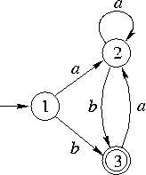
Table-driven FSMs: Example
int scanner()
{ char ch;
int currState = 1;
while (TRUE) {
ch = NextChar( );
if (ch == EOF) return 0; /* fail */
currState = T [currState, ch];
if (IsFinal(currState)) {
return 1; /* success */
}
} /* while */
}
T |  | input
 |  | a | b
state | 1 | 2 | 3
 | 2 | 2 | 3
 | 3^{(final)} | 2 | 1

Slide 22
What do we do on finding a match?
A match is found when:
The current automaton state is a final state; and
No transition is enabled on the next input character.
Actions on finding a match:
if appropriate, copy lexeme (or other token attribute) to where the parser can access it;
save any necessary scanner state so that scanning can subsequently resume at the right place;
return a value indicating the token found.

