Slide 1
Name Privacy in ICN--
Privacy preserving names
Somaya Arianfar
(Based on the work with Teemu Koponen, Barath Raghavan, Scott Shenker)
8.11.2012
CCW, Sedona, AZ

Slide 2
ICN
Promises
  Increased availability
  Increased security (Integrity and provenance)
Tools
  Capable infrastructure
  Named data
    Secure and trusted
    Location-independent
Privacy implication
  A major shift in communication privacy compared to IP stack
    From servers to the infrastructure
    Network related privacy plus data, storage and user level privacy
  Compromising the infrastructure is enough for tracing back the information

Slide 3
ICN Network and Applications
Above the API
  Possible discovery and translation service
    Unique/temporary matching
    Keywords to name
    Keywords to meta data
    …
Name-based API
Below the API
  1-stage lookup and forwarding
  2-stage lookup and forwarding
    Control plane
    Data plane
Notes:
What is passed and what is expected

Slide 4
Default Privacy
User, query, and storage privacy
Dependencies
  Name structure (how much a name reveals)
    Flat names in the network (data-plane)
    Human readable hierarchical names in the network (data-plane)
    …..
  Trust and information management
  Levels of indirection
  …

Slide 5
Example Scenario
Flat names in the network (data plane)
Permanent unique matching and lookup
  User-level names and API-level names
Above the API
  Keywords to meta data translation
Name-based API
Below the API
  1-stage lookup

Slide 6
Lookup implications
Network operator
  Knows exactly what is being requested
    Everything that a name or its matching content reveals
Subscriber
  Has no control on which part of the infrastructure serves its request
Privacy issues
  Easy activity monitoring
    On information items
      Censorship
    On subscribers
      Imprisoning

Slide 7
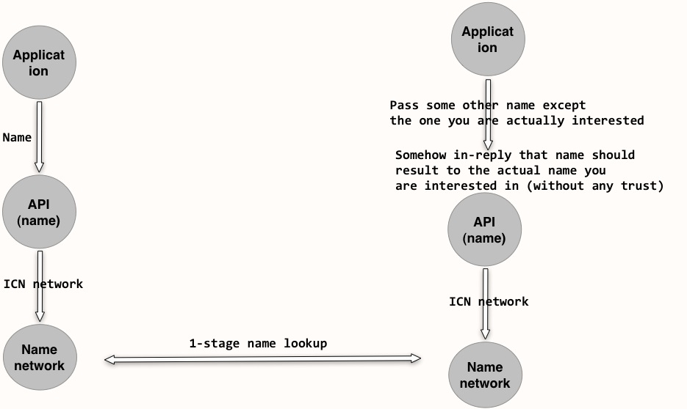
Privacy Requirements
Location aware overlays(?!)
Notes:
Logically you should be able to go through the application layer and hide the original name you are requesting, but at the end for the resolution to happen, someone should lookup a plain name for you, and be able to either hand it to you or tell you how to get it. But then the application should somehow be able to say which part of the network it trusts to send the plain text request, because otherwise if the request is still in the controlling parties hand, then they can just do whatever they wanted to do with it at first place

Slide 8
Assumptions
Entities
  Flagged data items
  Publisher
  User
No secrets, no key-distribution, no infrastructure support
Neutral storage
Willing publishers
Limited protection for individuals
No specialized server/storage/application requirement
  E.g. as in PIR, ToR(??!!)
Notes:
User, storage, and query
User privacy
Censorship resistance
Plausible deniability

Slide 9
Possible solution – privacy preserving names
No permanent unique matching
  Transient identifier
  Different identifiers resulting to same object
Preserving Privacy based on computational asymmetry
Create API level names on the fly
  Without affecting service/data discovery
Add salt values to names
  Relationship between name and content less predictable
Require publisher to contribute
  Generate combinatory contents: difficult to reverse guess

Slide 10
Possible Name Generation
Meta data retrieval
  Target file and cover files chunk names
Exclusive-or of cover and target chunks are published
  New names are generated for each published chunk
  n (t, i) = H(H(t),i)
  Generated tuple (t₂,c₇) ‘s name
    H(n(t,2),n(c,7)) = H(H(H(t),2),H(H(c),7))
    difficult to decompose

Slide 11
Thanks!

