Slide 1
Fighting Fire With Fire: Crowdsourcing Security Solutions on the Social Web
Christo Wilson
Northeastern University
cbw@ccs.neu.edu

Slide 2
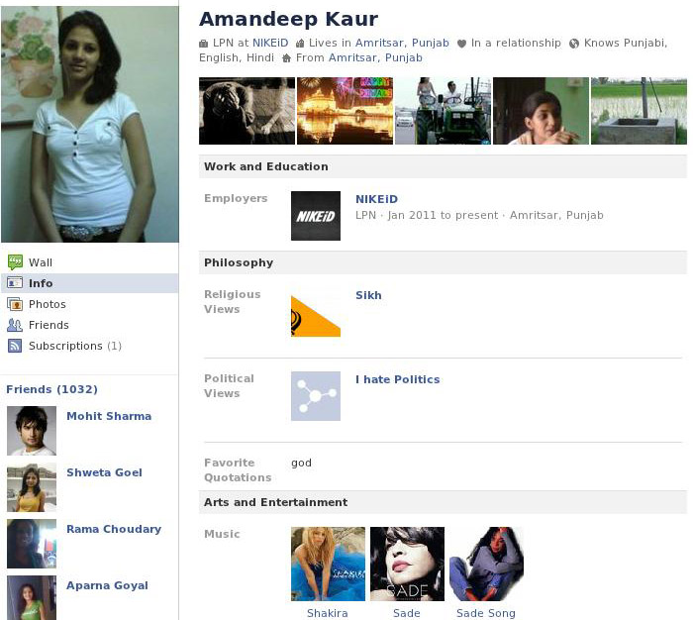

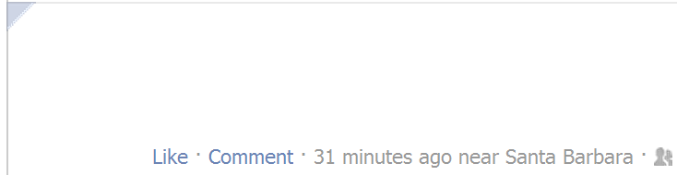
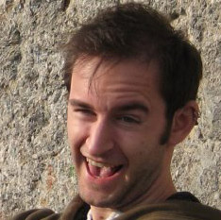
High Quality Sybils and Spam
FAKE
We tend to think of spam as “low quality”
What about high quality spam and Sybils?
Stock Photographs
Christo Wilson
MaxGentleman is the bestest male enhancement system avalable. http://cid-ce6ec5.space.live.com/

Slide 3
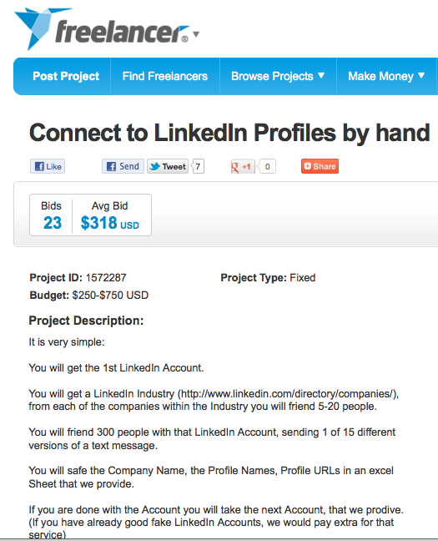
Notes:
Change circles to rectangles, don’t block the text

Slide 4
Black Market Crowdsourcing
Large and profitable
Growing exponentially in size and revenue in China
$1 million per month on just one site
Cost effective: $0.21 per click
Starting to grow in US and other countries
Mechanical Turk, Freelancer
Twitter Follower Markets
Huge problem for existing security systems
Little to no automation to detect
Turing tests fail

Slide 5
Crowdsourcing Sybil Defense
Defenders are losing the battle against OSN Sybils
Idea: build a crowdsourced Sybil detector
Leverage human intelligence
Scalable
Open Questions
How accurate are users?
What factors affect detection accuracy?
Is crowdsourced Sybil detection cost effective?

Slide 6
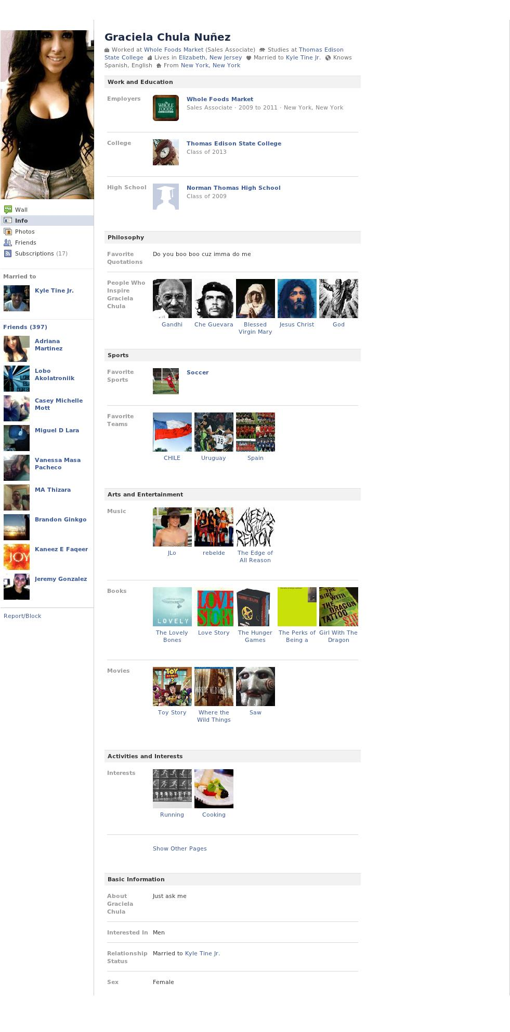
User Study
Also used by spammers
Two groups of users
Experts – CS professors, masters, and PhD students
Turkers – crowdworkers from Mechanical Turk and Zhubajie
Three ground-truth datasets of full user profiles
Renren – given to us by Renren Inc.
Facebook US and India
Crawled
Legitimate profiles – 2-hops from our profiles
Suspicious profiles – stock profile images
Banned suspicious profiles = Sybils
Stock Picture
Notes:
Pop up a box saying where the chinese turkers came from

Slide 7
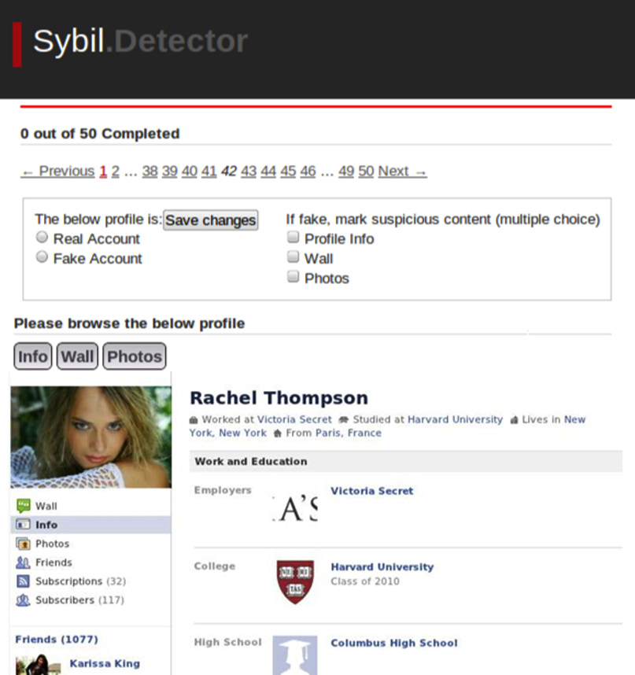
Testers may skip around and revisit profiles
Real or fake?
Why?
Progress
Classifying
Profiles
Navigation Buttons
Browsing
Profiles
Screenshot of Profile
(Links Cannot be Clicked)

Slide 8
Experiment Overview
Fewer Experts
Data from Renren
Dataset | # of Profiles |  | Test Group | # of Testers | Profile per Tester
 | Sybil | Legit.
Renren | 100 | 100 | Chinese Expert | 24 | 100
 |  |  | Chinese Turker | 418 | 10
Facebook US | 32 | 50 | US Expert | 40 | 50
 |  |  | US Turker | 299 | 12
Facebook India | 50 | 49 | India Expert | 20 | 100
 |  |  | India Turker | 342 | 12
Crawled Data
More Profiles for Experts
Notes:
Get rid of the suspicious column

Slide 9
Individual Tester Accuracy
Not so good :(
Experts prove that humans can be accurate
Turkers need extra help…
Awesome!
80% of experts have >90% accuracy!

Slide 10
Accuracy of the Crowd
Treat each classification by each tester as a vote
Majority makes final decision
Almost Zero False Positives
Experts Perform Okay
Dataset | Test Group | False Positives | False Negatives
Renren | Chinese Expert | 0% | 3%
 | Chinese Turker | 0% | 63%
Facebook US | US Expert | 0% | 10%
 | US Turker | 2% | 19%
Facebook India | India Expert | 0% | 16%
 | India Turker | 0% | 50%
Turkers Miss Lots of Sybils
False positive rates are excellent
Turkers need extra help against false negatives
What can be done to improve accuracy?

Slide 11
How Many Classifications Do You Need?
Only need a 4-5 classifications to converge
Few classifications = less cost
False Negatives
China
India
False Positives
US
Notes:
Put a circle on the sweet spot, 4 or five votes, add a conclusion about cost effectiveness

Slide 12
Eliminating Inaccurate Turkers
Most workers are >40% accurate
Dramatic Improvement
From 60% to 10% False Negatives
Only a subset of workers are removed (<50%)
Getting rid of inaccurate turkers is a no-brainer

Slide 13
How to turn our results into a system?
Scalability
OSNs with millions of users
Performance
Improve turker accuracy
Reduce costs
Privacy
Preserve user privacy when giving data to turkers
Notes:
Put bullet one as the title, get rid of original title

Slide 14


System Architecture
Filter Out Inaccurate Turkers
Maximize Usefulness of High Accuracy Turkers
Crowdsourcing Layer
Rejected!
Experts
Very Accurate
Turkers
Turker
Selection
Accurate Turkers
Sybils
Leverage Existing Techniques
Help the System Scale
All Turkers
Continuous Quality Control
Locate Malicious Workers
Heuristics
?
Social Network
User Reports
Suspicious Profiles
Filtering Layer
Notes:
Add rejected workers

Slide 15
Trace Driven Simulations
Simulate 2000 profiles
Error rates drawn from survey data
Vary 4 parameters
Classifications
2
Very Accurate
Turkers
20-50%
Controversial Range
Results
Average 6 classifications per profile
<1% false positives
<1% false negatives
Results++
Average 8 classifications per profile
<0.1% false positives
<0.1% false negatives
Accurate Turkers
90%
Threshold
Classifications
5
Notes:
Change votes to classifications, put in a box about 0.1% false blah improvements,

Slide 16
Estimating Cost
Estimated cost in a real-world social networks: Tuenti
12,000 profiles to verify daily
14 full-time employees
Minimum wage ($8 per hour) → $890 per day
Crowdsourced Sybil Detection
20sec/profile, 8 hour day → 50 turkers
Facebook wage ($1 per hour) → $400 per day
Cost with malicious turkers
Estimate that 25% of turkers are malicious
63 turkers
$1 per hour → $504 per day
Notes:
Adjust the numbers by including some bad workers

Slide 17
Takeaways
Humans can differentiate between real and fake profiles
Crowdsourced Sybil detection is feasible
Designed a crowdsourced Sybil detection system
False positives and negatives <1%
Resistant to infiltration by malicious workers
Sensitive to user privacy
Low cost
Augments existing security systems
Notes:
Crowdsourced detector is part of a larger system, augments existing systems

Slide 18
Questions?

Slide 19
Survey Fatigue
US Experts
US Turkers
No fatigue
All testers speed up over time
Fatigue matters

Slide 20
Sybil Profile Difficulty
Experts perform well on most difficult Sybils
Some Sybils are more stealthy
Experts catch more tough Sybils than turkers
Really difficult profiles
Notes:
Get rid of the first data point

Slide 21
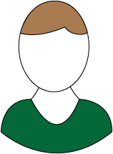
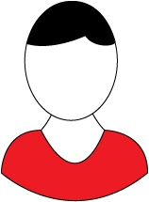
Preserving User Privacy
Showing profiles to crowdworkers raises privacy issues
Solution: reveal profile information in context
!
Crowdsourced Evaluation
Public Profile Information
!
Friend-Only Profile Information
Crowdsourced Evaluation
Friends
Notes:
Get rid of the last

