Slide 1
CSc 335: Three More OO Design Principles
Open Closed Principle
Law of Demeter
Liskov Substitution Principle

Slide 2
Four Design Smells
Rigidity-One change requires many other changes
Fragility-One change breaks other parts
Immobility-Can't pull out a piece to reuse
Needless Repetition-Repeated code is evil, to change the logic, change must happen in many places

Slide 3
Open Closed Principle
"All systems change during their life-cycles. This must be born in mind when developing systems expected to last longer than the first version", Ivar Jacobsen
Software entities (classes modules, functions, etc) should be open for extension but closed for modification, Bertrand Meyer 1988
Now known as the Open-Closed Principle

Slide 4
Modules that never change?
If a change to one module (class or method) results in a cascade of changes to other modules, you have bad design
When requirements change (and they always do), your design should
allow developers to extend the behavior by adding new code good design rather than changing the behavior of existing code bad design

Slide 5
Open and Closed?
The behavior of a module should be extended--as in adding behavior
An analogy: can add extensions to a house leaving other rooms intact at least relatively
Use an abstract classes and extends or interfaces and implements
The source code of this kind of module can not be changed

Slide 6
One Design
Imagine Client represents any module that depends on some other module named Server

Slide 7
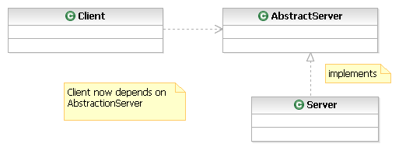
Abstraction
Client depends on an abstraction that does not change. It could be an abstract class or an interface

Slide 8
Example: Strategy Pattern
Previous UML showed the general form
Next slide shows has UML diagram of a specific application of the Strategy pattern
It is also an application of the open closed principle
Which class plays the role of client?
Which class plays the role of AbstractServer?
Why is Strategy OPEN/CLOSED?

Slide 9
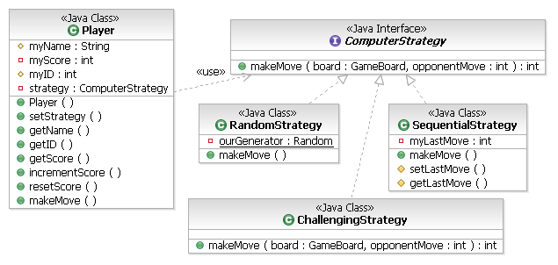
Example: Strategy Pattern

Slide 10
Another Example
Strategy follows the Open-Closed Principle because implementing a new Strategy does not require a change to the Player Class
This class is essentially closed for modification
Because we can pass in an object that implements ComputerStrategy, the class is open for extension
Extending Player (the client) only requires new modules (classes) be written that implement ComputerStrategy
There are no changes to the existing Player

Slide 11
Other Examples
Eclipse
Plugins can be added to with no changes to Eclipse
Plugins "extends" Eclipse
Using List parameters and return types
A module depends on List rather than a concrete class like ArrayList, LinkedList, or Vector
If you change ArrayList, or develop a new List class, you don't change clients that depends on it

Slide 12
Comparator is Open Closed
public class ComparatorTest {
@Test public void testComparators() {
BankAccount a = new BankAccount("A", 5);
BankAccount b = new BankAccount("B", 100);
BankAccount c = new BankAccount("C", 3000);
BankAccount d = new BankAccount("D", 200);
BankAccount e = new BankAccount("E", 50);
List<BankAccount> accounts =
new ArrayList<BankAccount>();
// Add "randomly" so these are not sorted.
accounts.add(e);
accounts.add(c);
accounts.add(d);
accounts.add(a);
accounts.add(b);

Slide 13
Comparator is Open Closed
Comparator<BankAccount> idComparator = new ByID();
Collections.sort(accounts, idComparator);
System.out.println(accounts);
// First element has the alphabetically first ID
assertEquals("A", accounts.get(0).getID());
Comparator<BankAccount> balanceComparator
= new ByBalance();
Collections.sort(accounts, balanceComparator);
System.out.println(accounts);
// First element has the most money
assertEquals("C", accounts.get(0).getID());
}
}

Slide 14
The Two Comparators
import java.util.Comparator;
public class ByID implements Comparator {
public int compare(Object arg0, Object arg1) {
BankAccount left = (BankAccount) arg0;
BankAccount right = (BankAccount) arg1;
return left.getID().compareTo(right.getID());
}
}
public class ByBalance implements Comparator {
public int compare(Object arg0, Object arg1) {
BankAccount left = (BankAccount) arg0;
BankAccount right = (BankAccount) arg1;
return (int) ((100 * right.getBalance()) - 100 * left.getBalance());
}
}

Slide 15
Law of Demeter
A style rule for designing object-oriented systems
"Only talk to your immediate friends"
Name of the Greek Goddess of Agriculture
In other words, grow software in small steps
Each module should have only limited knowledge about other modules
Those "closely" related to the current unit
Each module only talks to friends
“Don't talk to strangers”

Slide 16
Law of Demeter
This is low coupling in software engineering made more explicit
Try to avoid knowing about the structure of indirect objects
Use the direct object that you need to know about and let that object talk to indirect objects

Slide 17
Who are closely related friends?
From a method, messages can be sent to
this object
a parameter of the method
an instance variable of this object
an object created within the method

Slide 18
FRIENDS

Slide 19
An Example
Widely used in big projects, for example, at the Jet Propulsion Laboratory (JPL) for the Mars exploration software, the quote
The Law of Demeter … has taken a firm hold in many areas of JPL. Major systems which have used LoD extensively include … Mars Pathfinder Software. We are going to use LoD as a foundational software engineering principle for the X2000 Europa orbiter mission.

Slide 20
Grady Booch says
The basic effect of applying this Law is the creation of loosely coupled classes
Encapsulate implementation secrets
Such classes are fairly unencumbered
To understand the meaning of one class, you need not understand the details of many other classes

Slide 21
Abstract example
class A {
private B b = new B();
public void m() {
this.b.c.foo(); // High coupling: bad
}
}
class B {
C c;
}
class C {
public void foo() {
}
}

Slide 22
Silly example you already coded?
Which code represents the better design?
// a.
dog.body.tail.wag();
// b.
dog.expressHappiness();
The bad example couples dog to two indirect classes DogBody, and DogTail
The good design couples dog only to the direct class DogAnimal

Slide 23
Liskov Substitution Principle
The Liskov Substitution Principle of object oriented design states
In class hierarchies, it should be possible to treat a specialized object as if it were a base class object
Code with a reference to a base class should be able to use objects of the derived class without knowing it

Slide 24
From the source in 1988
Barbara Liskov first wrote this:
“What is wanted is something like the following substitution property: If for each object o1 of type S there is an object o2 of type T such that for all programs P defined in terms of T, the behavior of P is unchanged when o1 is substituted for o2, then S is a subtype of T.“
Or more simply:
Subtypes must be substitutable for their base types"

Slide 25
Consider this code
public class Rectangle {
protected int _width;
protected int _height;
public int getWidth() {
return _width;
}
public int getHeight() {
return _height;
}
public void setWidth(int width) {
_width = width;
}
public void setHeight(int height) {
_height = height;
}
}

Slide 26
Let Square be a subtype of Rectangle
class Square extends Rectangle {
@Override
public void setWidth(int width) {
_width = width;
_height = width;
}
@Override
public void setHeight(int height) {
_height = height;
_width = _height;
}
}

Slide 27
Compiles, but does it pass?
import static org.junit.Assert.*;
import org.junit.Test;
public class RectangleTest {
@Test public void testArea() {
Rectangle r = new Square();
r.setWidth(5);
r.setHeight(2);
// Does this assertion pass?
assertEquals(10, r.getWidth() * r.getHeight());
}
}

Slide 28
Solution?
If the behavior by Square is unacceptable and unexpected, Square should not be derived from Rectangle

Slide 29
Why follow Liskov?
Liskov basically wants you to think clearly about the expected behavior and expectations of a class before you derive new classes from it
It could turn out that when subtypes are substituted for a parent, you may get unexpected results
Unit tests help avoid this problem

