Slide 1
Chapter 4 Implementing Free Functions
3rd Edition
Computing Fundamentals with C++
Rick Mercer
Franklin, Beedle & Associates

Slide 2
Goals
Implement free functions
Pass values to your functions as input
Return values from your functions as output
Test your new functions
Begin to understand the scope of objects and functions

Slide 3
Implementing Free functions
The general form of a fully defined function
return-type identifier ( parameters )
block
The block groups together a collection of statements between { and }
General form of a block
{ // begin block
statements
} // end block

Slide 4
The return Statement
Many functions are designed to return a single value through the return statement
return expression;
When a return statement is encountered
the function terminates
the function call is replaced with expression

Slide 5
f(x) = 2x²-1 in C++
#include <cmath>
#include <iostream>
using namespace std;
double f(double x) {
double result;
result = 2 * pow(x, 2.0) - 1.0;
return result;
}
int main() {
cout << f(2) << endl; // 7
cout << f(4.0) << endl; // 31
return 0;
}

Slide 6
Another Example
#include <iostream>
using namespace std;
const double MONTHLY_FEE = 5.00;
double serviceCharge(int checks, int ATMs) {
// pre: checks >= 0 and ATMs >= 0
// post: return banking fee based on local rules
double result;
result = (0.25*checks) + (0.10*ATMs) + MONTHLY_FEE;
return result;
}
int main() {
double fee = serviceCharge(10, 7);
cout << fee << endl; // 8.2
return 0;
}

Slide 7
Test Drivers
The preceding main function was meant to show how to call a new function
A test driver is a program with the sole purpose of testing a new function
On the next slide, main is a test driver
It is designed to test a new function with different arguments representing different test cases
The == means equals
If the function call's actual return values matches the expected values, all lines of output should be 1 (true)

Slide 8
A test driver
int main() {
cout << (serviceCharge(0, 0) == 5) << endl; // 1
cout << (serviceCharge(1, 0) == 5.25) << endl; // 1
cout << (serviceCharge(0, 1) == 5.1) << endl; // 1
cout << (serviceCharge(1, 1) == 5.35) << endl; // 1
cout << (serviceCharge(2, 1) == 5.6) << endl; // 1
cout << (serviceCharge(2, 2) == 5.7) << endl; // 1
return 0;
}
Output
1
1
1
1
1
1

Slide 9
Scope of Identifiers
The scope of an identifier is the part of a program from which an identifier can be referenced
An identifier's scope starts at its declaration and ends at the end of the file (global identifiers)
Variables declared inside a function are only known in that function (local identifiers)

Slide 10
Scope of Function Names
The scope of a function name
begins at the point of declaration and continues to the end of the file unless the function name is re-declared
So a function can not be called until after it has been declared
the scope extends into any file that includes that function
Therefore, math.h functions are known after
#include <cmath>

Slide 11
Scope of Identifiers
// Makes cout, cin, endl global; known everywhere
#include <iostream>
using namespace std; // Reduces the need to use std::
// Scope of MAX extends to end of this file
const int MAX = 1000;
// Scope of f goes to end of file (not above here)
double f(double x) {
// Scope of x and temp is limited to function f
double temp;
// MAX can be referenced from f
return x * MAX;
}
int main() {
// Scope of j is limited to main
int j;
cout << endl;
}

Slide 12
Reference parameters
General Form of a reference parameter:
type & identifier
Examples
void swap(double & parm1, double & parm2)
// exchanges the values of two arguments
void moveToExit(Grid & g)
// move the mover until it as an exit
void decimals(ostream & os, int n)
// always show n decimal places for floats

Slide 13
Reference Parameters
The special symbol & is called the reference symbol
When placed before the parameter name, that parameter becomes an alias, another name for, the argument
A change to a reference parameter therefore changes the associated argument
This is called pass by reference, the argument's address, not the value, is copied to the function

Slide 14
void Functions
All functions shown so far have a return type
Sometimes functions do not need to return anything
We use the return type of void
void printDetails(int n, string str) {
cout << . . .
}
Call void functions with no expectation of a return
printDetails(99, "Adams University")

Slide 15
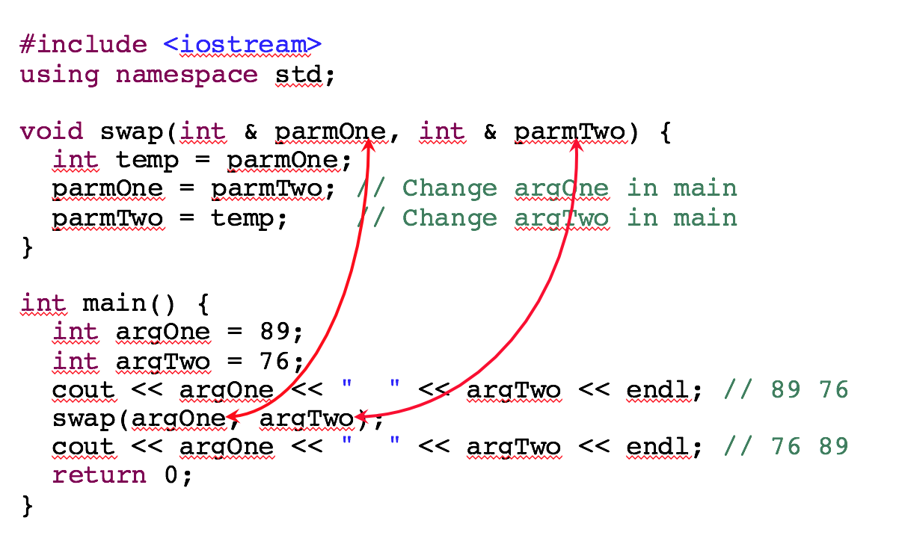
Need & to change two arguments
#include <iostream>
using namespace std;
void swap(int & parmOne, int & parmTwo) {
int temp = parmOne;
parmOne = parmTwo; // Change argOne in main
parmTwo = temp; // Change argTwo in main
}
int main() {
int argOne = 89;
int argTwo = 76;
cout << argOne << " " << argTwo << endl; // 89 76
swap(argOne, argTwo);
cout << argOne << " " << argTwo << endl; // 76 89
return 0;
}

Slide 16
Reference Parameters
swap has two reference parameters
class-name & identifier
The reference parameter parmOne acted as an alias for the argument argOne
The change to parmOne also changed argOne
The argument argOne was passed to the parameter parmOne by reference
parmOne and argOne refer to the same object

Slide 17
What is the Output?
void add2(int & n1) {
n1 = n1 + 2;
}
int main() {
int anInt = 0;
add2(anInt);
add2(anInt);
cout << anInt;
return 0;
}
void add3(int n1) {
n1 = n1 + 3;
}
int main() {
int anInt = 0;
add3(anInt);
add3(anInt);
cout << anInt;
return 0;
}

Slide 18
const Reference Parameters
C++ has four type of parameters
value parameters—for passing the values of small objects such as int
reference parameters—to allow a function to modify the state of one or more arguments
const reference parameters—use & for safety and efficiency use const reference when inputting "large" objects to a function and you also do not want to alter the object
pointer type parameter—allows a pointer to be passed to a function (not covered in this book)

Slide 19
const Reference Parameters
A "big" object is one that consumes a lot of memory
Here are the sizes of some classes
Type Bytes
int 4
double 8
ostream 72
Use const reference parameters when a large object is passed to a function and there should be no changes to that object
Often used when passing collections (Chapter 9)

Slide 20
const Reference Parameters
When an object is passed by value
the function must allocate enough memory to hold a copy of that object the argument
all bytes of the object must be copied to the function
passing "big objects, slows down the program
Solution: pass by reference--only 4 bytes needed
The argument can not be accidentally modified

Slide 21
Summary of Parameters
Value Parameter
int f1(int j)
Grab enough memory to store the entire object and copy the value to the function.
An attempt to change the parameter is not an error--it simply has no effect on the argument.
Reference Parameter
int f2(Vector<int> & b)
Grab about four bytes of memory to store the address of the object and copy that address to the function. Use this when you need to modify the argument. It's efficient too.
const Reference
void f(const Grid & g)
Like pass by reference, except the const means the argument can not be changed. To attempt a change, results in a compiletime error. This is the efficient and safe parameter passing mode.

