Slide 1
Chapter 12 Pointers and Memory Management
3rd Edition
Computing Fundamentals with C++
Rick Mercer
Franklin, Beedle & Associates

Slide 2
Goals
Understand pointers store addresses of other objects
Use primitive C++ arrays with no range checking
Use several methods for initializing pointers
Use the new and delete operators for memory management

Slide 3
Memory Considerations
In addition to name, state, and operations, every object has an address, where the values are stored
Objects also have a lifetime beginning with construction to when they are no longer accessible
With the following initialization, we see that the name charlie, state 99, and operations like = + cout << are known
int charlie = 99; // But where is 99 stored?

Slide 4
Addresses
An object's address is the actual memory location where the first byte of the object is stored
The actual memory location is something we have not needed to know about until now
We can't predict addresses, but ints are four bytes so two integers could have addresses 4 bytes apart
int a = 123;
int b = 456
Address Type Name State
6300 int a 123
6304 int b 456

Slide 5
Static and Dynamic Memory Allocation
Some objects take a fixed amount of memory at compiletime:
char int double
Other objects require varying amounts of memory, which is allocated and deallocated dynamically, that is, at runtime, string for example
We sometimes use pointers to allow for such dynamic objects

Slide 6
Pointers
Pointer store addresses of other objects and are declared with * as follows:
class-name* identifier ;
int anInt = 123; // The int object is initialized
int* intPtr; // intPtr stores an address
anInt stores an integer value
intPtr stores the address of variable
So pointer objects may store the address of other objects

Slide 7
About Pointer Types
Pointer objects store the address of other objects which are the same type as the type of the pointer
An int pointer hold an addresses to a int object
int intP = 25;
int* intPtr = &intP;
A double pointer hold an addresses to a double double doubleD = 25.45;
double* doublePtr = &doubleD;
A Grid pointer hold an addresses to a Grid object
Grid gridG(5, 5, 0, 0, south);
Grid* gridPtr = &gridG;

Slide 8
The State of Pointers
At this point, the value of intPtr may have or become one of these values
Undefined (as intPtr exists above)
The special value nullptr to indicate the pointer points to nothing: intPtr = nullptr;
The address of the int object: intPtr=&anInt;
& means address of

Slide 9
Pointer Values
Currently, we may depict the undefined value of intPtr as follows:
intPtr
The & symbol is called the address-of operator when it precedes an existing object
This assignment returns the address of anInt and stores that address into intPtr:
intPtr = &anInt;
???

Slide 10
Defining Pointer Objects
The affect of this assignment
intPtr = &anInt;
is represented graphically like this:
intPtr anInt
Now intPtr is defined
123

Slide 11
The State of Pointers
We can change the value of anInt indirectly with the dereference operator *
*intPtr = 97; // The same as anInt = 97
Now both objects are defined
intPtr
anInt or *intPtr
97

Slide 12
The dereference Operator
intPtr
anInt
97
The following code displays 97 and 96
cout << (*intPtr) << (*intPtr-1) << endl;
This code changes 97 to 98
*intPtr = *intPtr + 1;

Slide 13
The & operator
The & operator has different meanings depending on how you use it.
When you use & to create a variable, you are creating a reference
When you use & in front of an existing variable the & is called the address-of operator and returns the address of the variable and not the value stored in the variable

Slide 14
The * operator
The * operator also has different meanings depending on how you use it.
When you use * to create a variable, you are creating a pointer
When you use * in front of an existing pointer, you get the value stored at the address the pointer contains and not the address stored in the pointer
The * is also used in math operations when between numeric types

Slide 15
Address-of and Dereference
What is the output generated by this program?
#include <iostream>
using namespace std;
int main() {
int *p1, *p2;
int n1, n2;
p1 = &n1;
*p1 = 5;
n2 = 10;
p2 = &n2;
cout << n1 << " " << *p1 << endl;
cout << n2 << " " << *p2 << endl;
return 0;
}

Slide 16
Pointers to Objects
Pointers can also store the addresses of objects with more than one value
Because function calls have a higher precedence than dereferencing, override the priority scheme by wrapping the pointer dereference in parentheses
BankAccount anAcct("Ashley", 123.45);
BankAccount* bp;
bp = &anAcct;
(*bp).deposit(123.43);
cout << (*bp).getBalance(); // 246.88

Slide 17
Arrow Operator ->
C++ also has an arrow operator to send message to object via its address (location in memory)
BankAccount anAcct("Ashley", 123.45);
BankAccount* bp;
bp = &anAcct;
bp->deposit(123.43);
cout << bp->getBalance(); // 246.88

Slide 18
The Primitive C Array
C++ has primitive arrays
string myFriends[20]; // store up to 20 strings
double x[100]; // store up to 100 numbers
There is no range checking with these

Slide 19
Compare C arrays to vector
Difference | vector Example | C Array Example
vectors can initialize all vector elements at construction; arrays cannot. | vector <int> x(100, 0); All elements are 0 | int x[100]; All garbage
vectors can be easily resized at runtime; arrays take a lot more work. | int n; cin >> n; x.resize(n); | Can "grow" an array with more code
vectors can be made to prevent out-of-range subscripts. | You are told something is wrong cin >> x.at(100); | Destroys other memory cin >> x[100];
vectors require an #include primitive, built-in arrays do not. | #include <vector> | No #include required

Slide 20
The Array/Pointer Connection
A primitive array is actually a pointer
The array name is actually the memory location of the very first array element
Individual array elements are referenced like this
address of 1st array element + ( subscript * size of 1 element)
Arrays are automatically passed by reference when the parameter has []
void init(int x[], int & n)
// Both x and n are reference parameters

Slide 21
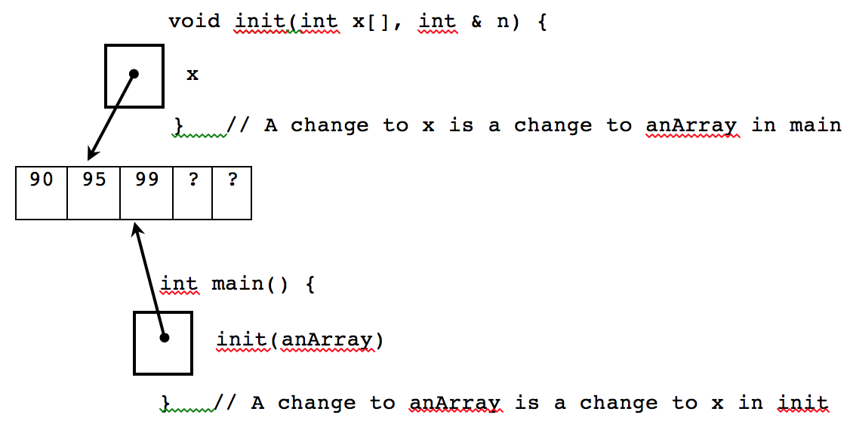
Array parameters are reference parameters
When passing arrays as parameters, you don't need &
x and anArray reference the same array object

Slide 22
Allocating Memory with New
Pointers can also be set with the C++ new operator
This code allocates a contiguous block of memory to store the state.
It also returns the address, or a pointer to the object
int* intPtr = new int;
*intPtr = 123;
cout << *intPtr; // 123
This code allocates a new array
int* nums = new int[10];
nums
? | ? | ? | ? | ? | ? | ? | ? | ? | ?
[0] | [1] | [2] | [3] | [4] | [5] | [6] | [7] | [8] | [9]

Slide 23
The delete Operator
new allocates memory at runtime
delete deallocates that memory to avoid memory leaks so it can be used by other new objects
General form for recycling memory
delete pointer;
delete[] pointer-to-array;
For the programs you write, you won't notice any difference by forgetting to delete
In a future course with destructors, or in an internship or job, you probably will

